Slide 1
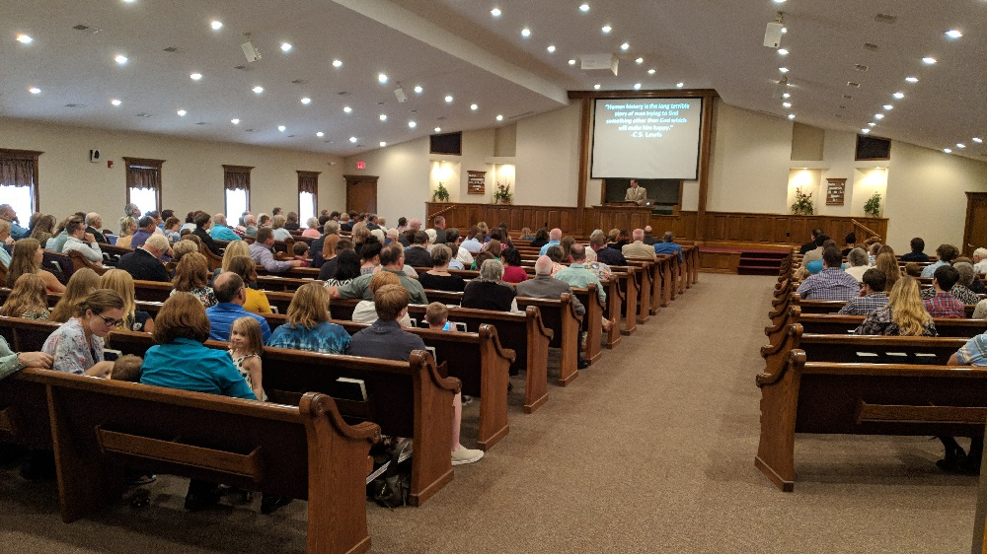
Lesson for Sunday, March 29, 2020 “Christian Living in a Distressing Time”
Since this lesson is presented for the Southport congregation in absentia (while we’re not present actually), I thought this “group” picture might help us to at least feel like we’re together physically while we gather virtually to study from God’s Word.
Slide #1

Slide 2
“Christian Living in a Distressing Time” 1Peter 1:13-25
Introduction/Background to our primary text, 1Pet.1:1-12
This epistle (letter) is written to those “who are chosen,” v.1; thus, Christians
But these Christians were residing “as aliens, scattered...” v.1; and more to the point of our lesson, they were, “now for a little while, if necessary,” being “distressed by various trials,” v.6b
During this temporary but distressing time, they were to “greatly rejoice,” v.6a
Such sure seems apropos for “us” currently!
But it also begs the question, “How could they (and can we) “greatly rejoice” under such circumstances?”
Slide #2
Notes:
“necessary” in v.6 is translated from the Greek word die, which here refers to a “necessity brought on by circumstances

Slide 3
“Christian Living in a Distressing Time” 1Peter 1:13-25
Introduction/Background to our primary text, 1Pet.1:1-12
Vv.1-9 provide the answers; note that God has:
Chosen us according to His foreknowledge by the sanctifying work of the Spirit that we may obey Jesus Christ and be sprinkled with His blood (purified), vv.1-2
Caused us to be born again (thus becoming His children) to a living hope through the resurrection of Jesus, v.3
For the purpose of obtaining an imperishable inheritance that is reserved for us in heaven, v.4
And as His children, we are protected by the power of God through faith for eternal salvation, vv.5,9
So that, even in temporary distress, we are able to rejoice!
Slide #3

Slide 4
“Christian Living in a Distressing Time” 1Peter 1:13-25
Introduction/Background to our primary text, 1Pet.1:1-12
Now that we understand the what/how/why that God has done, we’re ready to begin understanding what we must do in order to “rejoice” during this temporary but distressing time of trials (and inherit eternal salvation).
Vv.13-25 contain SEVEN essential imperatives
An imperative is part of speech; it is a command or directive; in other words, do this or don’t do that
For the remainder of our lesson, we’ll briefly identify and explain these seven imperatives (our part) that, when combined with what God has done and will do, enable us to “rejoice” in these distressing times.
Slide #4

Slide 5
“Christian Living in a Distressing Time” 1Peter 1:13-25
Note the imperatives from our primary text of vv.13-25:
Gird your minds for action, v.13a
Gird literally means to bind up long flowing garments close to the body and fasten them tightly, cf. Phil.4:4-9
So, during these distressing times, we must bind up our minds and keep them securely fastened; don’t let them run wild; don’t panic, prepare your mind for action!
Keep sober in spirit, v.13b
Here, sober means to be calm and collected in spirit (yours, not the H.S.; spirit refers to our inner being)
As #1 directed our minds, now our spirits are also to be kept calm and collected, cf. Prov.4:23
Slide #5

Slide 6
“Christian Living in a Distressing Time” 1Peter 1:13-25
Note the imperatives from our primary text of vv.13-25:
Fix your hope completely, v.13c
This complete (total) fixation (to set or rest) of hope (desire plus expectation of attainment) is to be on the grace (undeserved favor) that will be brought at the revelation of Jesus Christ (supplied by Him, but then not now), cf. Titus 2:11-14; Heb.3:6; 6:11,18,19
Do not be conformed to the former lusts, v.14
We have been born again to a living hope, so don’t revert to that from which we have been freed and purified, vv.2-3; cf. Heb.10:39
Rom.6:1-7 makes the same point
Slide #6

Slide 7
“Christian Living in a Distressing Time” 1Peter 1:13-25
Note the imperatives from our primary text of vv.13-25:
But be holy in all your behavior, vv.15-16
Because God (our Father) is holy, vv.3,15a
Therefore, as children of our Father, be obedient by being like Him in all your behavior, vv.14a,15b,16
Conduct yourselves in fear, v.17b
if God (who judges impartially according to each man’s work) is your Father, v.17a
during the time of your stay on earth (duration), v.17c
knowing the price of your redemption (cost), vv.18-19
and on Whom your hope and faith rest, vv.20-21
Slide #7

Slide 8
“Christian Living in a Distressing Time” 1Peter 1:13-25
Note the imperatives from our primary text of vv.13-25:
Fervently love one another, v.22c
from the heart, v.22d; cf.1Tim.1:5
Since you have purified your hearts for that purpose, v.22b
by obeying the truth, v.22a,23-25
Conclusion / Application Points:
We are currently being distressed by various trials, but they are temporary! And since our inheritance is eternal,
Rejoice by remembering what God has already done for us,
But also understanding and doing our part- the seven imperatives of 1Pet.1:13-25!
Slide #8

Slide 9
“Christian Living in a Distressing Time” 1Peter 1:13-25
Here are the imperatives from 1Pet.1:13-25 again:
Gird your minds for action, v.13a
Keep sober in spirit, v.13b
Fix your hope completely on the grace of Jesus Christ, v.13c
Do not be conformed to former lusts, v.14
But be holy yourselves in all your behavior, vv.15-16
Conduct yourself in fear, vv.17-21; and
Fervently love one another, vv.22-25
May we all greatly rejoice in these distressing but temporary trials that are helping to prepare us for the glorious inheritance of eternal salvation through the grace of Jesus Christ!
Slide #9

