Slide 2
Is Your Life…
Hectic to say the least? (nine million things to do each day, and even more tomorrow, next week, next month, next year)
Consistently Chaotic? (perpetual exercise in crisis management, merely prioritized catastrophes)
Filled with Stress? (knotted or tied up, stressed out, anxiety-laden, overflowing with worries and concerns)
Demanding of Perpetual Motion? (not enough hours in the day, too many days in the work week, not enough in the weekend, and too much water going under the bridge)
Filled with Conflict? (inner turmoil, outer quarrels, barraged with consuming challenges and impossible deadlines)
Constant Communication and Overflowing Information? (calls, texts, emails, instructions, questions, requirements)

Slide 3
Does it Leave You…
Constantly Confused? (ever-searching and striving but never really feeling like you know what you’re doing)
Perpetually Perplexed? (overflowing with information and yet drowning in doubt)
Decidedly Undecided? (the only thing you’re sure of is how uncertain you are)
Dizzy, Disoriented, and Lost? (head-spinning with choices to be made but no real sense of direction, aim, or purpose)
Filled with Fear? (of making a decision, and constantly second, third, and fourth-guessing every one that is made)
Question-Filled and Answer-Empty? (like you’re stumbling forward, or perhaps even in circles, in foggy darkness)

Slide 4
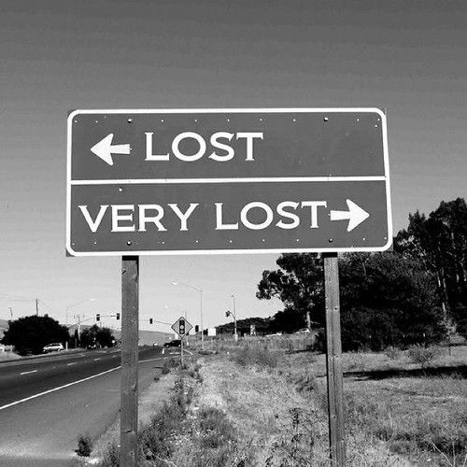
So that You Feel…
Powerless? (not only unable to know what to do, but impotent to do anything to change your situation even if you did)
Out of Control? (like you’re forced to sit in the driver’s seat, but without a steering wheel, brakes, or accelerator)
Unloved? (that no one even really cares about how desperately out of control and unhappy you are)
Orphaned and Alone? (that you seem to be the only one who doesn’t “get it,” or that there is no one to help you)
Unstable? (stuck without a firm place to stand, let alone a good “toe hole” from which to move forward)
Vulnerable? (cold, wet, hungry, alone, afraid, and completely lost)

Slide 5
God has an answer for you in Psalm 46.
Especially in v.10, “Cease striving” (NASB), or “Be still” (KJV)
Literally, raphah means to sink; thus to let drop, abandon, forsake, abandon; to relax; God says just “stop” and “be still.”
So stop and be still… (yes you can, make it happen!)
Stop talking and listen (to God- via His word)
Mute your phone / turn off you computer
Stop “scrolling” and turn to the Scroll
Stop commenting on everything and arguing about anything
Stop questioning and complaining
Cease striving and just be still, cf. 2Thess.4:11.

Slide 6
God has an answer for you in Psalm 46.
Especially in v.10, “and know”
Not only come to understand, but also be fully convinced, and constantly reminded.
So know…
Learn what God says (again, in His Word)
Then, stop doubting, questioning, and second-guessing what He says and “know” (it, and it to be true), John 3:33; Rom.3:4
Be both assured and convinced, Heb.11:1
Once you know (God and His will), no second opinions needed
Knowledge is not only power, but freedom, John 8:31-32

Slide 7
God has an answer for you in Psalm 46.
Especially in v.10, “that I am God”
Not you, and not anyone else; HIM!
The…
Almighty who empowers the powerless
One in Control for all things, including the out of control
God of Love who loves all- even the otherwise unlovable
Father to the orphaned and alone
Rock, Fortress, and Foundation for the floundering, helpless, and sinking
Shepherd who protects, feeds, and guides
The God of Psalm 46!

