Slide 2
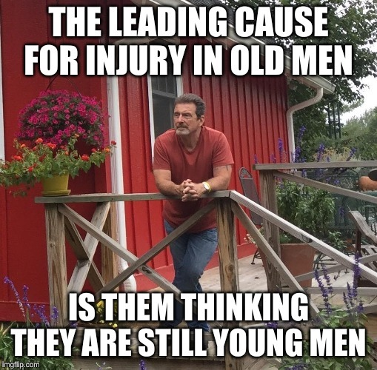
Perhaps you’ve seen this before…
…

Slide 4
The real problem is
“Distorted Self-Image”
… and it certainly isn’t limited to “old men”!
Jas.1:22-25

Slide 5
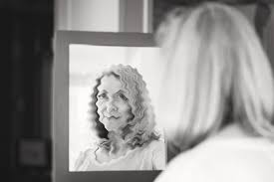
While there are many forms of distorted self-image (Body Dysphoria, Body Dysmorphic Disorder, etc.), we’re going to focus on 3 spiritual ones:
Seeing Too Little in Yourself.
Failing to see the worth/value God sees in you, Rom.5:6-11 (cf. Matt.10:28-33)
Failing to see the potential God sees in you, Rom.5:1-5
Consider Paul, as an example, 1Tim.1:15-16

Slide 6
While there are many forms of distorted self-image (Body Dysphoria, Body Dysmorphic Disorder, etc.), we’re going to focus on 3 spiritual ones:
Seeing Too Much in Yourself.
No one is spiritually “bullet-proof,” 1Cor.10:12; Rom.11:20; 2Pet.3:17-18
Satan is “like a roaring roaring lion,” 1Pet.5:8
But that doesn’t mean he can’t be resisted, 1Pet.5:9
Peter is an example, Luke 22:33-34,31-32

Slide 7
While there are many forms of distorted self-image (Body Dysphoria, Body Dysmorphic Disorder, etc.), we’re going to focus on 3 spiritual ones:
Seeing Too Much of Yourself.
Those who “see” too much of themselves, see little else.
Everything becomes about “me.”
Obviously, this is not the way,Rom.15:1-7.
The Pharisee of Luke 18:9-13 is an example.

Slide 8
As we’ve said, there are many forms of distorted self-images, and we’ve focused on 3 dangerous spiritual ones:
Seeing Too Little in Yourself denies the worth/value and potential God sees in you.
Seeing Too Much in Yourself denies your vulnerability and the need we all have to lean on and trust in God and His power rather than our own.
Seeing Too Much of Yourself makes it difficult to “see,” let alone “serve,” others.
So, look closely, see clearly, remember well (what you see), and make the changes God’s perfect mirror of the soul requires, Jas.1:25!

