Slide 2
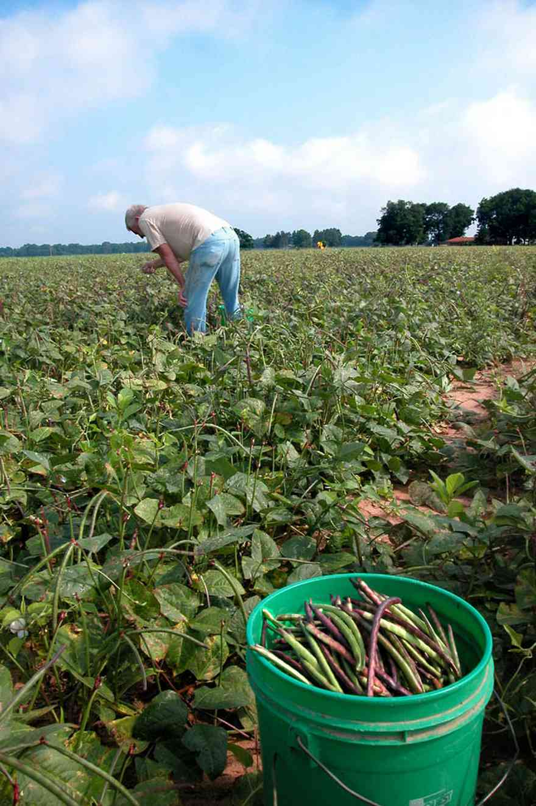
God’s Field
“For we are God’s fellow-workers; you are God’s field…” 1Cor.3:9
Jesus and NT writers often used agricultural illustrations to teach lessons of duty and reward:
The Sower, Matt.13:3ff
The Vine & Branches, Jn.15:1-8
Hard-Working & Patient Farmer, 2Tim.2:6; Jas.5:7
The agrarian-based society of the time provided fertile fields for planting the seed through these kinds of analogies.
But perhaps we need to more closely consider some of the specific “jobs” included in this kind of work, and what they should mean to us…

Slide 3
God’s Field (His “P” Patch)
“For we are God’s fellow-workers; you are God’s field…” 1Cor.3:9
Planters:
The seed is “the word of God,” Luke 8:11
When planted in good soil, it germinates and breaks through as a new plant.
Then, with water and sunlight and freedom from disease, it grows, matures, blooms and bears fruit.
Foliage and flowers may be pretty, but the fruit contains more seed!
If we become soil testers (Mt.13:8) instead of seed-producers and seed-sowers, or if we content ourselves to just eating the fruit and its seed ourselves, there won’t be a harvest, John 15:8.
Are you a Planter?

Slide 4
God’s Field (His “P” Patch)
“For we are God’s fellow-workers; you are God’s field…” 1Cor.3:9
Precipitants:
For seed to germinate and grow into a mature plant, someone has to water it.
Apollos watered what Paul planted, 1Cor.3:6.
It wasn’t water for baptism, Acts 18:1-11, but for continued nutrition to growth, 2Pet.3:18; 1:5-11.
Barnabas was evidently a great precipitant/waterer, Acts 4:36!
More mature precipitants can be great assets through teaching and encouragement, Eph.4:11-16.
Are you a Precipitant?

Slide 5
God’s Field (His “P” Patch)
“For we are God’s fellow-workers; you are God’s field…” 1Cor.3:9
Pruners: (John 15:1-8)
Pruning doesn’t mean to throw dried plums.
It does mean to cut off or cut back parts for better shaping, strength, and productivity.
This occurs when we are taught, reproved, corrected, and trained with/by the word, 2Tim.3:16; (cf. Matt.18:15-27; Gal.2:11ff; 1Cor.5).
The pruning instrument is the word of God (Heb.4:12), but usually requires a proficient pruner to yield its greatest effect.
Are you willing to be a Pruner?

Slide 6
God’s Field (His “P” Patch)
“For we are God’s fellow-workers; you are God’s field…” 1Cor.3:9
Pickers: (John 4:35)
It’s mixing metaphors, but there is always an immediate need for reapers/pickers.
Planting, precipitating, and pruning are all necessary and important, but without the pickers there is no harvest, John 4:36-38!
And without the harvest of fruit-bearing seeds, the reproductive cycle is broken and can become barren.
There is nothing more precious than a soul, Matt.16:26. And there is nothing more tragic than unharvested souls rotting due to a lack of pickers/harvesters.
Are you willing to be a Picker?

Slide 7
God’s Field (His “P” Patch)
“For we are God’s fellow-workers; you are God’s field…” 1Cor.3:9
But what God’s “P” Patch DOESN’T need is Performers:
Planters, precipitators, pruners, and pickers use the Word of God as seed, water/nutrients, shears, and a reaping tool for the production and harvesting of souls. But…
Performers use the Word, to the degree they use it at all, for a tool of self-promotion, cp. 2Cor.5:9 with Phil.1:17; Jas.3:13-18.
And yet performing is ALL that some want to do- to sing, dance, act, or preach to glorify self instead of God.
The vineyard/field of the Lord doesn’t need performers- if it did, the NT would be filled with instructions for solos, dance routines, and plays or dramatic presentations. But it isn’t.
Are you willing to be a Planter, Precipitant, Pruner, and a Picker instead of just a Performer?

