Slide 1
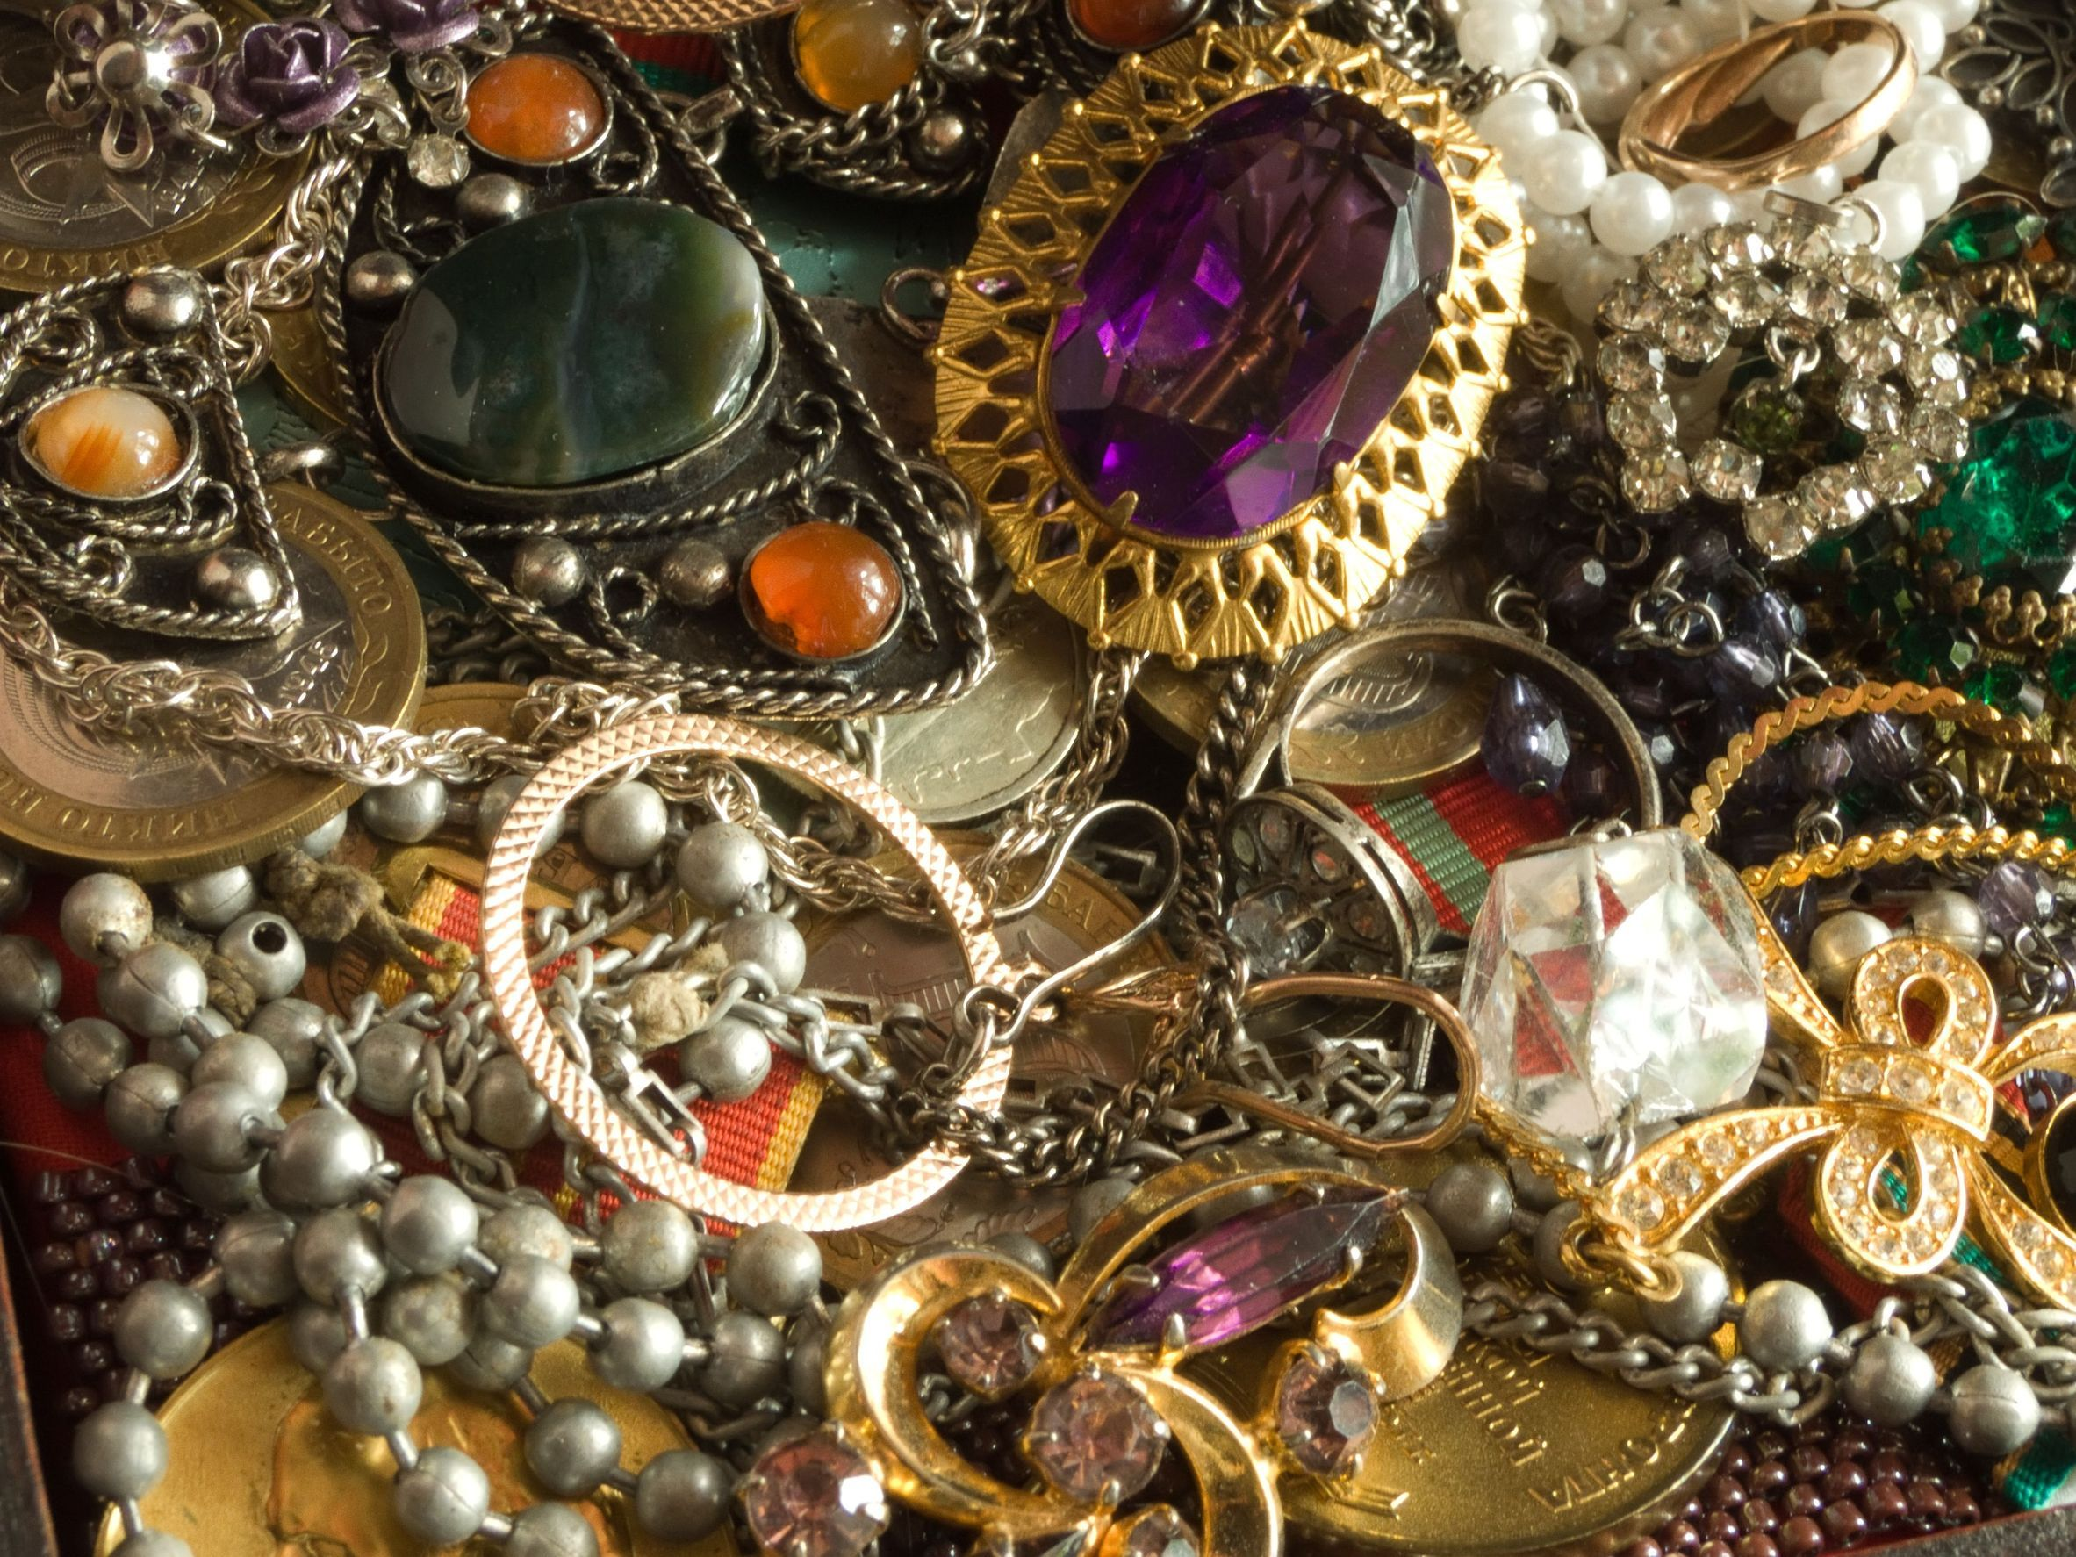
“Far Above Jewels…”
An Excellent Wife
Proverbs 31:10-31
Is diligent and dedicated in her work to provide sustenance to her household, vv.13-15,24
Is thoughtful and proactive in her preparations for the future, vv.16,25
Takes care of herself that she may have endurance in her work, and takes pride in her productivity, vv.17-18
Is skillful, and utilizes her talents to care for the poor and needy as well as her family and herself to be sure all are adequately prepared for hardship, vv.19-22,27
Is never a disgrace to her husband; and he is, at least in part due to her faithfulness to him and charity to others, well-respected in even the most noble circles, v.23
Is clothed with strength and dignity, and thus smiles at the future, v.25

Slide 2
“Far Above Jewels…”
An Excellent Wife
Proverbs 31:10-31
Is careful with her words; wisdom and kindness characterize her speech, v.26
Is not idle and takes care of her own household, v.27
Because of these things, she is blessed by her children and praised by her husband as well as her works, vv.28-31
Not to diminish or belittle any of these things, but surely you’ve/we’ve heard all of this before…
But have you ever considered these characteristics relative to ourselves as the bride of Christ?
What kind of wife are we/you to our/your spiritual husband, Jesus Christ? cf. Eph.5:22-33
Are we an excellent wife in our spiritual marriage to Christ?

Slide 3
“Far Above Jewels…”
An Excellent Wife
to Jesus Christ?
Do we/you engender trust from our spiritual husband because we/you do Him good and not evil all the days of your life? 1Thess.1:6-10
Are you/we diligent and dedicated to our/your work in providing sustenance to our spiritual household? Eph.4:11-16
Are we/you thoughtful and proactive in our/your spiritual preparations for the future? Matt.6:19-21
Do we/you take of yourself spiritually so that you will have endurance to complete our/your spiritual work in such a way that enables pride in productivity? Heb.12:12-13; 10:36
Are we/you spiritually skillful with the tools provided to care for the spiritually poor and needy, as well as for the spiritual needs of ourselves and our families? Gal.6:1-5; 1Tim.5:8

Slide 4
“Far Above Jewels…”
An Excellent Wife
to Jesus Christ?
Are we/you a disgrace to your spiritual Husband, or does our/your faithfulness to Him and charity to others Cause Him to be well-respected even in the most noble circles? Matt.5:16
Are we/you spiritually clothed with strength and dignity, and thus able to smile at your spiritual future? 1John 3:21-24
Are you/we careful with our spiritual words so that wisdom and kindness characterize them? Col.4:5-6; Matt.12:34-36
Are we/you spiritually idle, or do we/you take care of the spiritual household? 1Thess.4:9-12; 1Tim3:15
If we/you are an “excellent wife” to our spiritual Husband, we/you will be blessed by the children of God, and praised by Him also,
And our/your works will follow you to the gates of Heaven, Matt.25:34-40!

