Slide 1
Man’s Greatest Achievement
“While our ancestors have been around for about six million years, the modern form of humans only evolved about 200,000 years ago. Civilization as we know it is only about 6,000 years old, and industrialization started in the earnest only in the 1800s. While we’ve accomplished much in that short time, it also shows our responsibility as caretakers for the only planet we live on right now.”
“The effects of humans on Earth cannot be understated. We’ve been able to survive in environments all over the world, even harsh ones such as Antarctica. Every year, we fell forests and destroy other natural areas, driving species into smaller areas or into endangerment, because of our need to build more housing to contain our growing population.”
universetoday.com “How long have humans been on Earth?”

Slide 2
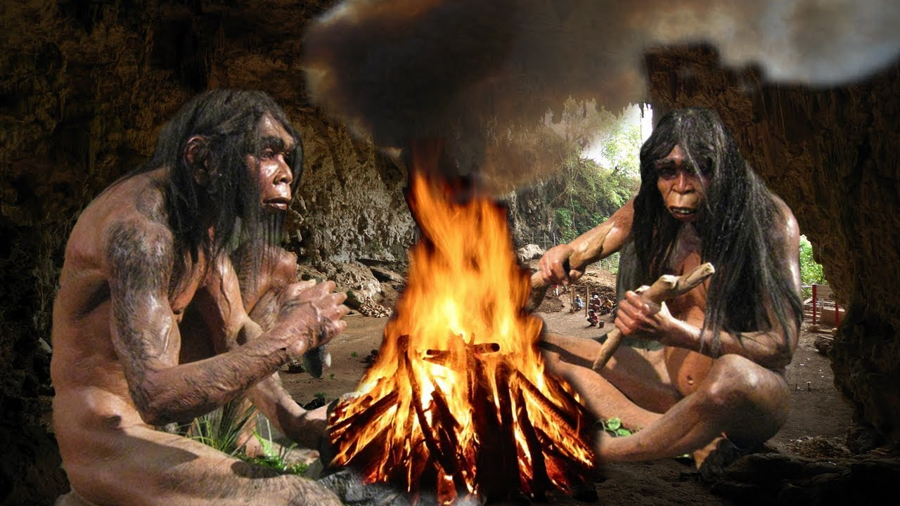
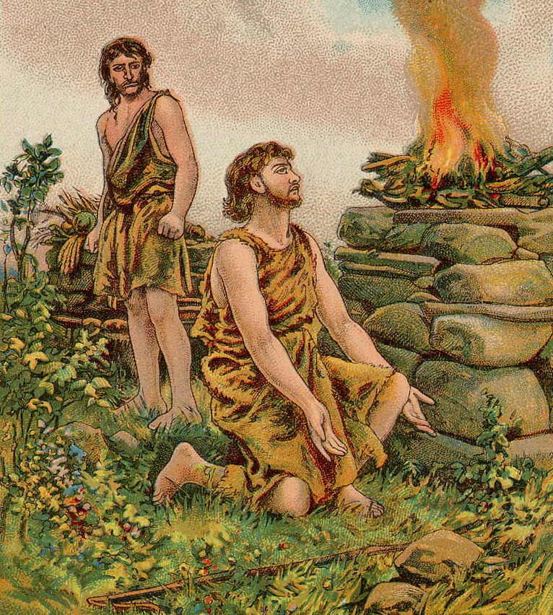
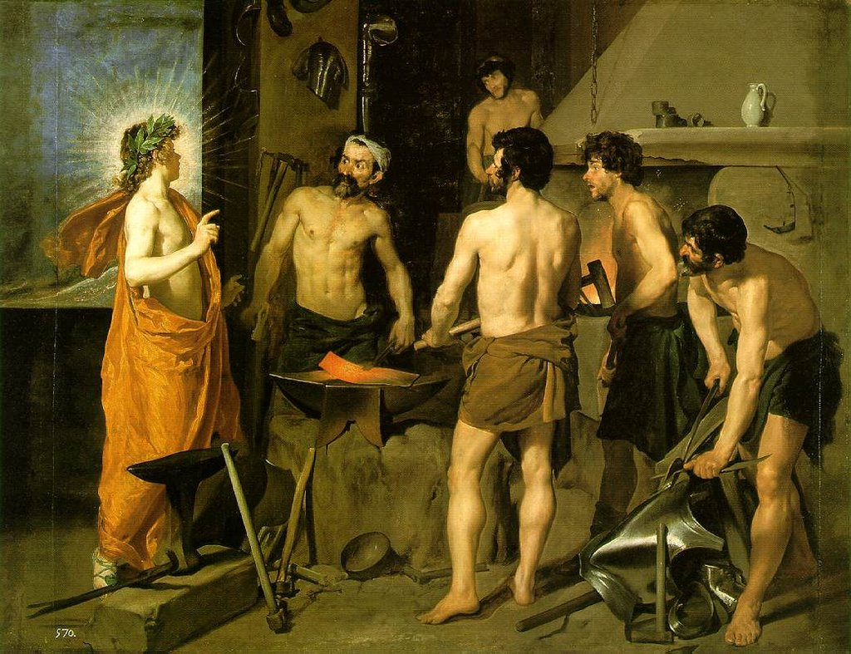
Man’s Greatest Achievement
Is not the Discovery/Use of Fire.
Abel used it to worship, Gen.4:4
Enoch perhaps to build a city, v.17
Tubal-cain to forge implements, v.22
Notes:
*Not 230,00 – 400,000 or even 1.4 – 1.5 million years ago.

Slide 3
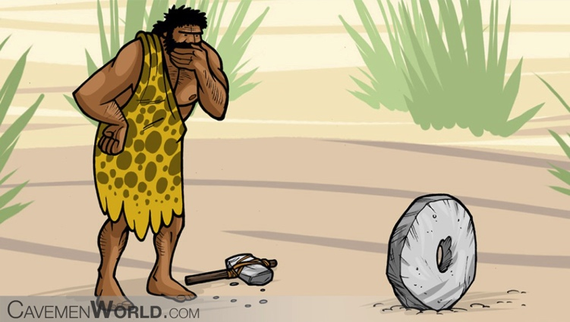
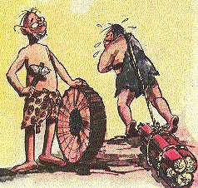
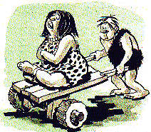
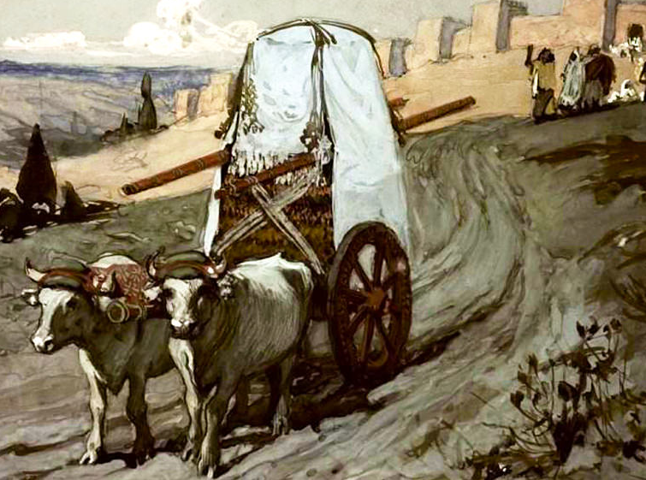
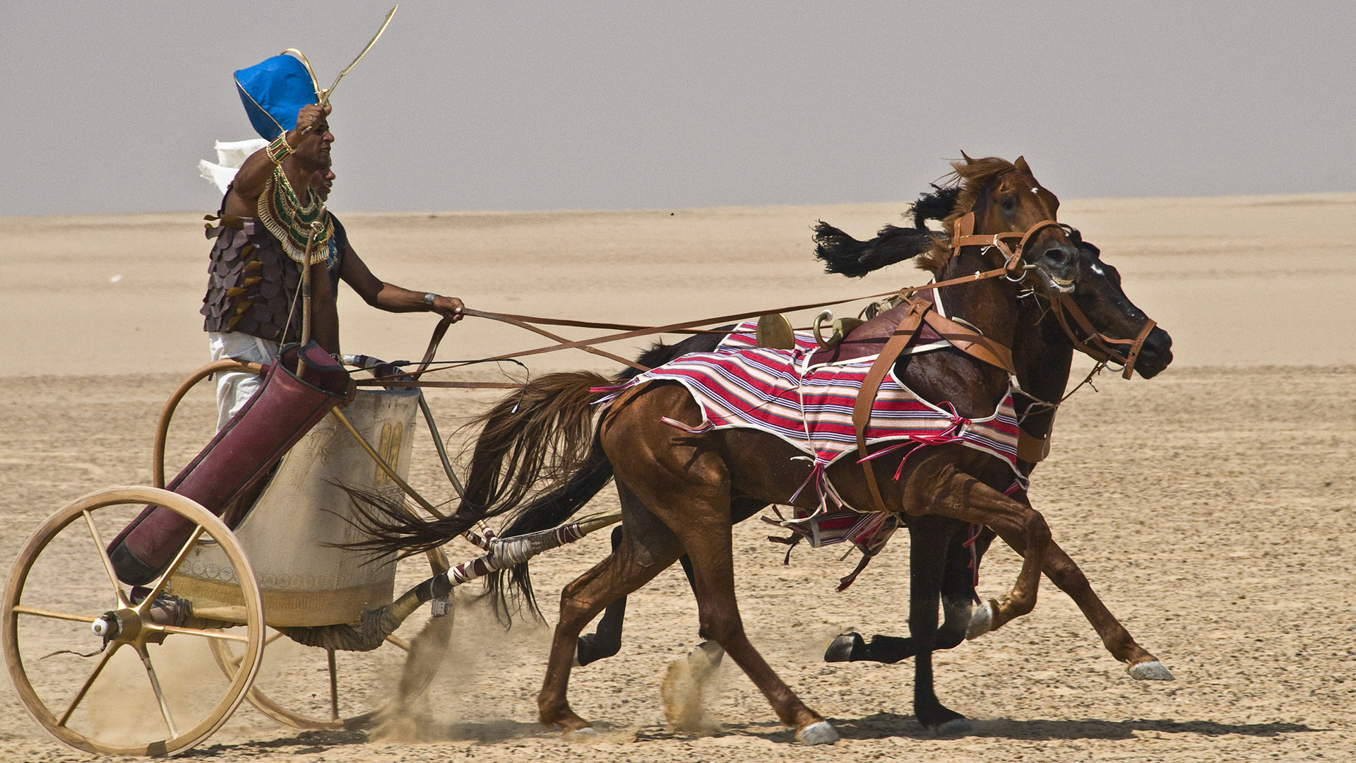
Man’s Greatest Achievement
Is not the Invention/Use of the Wheel.
Egyptians used chariots, Gen.41:43
Israelites used carts, Num.7:3ff

Slide 4
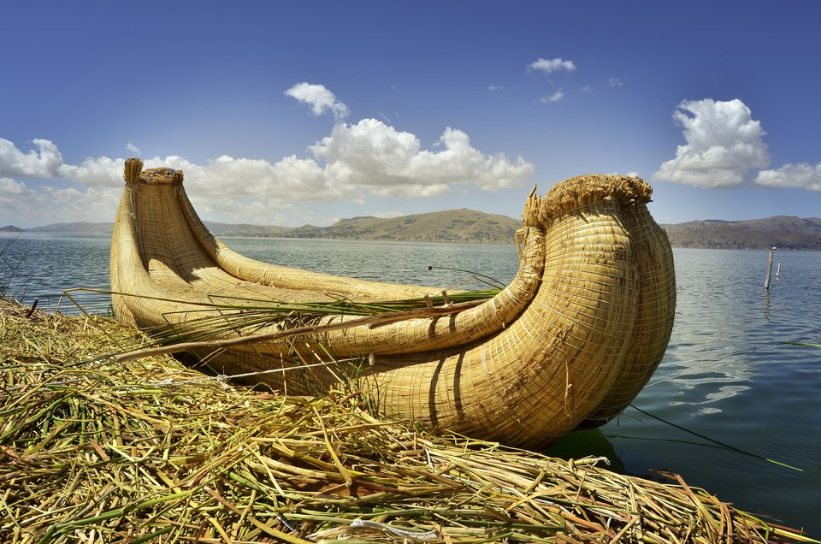
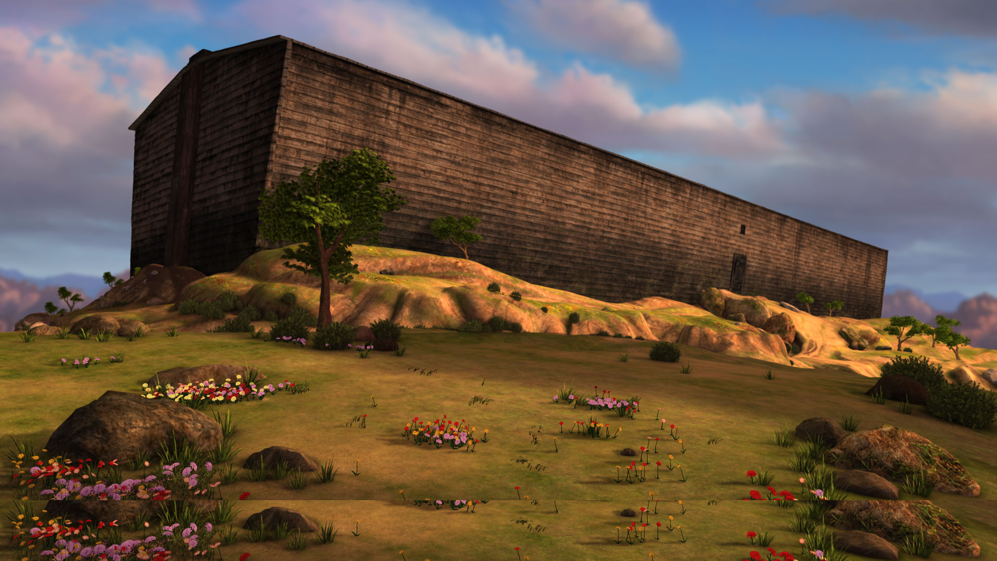
Man’s Greatest Achievement
Is not the Making/Use of Boats or Water Travel.
God designed and Noah built the first one, Gen.6 - 7

Slide 5
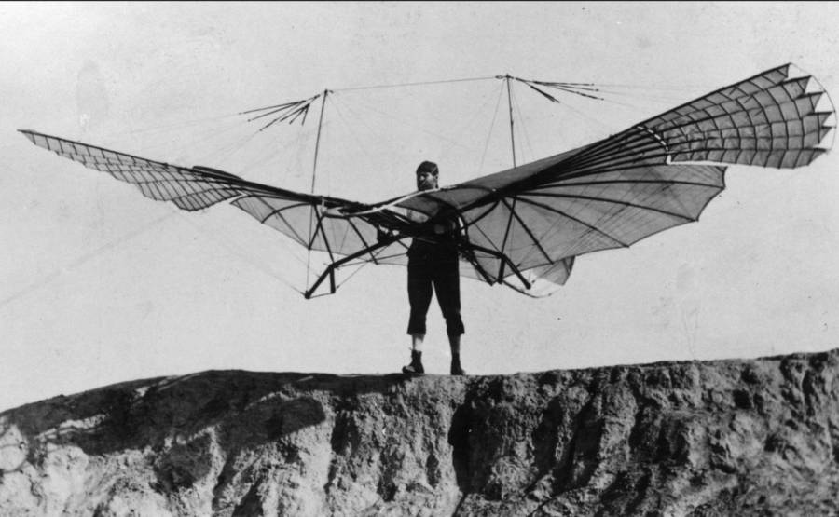
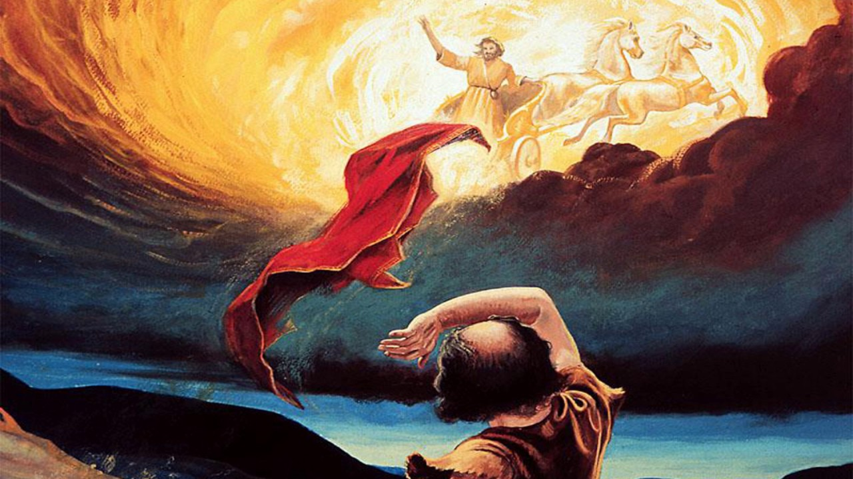
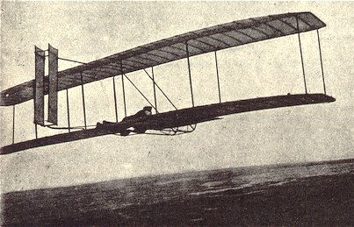
Man’s Greatest Achievement
Is not Flight (gliding or powered).
God built and piloted man’s first flying machine, 2Kings 2:11

Slide 6
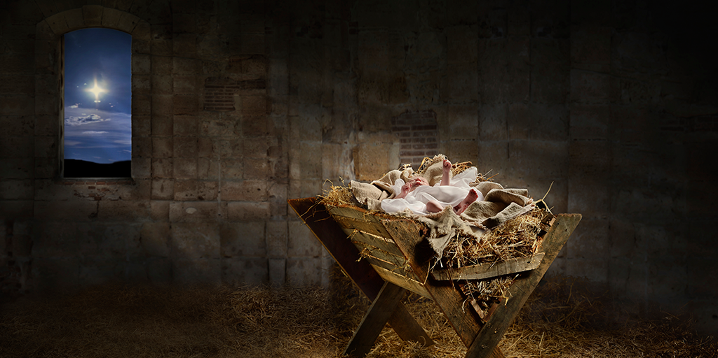
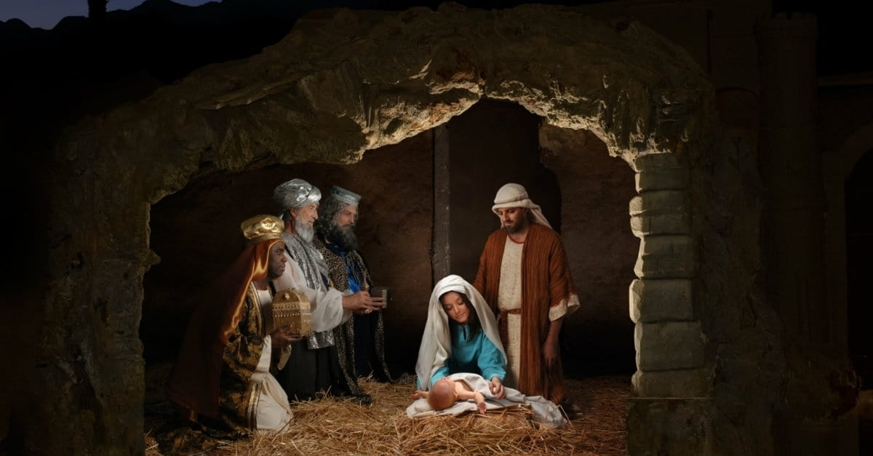
Man’s Greatest Achievement
Is not even the Birth of Jesus.
As momentous as was this event,
Man had little to do with it, Matt.1:18-25
Obviously, Mary was surely involved, but was overshadowed by “power of the Most High” to produce “the Son of God,” Luke 1:35.
Of itself, this event only put God in flesh, Heb.2:14-18.

Slide 7
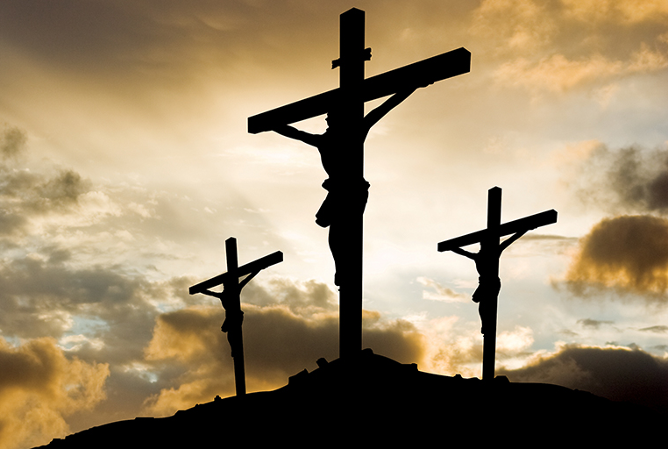
Man’s Greatest Achievement
Nor was it the life or death of this God in flesh Man.
As many as were His miracles, John 20:30-31
As profound as were His teachings, Matt.7:28-29
As much as His example altered human behavior, Phil.2:1-7
Even as much as His death did to change the destiny of man, Phil.2:8-11
Though man surely killed Him, Acts 2:23
These were not the greatest achievement of man…

Slide 8
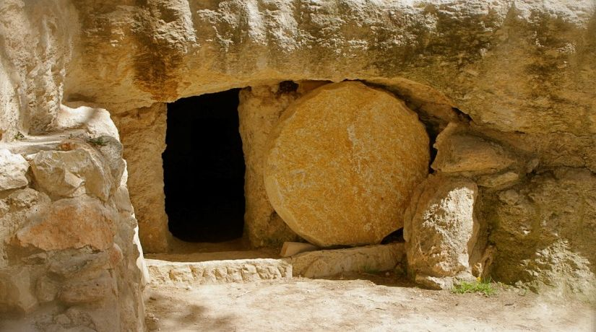
Instead, Man’s Greatest Achievement
Was that first step out of the Tomb, Rom.1:4!
Without this single momentous achievement- the victory over death, nothing else would matter, 1Cor.15:12-19.
No other “achievement” or “event” in human history had such impact, 1Cor.15:20-28.
Without His resurrection, His birth, life, teachings, and even death would be meaningless, Acts 2:32,36.
This is why such matters are “of first importance…” 1Cor.15:1-4

Slide 9
So, Man’s Greatest Achievement
Did not occur on July 20, 1969 when Neil Armstrong first stepped out of Apollo 11 onto the surface of the moon and uttered those famous words, “That’s one small step for man, one giant leap for mankind”…
But when the Man, Jesus the Christ, stepped out of the tomb the risen Savior of mankind,
And the angels proclaimed, “He is not here… He has risen.” Luke 24:6!

Slide 10
Now…
I really don’t care if you’re wearing new/special clothes this morning (if so, I certainly don’t want you to be embarrassed),
Or if you hunt colored eggs and eat chocolate bunnies this afternoon.
I’m not overly concerned regarding your particular motivations for being here today,
But what I do care about is that you understand the supreme importance of the Resurrection of Jesus Christ from the dead.
I want you to understand that it is the single most important achievement/event of human history…
And I want you to be forever changed by it, Rom.6:1-11!
I want you know, understand, and commemorate it- not just once a year, but every first day of the week, cf. 1Cor.11:23-26; Acts 20:7,
And remember it and be changed by it every day in between!

