Slide 2
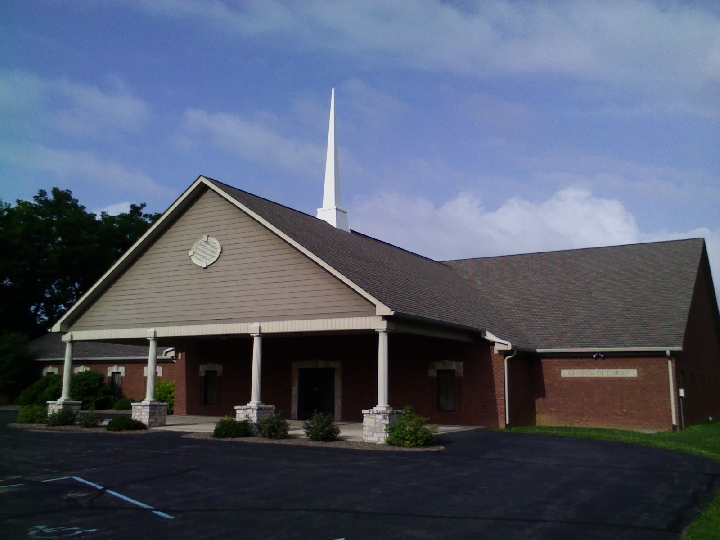
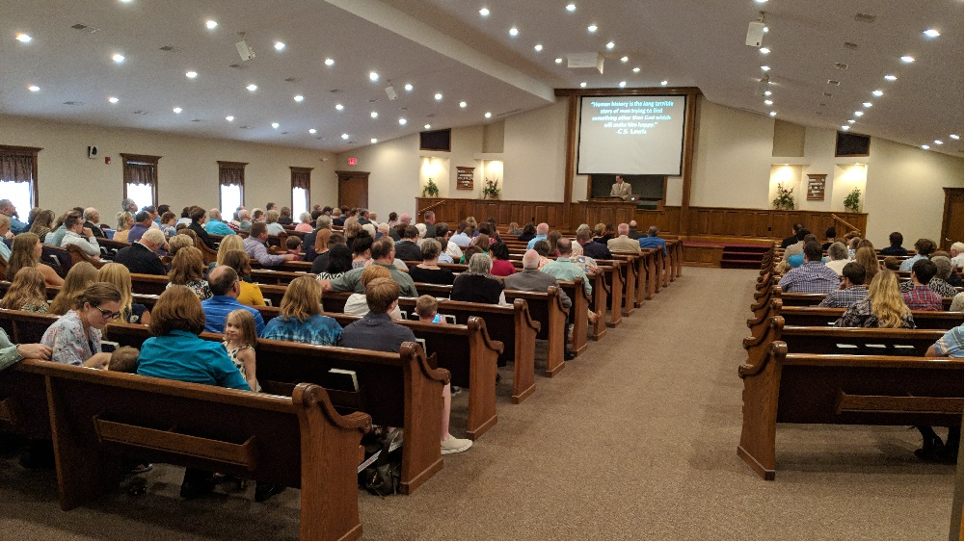
“Church”
What images or thoughts does this word conjure in your mind?
That it is unfortunately often applied to the container (building)
That it shouldn’t be capitalized since it isn’t used as a proper noun, and that of the 112 occurrences in the N.T. (NASV), not one of them starts with an upper case? cf. Rom.16:16
That ekklesia really just means congregation or assembly as used in Acts 7:38; 19:32,39,41?
That it can be used in universal (Matt.16:18), regional (1Cor.16:1), or local (Rev.1:11) senses?
Something else?
rather than the contents (people)?

Slide 3
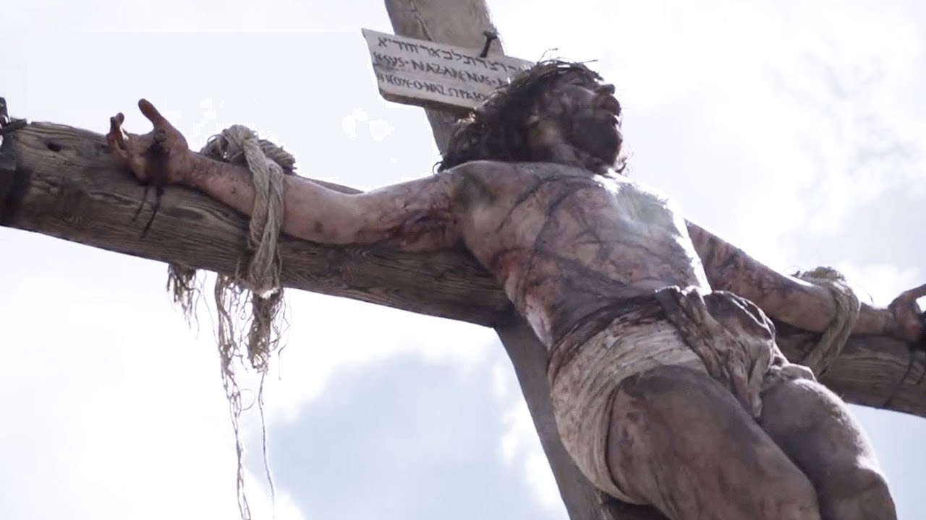
Think about the church…
Origin- The church is what Jesus built and purchased with His blood, Matt.16:18; Acts 20:28.
Organization- The church is the body over which He is the Head (executively, legislatively, and judicially), Eph.1:22-23.
Access- The church is entered through faith, repentance, and baptism, Acts 2:36-38, 40-41.
Composition- The church is comprised of the saved of all time, Heb.12:23.
Certainly, it began in a sense on Pentecost in 33 A.D. as recorded in Acts 2; but
One must also recognize that Jesus’ sacrifice reached back to save the faithful of the previous dispensations and covenants, Rom.3:25-26; Heb.9:15; 10:12.

Slide 4
But now think about this church…
Origin- It began when Christians (fellow members of the universal church) decided to ban together to worship and work collectively at this location, Acts 2:42-47.
Organization- Though the Head (executively, legislatively, and judicially) remains the same, it has been overseen locally by elders, served by deacons, and comprised of saints/members, Phil.1:1.
Access- Either by conversion, Acts 4:4; or by deliberate choice to join (and accept as fellow local members) members are added to this fellowship, Acts 9:18,26-28.
Composition- Over the years, members have been both added and subtracted, 2Thess.3:6,14-15. But, as fallible men, we must admit the possibility of error by:
Adding/keeping those we should not, 1Cor.5:1-13; or,
Expelling those we should not, 3John 9-11.

Slide 5
What’s the Point?
A few, actually:
The church (universal) belongs to Christ; He bought, oversees, and maintains its perfect fellowship.
This church (local) still belongs to Christ (Rev.1:12-18ff), but…
We paid/pay for it, 1Cor.16:1-2; and must continue to sacrifice ourselves for it, cp.2Cor.8:1-5; Rom.12:3-13.
We oversee it; 1Pet.5:1-4;
We maintain its fellowship, Acts 9:27; 1Cor.5:9-13.
Hopefully, we do so in ways that please Him, Luke 12:42-44!
Therefore, the church belongs to Christ; but,
This church is our responsibility as stewards to maintain and grow in ways that please Him; compare…
Rev.3:7-12, Philadelphia- nothing bad to say
Rev.3:14-22, Laodicea- nothing good to say
Rev.3:1-6, Sardis- contained both good and bad

Slide 6
So…
What will it be for Southport? What would/will our letter from the Master say?
Just as importantly, on which side of Sardis/Southport are you? Rev.3:2-5 (soiled or white; problem or solution)
Are you glued/fastened hard to this church as per Acts 9:26 (Matt.19:5; Acts 17:34)?
Or, have you just put your “sticky note” of membership here for the time being?
Do you feel personally responsible for its successes and failures because you’re an integral part of this body, 1Cor.12:12-27?
Or, are you just here when it suits you and for what you can get out of it?
What kind of steward will you be going forward? 1Pet.4:10

