Slide 2
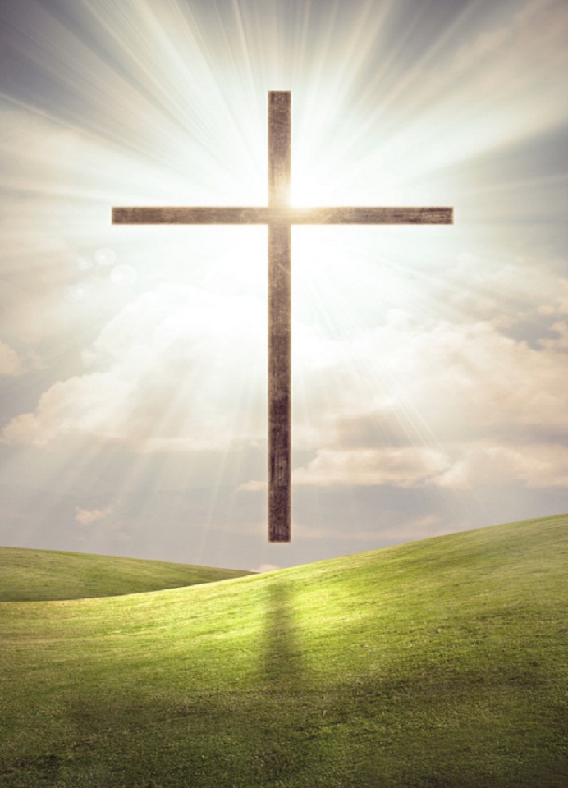
Seeing Ourselves
As God Does
Notes:
I often pray, publicly and privately, that I/we might see myself/ourselves as God does. While that may definitely have a negative effect if I/we “delude” ourselves (Jas.1:22) that we “have fellowship with Him and yet walk in darkness” (1John 1:6). And yet, there is also a positive side to seeing ourselves as God does also- one which many of us fail to take into account in our self-evaluations, and thus our self-images....

Slide 3
Seeing Ourselves as God Does
worth Revelation
Matt.11:27 John 1:18
worth Redemption
1Pet.1:17-19
worth Propitiation
Rom.3:21-25
worth Adoption
Gal.4:3-7
worth Fellowship
1Cor.1:4-9 1John 1:1-4

Slide 4
Can we help further? Rom.8:29-30
I don’t know how you see yourself…
I do know how God sees you.
I hope your self-image has changed today.

