Slide 2
The Church You Read About in the Bible, #3
This series of lessons has two primary objectives:
To help us stay or become the church Jesus intended; and,
To help others to be better able to identify the church of the New Testament and its imposters.
Last time, we established the importance of authority from the standard of the revealed Word, Phil.3:15-16; and,
Noticed examples and patterns of inspired men (apostles and others) who guided the early church, Phil.3:17.
We also noted that following our own ideas and desires in the matter of religion makes us enemies rather than advocates for the cross of Christ, Phil.3:18-19.
Today, let’s continue our study of…
Form and Function

Slide 3
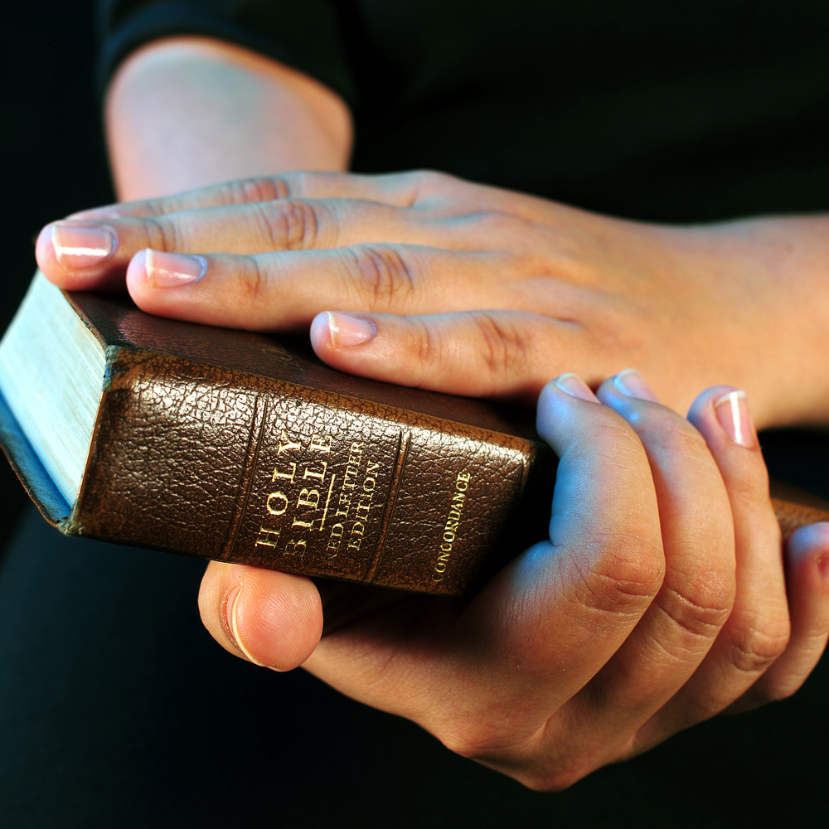
The Church You Read About in the Bible- Form & Function
Please follow this quick sequence of passages which demonstrate the foundational need of these lessons:
Jesus came, lived, and died to build His church, Matt.16:18-28;
It was comprised of the saved, Acts 2:41,47;
But apostasy was also predicted, 1Tim.4:1-3; 2Tim.3:1-5;
However, the Seed Principle allows apostasy to be overcome, 1Pet.1:22-25; Matt.15:13.
All of which shows the importance of:
  The inspiration of the N.T., 1Cor.2:10-13; Eph.3:3-5; and
  The sufficiency, completeness, and authority of the N.T., John 12:46-50; 16:13; 2Tim.3:16-17.

Slide 4
The Church You Read About in the Bible- Form & Function
Let’s briefly look at the form (pattern of salvation Rom.6:17) of this church Jesus built: Acts 2
They listened to/heard inspired teaching, vv.1- 4,8,11,14-21;
Believed Jesus as Lord and Christ (death & resurrection), vv.22-36;
Repented (change of mind & heart → direction & allegiance in life), vv.37-38 → vv.41- 47;
Confessed (proclaimed publically their sins, faith, & allegiance), vv.37b → 43- 47;
Baptized (immersed in water for remission of sins), vv.38,41; and they,
Continually Devoted themselves to spiritual things as directed by inspiration, vv.42- 47.
Notes:
Listened/heard inspired teaching rather than “following my heart” or waiting for a “personal experience”; Believed rather than “felt”; Repented/changed rather than expecting to be “accepted as I am”; Confessed rather than “keeping this between me and God”; Baptized rather “accepted Jesus as my personal savior”; Continually devoted rather than “once saved, always saved” or “when it’s convenient for me”

Slide 5
The Church You Read About in the Bible- Form & Function
Let’s briefly look at the function (pattern of work) of this church Jesus built from Acts 2ff.
They worshipped according to inspired teaching, vv.42-43, which included:
  Apostolic/inspired Teaching, v.42a;
  Fellowship (assembling together/joint participation), v.42b; 1Cor.11:18; Heb.10:25;
  Breaking Bread (partaking of Lord’s Supper), v.42c; 20:7; 1Cor.11:20-34; and
  We also read that N.T. churches sang psalms, hymns, spiritual songs, Eph.5:19; Col.3:16.
Notes:
Teaching- they were taught, not just inspired/motivated; Fellowship- koinonia, joint participation- not just eating together; Breaking Bread- note “the breaking of bread” seems to indication Lord’s Supper rather common meal, cp.v.46 (also note other items associated with in v.42 which seem to indicate “worship”); sang rather than played or listened

Slide 6
The Church You Read About in the Bible- Form & Function
Let’s briefly look at the function (pattern of work) of this church Jesus built: Acts 2ff (cont.)
They worshipped according to inspired teaching, vv.42-43; and,
They practiced benevolence toward one another (saints), vv.44-45; 1Cor.16:1ff; Rom.15:25-27;
They edified (to spiritually build up) one another both in and out of the assembly, vv.46-47; Eph.4:11-16; and,
They evangelized everywhere they went, 8:1-4; 11:19; Rom.10:14-18.
Notes:
Benevolence was toward “all who believed” and “were together” (in this case, locally) rather than Universal benevolence; Edification rather than a social or recreational purpose; personally and locally, and through supporting preachers in other places, cp. Phil.4:15-16

Slide 7
Conclusions
The church you read about in the Bible:
Became members by obeying inspired requirements of hearing, believing, repenting, confessing, being baptized, and continual devotion to inspired spiritual practices.
  If any now wish to become members of the church you read about in the Bible, it will be by following this same form, Rom.6:17.
Functioned according to the direction of inspired teaching in the practice of worship, benevolence, edification, and evangelism.
  Any today claiming allegiance to Christ must also follow these same inspired instructions and examples in their function, or else be rejected by God, Matt.7:21-23; 15:13.

