Slide 2
Question: If you were “brought up in the church,” have you ever wondered if you would have found and obeyed the gospel without your parents’ influence, teaching, and training?
It’s a scary consideration for some of us! Would we have had or developed enough of an interest in spiritual things for:
Sufficient desire for Truth and salvation to pursue them?
The diligence necessary to “weed through/out” the imposters? And,
The required determination to follow through with obedience to the gospel “on our own”?
Even if you developed the spiritual interest and desire to do so, how would you go about finding “the church of the Bible”?

Slide 3
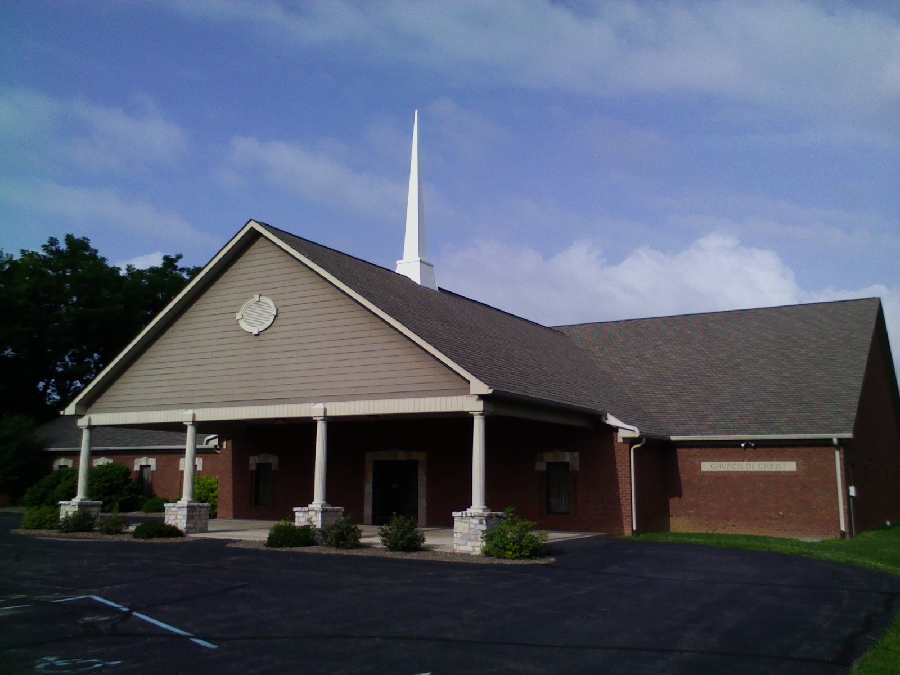
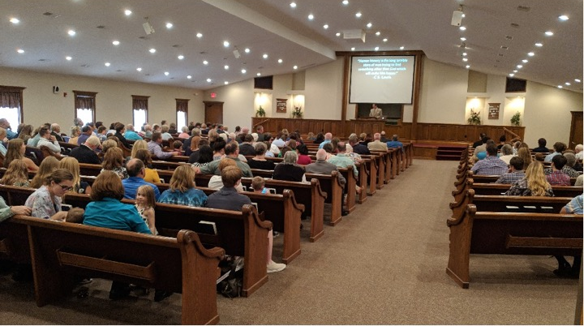
The Church You Read About in the Bible, #1
Is this it,
or at least part of it?
How do you know /how can you tell?
Prophetic Origin and Fulfillment

Slide 4
The Church You Read About in the Bible- Prophetic Origin and Fulfillment
This is a vitally important subject, because:
Jesus built His church, Matt.16:18; and,
The Bible speaks of “one body,” or “church,” Eph.4:4; 1:22-23.
So, just any old church that claims to believe in Him and teach the Scriptures isn’t necessarily proof that it is “The Church you read about in the Bible.”
But, the importance and relevance of the subject doesn’t mean that it is difficult, or hard to find in the text:
You just have to remember and connect 4 chapter 2s!
Let’s look at them together….

Slide 5
The Church You Read About in the Bible- Prophetic Origin
Remember 4 Chapter 2s
The 1st Chapter 2: Isaiah 2:1-4 (~720 - 700 B.C)
V.1 tells who and where- “Judah” (the spiritual people of God), cf. Rom.9:6-8; and “Jerusalem,” (the spiritual city of God), Acts 1:4,8;
V.2a tells when- “the last days” (Jesus’ time to the present), cf. Heb.1:1-2;
Vv.2b-3 tells what- “The mountain of the house of the Lord will be established…” (the church/kingdom; “the law will go forth,” (the gospel), cf. Luke 16:16; Acts 2:14ff;
V.4 tells how- not by physical but spiritual revolution, “swords into plowshares…spears into pruning hooks,” cf. John 18:36; 2Cor.10:3-6.

Slide 6
The Church You Read About in the Bible- Prophetic Origin
Remember 4 Chapter 2s
The 2nd Chapter 2: Daniel 2:36-45 (~537 B.C.)
V.44a tells when- “in the days of those kings” (the Roman Empire), cf. vv.36-43; Luke 2:1ff;
V.44b tells what- “a kingdom which shall never be destroyed” (Christ’s church), Matt.16:18b; Heb.12:28;
V.45 tells how- “stone…without hands…crushed the iron…” (the Rock/Stone upon which the church is built), Matt.16:16,18a; 1Pet.2:4-10;

Slide 7
The Church You Read About in the Bible- Prophetic Origin
Remember 4 Chapter 2s
The 3rd Chapter 2: Joel 2:28-32 (~830 or after 722 B.C.)
V.28a tells when- “after this” (the time of rejoicing/ refreshing for the people of God following their repentance), cf. vv.21-27; Matt.3:1-6; 4:23-25; 21:9;
Vv.28b-29 tell how- “pour out My Spirit…sons and daughters will prophesy…” (coming of the Spirit), cf. John 14:26; 15:26; 16:7-13; Acts 1:8; 2:1-4ff; 10:44-46; 21:9;
Vv.30-31 tell what- “the day of the Lord” (the destruction of Jerusalem, which prefigures the end), cf. Matt.24;
V.32 tells who, how, what, and where- “whoever calls on the name of the Lord will be delivered…on Mount Zion and in Jerusalem” (all flesh/mankind, obedience to the gospel, salvation, starting in Jerusalem), cf. Acts 1:8, 2:1-21, 22-41; 10:34-35.

Slide 8
The Church You Read About in the Bible- Prophetic Fulfillment
Remember 4 Chapter 2s
These 3 Prophetic Chapter 2s all point to 1 Fulfillment Chapter 2:
Isaiah 2:1-4
Daniel 2:44-45
Joel 2:28-32
The 4th Chapter 2: Acts 2
V.1 shows who and where- “they” (the apostles), 1:21-26; and “one place” (Jerusalem), 1:8.
Vv.2-11 show how- “Spirit gave utterance” (Spirit-inspired), John 16:13;
Vv.12-21 show when- “in the last days” (then to now), Mark 9:1;
Vv.22-40 show what/how- “be saved” (obedience to the gospel), Mark 16:15-16;
Vv.41-47 show the result- “the church” (the saved), Matt.16:18; Col.1:13-14.

Slide 9
The Church You Read About in the Bible- Prophetic Origin and Fulfillment
Remember 4 Chapter 2s
These 4 Chapter 2s are vitally important to our understanding of the Church. So, remember:
Isaiah 2; Daniel 2; Joel 2; and Acts 2.
Now, 2 Questions:
Are the people here at Southport a part of the church you read about in the Bible?
Are the people wherever you worship a part of the church you read about in the Bible?
It makes a difference: Matt.16:18 → 15:13!

