Slide 2
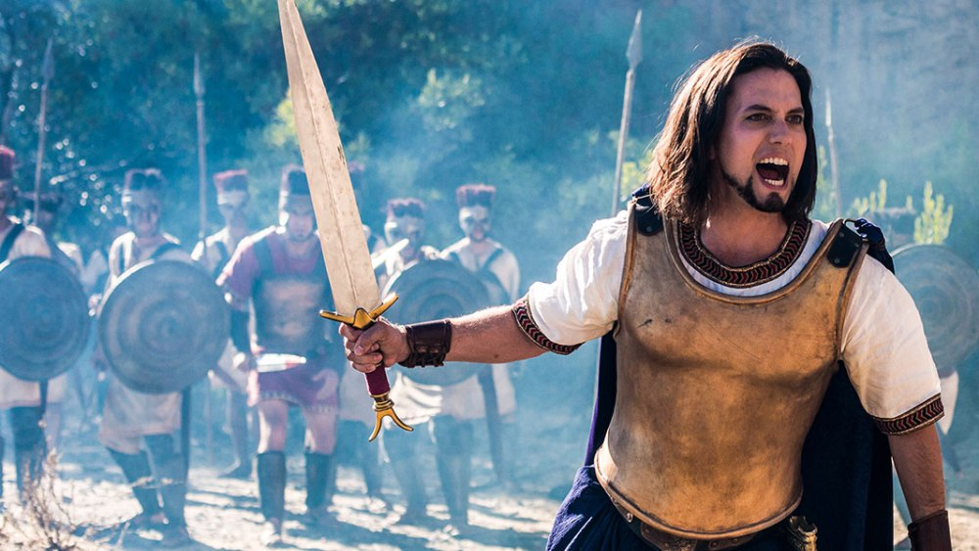
Hero to Emulate or Villain to Avoid?
Samson:
“Yes” just might be the best answer.
The Bible stories we’re taught as children (in which positives are typically emphasized) sometimes take on new meaning when viewed with “adult” eyes and perspectives.
But whether “young” or “not so young anymore,” the life of Samson provides several valuable lessons.
Cautionary Note: Our purpose is not judge Samson’s eternal destiny, but to learn from both his successes AND failures to better emulate the former, and hopefully avoid the latter.

Slide 3
Hero to Emulate or Villain to Avoid?
Samson:
The story’s background…
It is set during the time of the Judges (deliverers and leaders appointed by God for Israel), ~1400 - 1100 B.C.
This was a cyclical period of faithfulness, apathy, apostasy, oppression, repentance, and deliverance (through a Judge), and then faithfulness again- usually for the lifetime of the Judge. Then the cycle repeated, cf. Jud.12:15 - 13:1.
Samson is one of the best remembered Judges- primarily for both getting himself into and then out of trouble.
But remember: God appointed him for His purposes, vv.2-5,24-25.

Slide 4
Hero to Emulate or Villain to Avoid?
Samson:
The basics of the story…
Samson selects a Philistine wife, chp.14
She was not from God’s people, vv.1-3a
He chose her on the basis of looks- physical desire, vv.3b,7
She manipulated him to get what she wanted from him, vv.15-17
Ultimately, she was given to Samson’s friend, v.20
Don’t forget that this was from the Lord, and for His purposes, vv.4,19

Slide 5
Hero to Emulate or Villain to Avoid?
Samson:
The basics of the story…
Samson tries again, chp.15
He tried to make amends, but it was too late, vv.1-2
Rather than accept it and move on, he sought vengeance, vv.3-5
Ultimately, it cost her and her father their lives, v.6
Samson sought revenge, and thought he could then quit, vv.7-8
He missed the Golden Rule (Mt.7:12) completely, vv.9-11
But then recovered well; obviously with God’s help, vv.14-20
Things didn’t go well when Samson did things his way for his purposes, but did when he submitted himself to God’s way and purposes, cp.vv.1-8 with vv.9-20

Slide 6
Hero to Emulate or Villain to Avoid?
Samson:
The final chapter…
His downfall, or triumph? chp.16
Wrong woman #2, vv.1-3
Wrong woman #3.0 (the third time was NOT the charm), vv.4-5
Wrong woman #3.1, vv.6-9
Wrong woman #3.2, vv.10-12
Wrong woman #3.3, vv.13-14
Wrong woman #3.4, vv.15-19
Through disobedience (cf.13:5), fellowship with God was broken, v.20
Without God, bad things happen, v.21
Samson learned his lesson, vv.22,28
But the Philistines didn’t learn theirs, vv.23-25
The tragic end, vv.29-31
Samson both lost and won, cp.Matt.10:39 with Heb.11:32!

Slide 7
Was neither all good nor all bad, and we’re a lot like him!
Samson:
A Few Lessons for Us
Please, look for and FIND godliness first and foremost in a mate, 2Cor.6:14-18.
Fellas, admire, seek, and find the imperishable qualities, 1Pet.3:1-6
Ladies, desire, seek, and find this kind of man, 1Pet.3:7; Titus 2:6-8
And don’t forget to be godly for your potential mate, 1Pet.3:8-9.
Doing things our way and for our purposes never works out well.
It didn’t for Samson, and it won’t for us. When we break fellowship with God by disobedience, His strength will depart from us too, 13:5; 16:19-20; 1Pet.3:10-12.
When we “make a mess” of our lives (and those around us)- even a BIG mess, we can start over.
The purification for the Nazirite vow, once broken, could be restarted, 16:22.
So can your life in Christ, 1John 1:9; Prov.28:13; John 8:11; Luke 7:47; John 3:3,5

