Slide 2
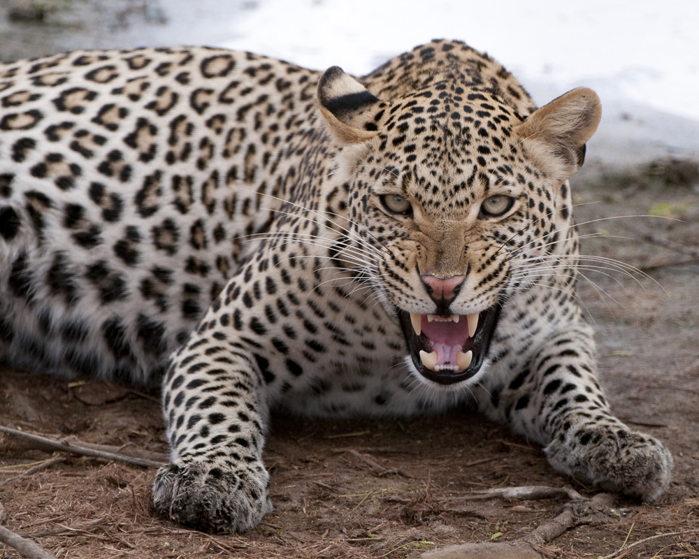
Changing the Leopard’s Spots
Jeremiah 13:23

Slide 3
Changing the Leopard’s Spots
The phrase is likely unfamiliar to younger folks.
It is usually stated as “A leopard can’t change his spots.”
The typical meaning intended is that one can’t change “who he is.”
This meaning seems to be supported by the text of Jer.13:23 (especially in the NIV) from which it apparently comes.
However, a closer look at the context reveals that it has to do with Judah being so steeped in sin that they cannot change themselves, but must go away into captivity to be brought to repentance, vv.20-27; cf. Eph.2:1-5.
Notes:
The statement of v.23 includes a consequential clause that is introduced, and denied by, the preceding question. If the question’s answer is “no,” then the consequential clause is impossible. If the introductory question’s answer was “yes,” then Judah could change themselves by repentance and avoid the coming captivity.

Slide 4
Changing the Leopard’s Spots
Most of us have things about ourselves we wish we could change…
Type or amount (or location) of hair, height, build, or body type, etc.
Certainly, there are some attributes about ourselves that we really cannot change, Luke 12:25-26.
But there are others that we can change, but haven’t, and probably won’t…
Like personality traits such as being timid or brash, naïve or cynical, cautious or reckless, hapless or excessively driven.

Slide 5
Changing the Leopard’s Spots
There are two items about these matters we should note:
Most of us wish we could change things about ourselves (presumably for the better); and,
Many of us doubt that we actually can change- it’s the leopard and his spots thing!
Obviously, the changes with which we ought to concerned are those that affect our spiritual well being, Luke 12:22-34.
However, many don’t really believe they can change their spots in this area of their lives- “It’s too much/late for me.”

Slide 6
Changing the Leopard’s Spots
So the question becomes,
“Can the leopard really change his spots?”
The Bible teaches that the answer is “Yes,”
With the right information,
With the right motivation,
With the right effort,
And the right assistance.
“How do you know? I don’t think I can change that way!”
Jesus was “transfigured,” Matt.17:1-8.
The same Greek word is used in Rom.12:2 and 2Cor.3:18.

Slide 7
Changing the Leopard’s Spots
If we are “the leopard,” how do we “change our spots”?
By being made new:
Through God’s grace and washing, Titus 3:5-7;
Through our putting off and putting on, Eph.4:17-24.
“But I don’t think I can…”
No, by yourself, you can’t.
But with God you can!
2Cor.5:14-19
Sinners can become saints,
1Cor.6:11!

Slide 8
Changing the Leopard’s Spots
If we are “the leopard,” how do we “change our spots”?
By growing and maturing:
God wants His babies to mature, Heb.5:12 – 6:8;
His soldiers to develop their skills, Eph.6:10-17; and,
His workers to improve their productivity, 2Pet.1:5-8.
This is not optional, 2Pet.3:18.
No one can remain a spiritual infant indefinitely.
If we do not grow and mature as Christians, and thus do our part to change our spots, we will die spiritually! John 15:1-8

Slide 9
Changing the Leopard’s Spots
If we are “the leopard,” how do we “change our spots”?
By realizing that our refusal to change affects more than just us.
The immature think and act selfishly without regard for others, 1Cor.13:11a;
But the mature realize the impact of their actions or inaction on others, 1Cor.13:11b;
And accept the responsibility of leadership with their own children, and others, Eph.6:4; 5:1-17; Matt.18:1-11.
Christians live in glass houses,
what an opportunity! Matt.5:14ff

Slide 10
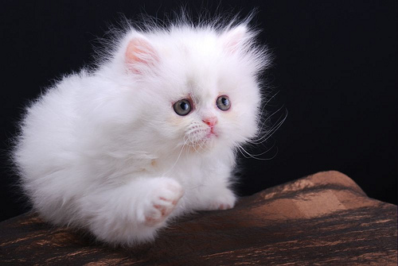
Can we leopards change our spots?
“Yes!”
Through God’s grace and cleansing,
And our continued efforts toward growth and maturity,
Along with the understanding and acceptance of responsibility to Him and those around us!
Now, are you ready to let God and us help you change your spots of sin into purity by being washed and transformed?

