Slide 2
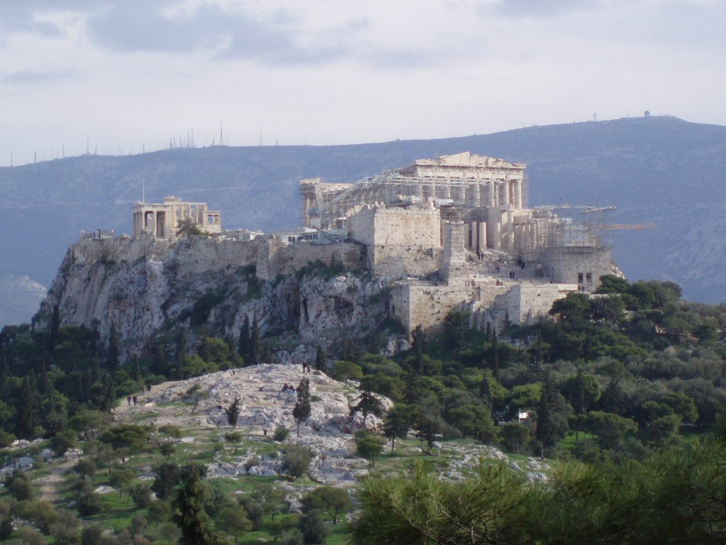
The God that We Should Know
(but the Athenians didn’t)
Paul at the Areopagus
Acts 17:16-34
Notes:
* This lesson is NOT to correct anything that bro. John McCauley said in his recent excellent bible class on this text, it is merely an additional “sermon” view of it. Credit also goes to my good friend and preaching colleague, Ira Lynn, who’s recent lesson on this passage both enlightened and inspired me to take another look at it.

Slide 3
The God that We Should Know
(but the Athenians didn’t)
Preliminaries
After the Jews from Thessalonica caused problems at Berea, Paul left Timothy and Silas behind and went to Athens, vv.13-15
While he waited, his spirit was provoked (paroxuno- to stimulate or irritate, cf. 1Cor.13:5; Heb.10:24) by the Athenians’ idolatry, v.16
He reasoned (dialegomai- to revolve in the mind, argue, reason) with the Jews, God-fearing Gentiles, and anyone else who would listen, v.17
Notes:
par·ox·oo·no dee·al·eg·om·ahee

Slide 4
The God that We Should Know
(but the Athenians didn’t)
Preliminaries
There were a couple of prominent philosophies present in Athens:
Epicureans sought relief from sorrow or difficulties through the studied pursuit of life’s varied and plenteous pleasures, v.18a
Stoics believed in complete indifference to both pleasure and sorrow, v.18b
Most all were idolatrous; it is said there were some 30,000 gods in Athens, cf. v.16b

Slide 5
The God that We Should Know
(but the Athenians didn’t)
Preliminaries
Generally, the Athenians and visitors there were consumed with telling or hearing something new, v.21
They, like many philosophers, seemed to be more interested in questions and debate than actual answers and truth, vv.32-33
So, they were willing to hear what they termed an idle babbler (spermologos- one who picks up seed; of birds that pick up grain in the fields; or one who lounges in the marketplace picking up merchandise that falls from a load), v.18c
Especially one who proclaimed strange (new) deities (diamonion- god, spirit, deity, divinity), cf. v.18d-21
Notes:
sper·mol·og·os dahee·mon·ee·on

Slide 6
The God that We Should Know
(but the Athenians didn’t)
So what did Paul want these idolatrous, philosophizing, consumed with the novelty of the new and very religious* Athenians to know?
The God they had failed to discover- the Unknown God that they had only worshipped in ignorance, vv.22-23
Thus, the sermon that follows is specifically designed and delivered to manifest the one true God and His attributes to the Athenians, and all since like them!
Notes:
*diesdiamonesteros (dice·ee·dahee·mon·es·ter·os) - in a negative sense, demon-fearing, or one who worships dead men deified; in a more positive sense, which Paul’s tone hereafter seems to warrant, very religious; the exact meaning is uncertain.

Slide 7
The God that We Should Know
(but the Athenians didn’t)
The Sermon: This Unknown God is:
Your Creator, v.24; cf. 14:15; Heb.11:1-3
Your Sustainer, v.25; cf. 14:16-17
Your Unifier, v.26a; cf. 10:34-35; Gal.3:28-29
Your Limiter, v.26b; cf. Job 12:23
Your Life’s (near) Objective, v.27; cf. Rom.1:18-20
Your Source/Father, vv.28-29a; cf. Job 12:10
Your Spiritual Source/Father, v.29b; cf. 7:48-50
And why the Athenians (and we) need to know these things in particular about the Unknown God?

Slide 8
The God that We Should Know
(but the Athenians didn’t)
Because:
This God has and will overlook (the/your) times of ignorance, v.30a; cf. 3:17; 14:16; Rom.3:25
If you/we will repent, v.30b; cf. Luke 24:27; Titus 2:11-14
Otherwise:
Judgment through the Resurrected One, v.31…
Whether you believe in resurrection or not, vv.32-34
And even if you believe (and live like) that this life is all there is, cf. v.18!

Slide 9
Conclusions
It was imperative that the Athenians come to know this Unknown God.
He was/is the answer to everything that their philosophies and pursuits had failed, and would continue to fail, to produce.
We (societally and generationally) are far closer to the Athenians than we’d probably like to admit.
We, too, must come to know this Unknown God to truly understand “life,” and be prepared for judgment! “He is the God that we should know”!

