Slide 2
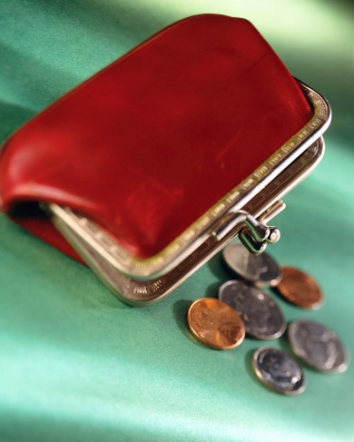
“Change” can be a good thing.
I don’t mean the left-over coins from a dollar bill;
Or the kind a politician promises, hoping everyone is sufficiently dissatisfied with the current administration to vote for him/her.
I do mean the kind to which we humans are sometimes strongly resistant.
Vote for Change!

Slide 3
“Change” can be a good thing.
In fact, change is absolutely necessary if we are in the “domain of darkness,” Col.1:13.
And it is essential if we are currently “conformed to this world,” Rom.12:2.
Even if you were “raised in the church” and are “a good person,” change is absolutely imperative to becoming and remaining a Christian. Here’s why….

Slide 4
To become and remain a Christian, we must change our Allegiance.
“This world” has a “prince” who currently rules it, Eph.2:2.
But he has been “judged” John 16:11; and will be “cast out,” John 12:31.
But the “King of kings and Lord of lords” (1Tim.6:15) rules a kingdom which is not of “this world,” John 8:23; 18:36.
To become and remain a Christian, you must change your allegiance, because you’ve changed Kings and kingdom, Acts 26:18!

Slide 5
To become and remain a Christian, we must change our Values/Priorities.
“This world” values image and appearance, fame and success, wealth and independence.
But Jesus’ kingdom values:
The inward beauty of “the hidden person of the heart…gentle and quiet spirit…which is precious…” 1Pet.3:4; (see also Matt.6:1-4; 5-6; 16-18).
A different kind of fame, Heb.11:32-40; and success, Luke 16:19-22.
Those “rich in good works,” 1Tim.6:18-19; and service, Matt.20:20-28; Gal.5:13; 1Pet.4:10.
Values/Priorities simply must change, Matt.6:33!

Slide 6
To become and remain a Christian, we must change our Expectations.
The expectations of “this world” are all about TODAY. Therefore
They have to cram in all the living/gusto they can.
Physical life is valued above all else.
There is no hope for tomorrow.
But in the Kingdom, expectations are different:
Each day is a blessing, but provides opportunity to serve, Phil.1:21-24.
Physical life is important, but not more so, Luke 9:23ff.
“Tomorrow” is still not guaranteed, Jas.4:13-17; but is not a cause of concern either, Matt.6:25-34.

Slide 7
“Change” is good, if…
We’re changing our allegiance from the kingdom of Satan to that of Christ;
We’re changing our values/priorities from “this world” to the next one; and if
We’re changing our expectations of the “here and now” for the “hereafter.”
Such is “change” with which we can all live, and certainly should not be resisted.
“And do not be conformed to this world, but be transformed by the renewing of your mind, that you may prove what the will of God is, that which is good and acceptable and perfect.” Rom.12:2
So, are YOU willing to change?

