Slide 1
“Human history is the long terrible story of man trying to find something other than God which will make him happy.” -C.S. Lewis
“Most truly profound quotes are repackaged reproductions
of divine revelation.”
-P.C. Strong
Eccl.12:11
Notes:
Eccl.12:11

Slide 2
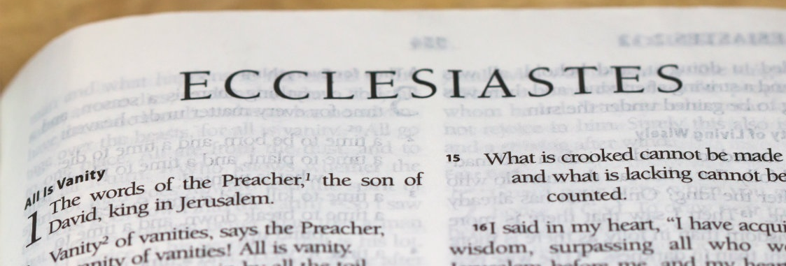
The Quest for Meaning in Life
Preliminary Observations:
Solomon, aka “the Preacher,” had all the advantages and was well-equipped for this particular quest, 1:1,12-13a (cf. 1Kings 4:29-34).
But found it to be a grievous task and striving after wind that resulted in grief and pain, 1:13b-18.
In chp.2, Solomon reviews his efforts and findings…

Slide 3
The Quest for Meaning in Life
Solomon sought for Meaning in Life through:
Pleasure and laughter , 2:1-2
Chemical enhancement, 2:3
Industry, work, accomplishment (houses, vineyards, gardens, parks, orchards, ponds), 2:4-6
Servants and being served, 2:7
Abundance and wealth, 2:8a
Entertainment and pleasures of men, 2:8b
Indulgence, 2:10
Does any of this sound familiar? 1:2-11

Slide 4
The Quest for Meaning in Life
Solomon sought for Meaning in Life through:
Pleasure and laughter , 2:1-2
Chemical enhancement, 2:3
Industry, work, accomplishment (houses, vineyards, gardens, parks, orchards, ponds), 2:4-6
Servants and being served, 2:7
Abundance and wealth, 2:8a
Entertainment and pleasures of men, 2:8b
Indulgence, 2:10
Jas.4:1-3,9
1Pet.4:1-5
1Thess.4:9-11
Phil.2:1-7
1Tim.6:3-12; Luke 12:15
1Thess.4:1-8
Acts 24:25-27; Gal.5:23

Slide 5
The Quest for Meaning in Life
So what’s the answer to “life” and its meaning?
Nothing “under the sun” will provide meaning to life, cf. Eccl.1:9,14.
Fulfillment- and with it happiness, is to be found only in pursuit of those things above the sun, Eccl.12:13-14.
Don’t redo Solomon’s experiment(s)- he had much more wealth, power, and wisdom than we do, but still found that service to God and His kingdom is the only path to fulfillment and meaning in life, cf. Matt.6:33.

