Slide 2
Leading & Following
God’s people tend to wander off
God has always provided leaders

Slide 3
The First Century Church Twenty Centuries Later
God’s Powerful Church

Slide 4
Powerful
W
O
R
S
H
I
P
F
E
L
L
O
WS
H
I
P
L
E
A
D
E
R
S
H
I
P
E
V
A
N
G
E
L
I
S
M

Slide 5
Leadership in the Church
First, we talk about what shouldn’t be
Secondly, we talk only about qualifications

Slide 6
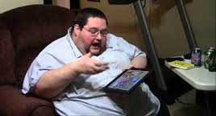
Qualification for the Office of President: “No person except a natural born citizen shall be eligible to the office of President; neither shall any person be eligible to that office who shall not have attained to the age of 35 years and been 14 years a resident within the United States.” (Article II, section 1, US Constitution)

Slide 7
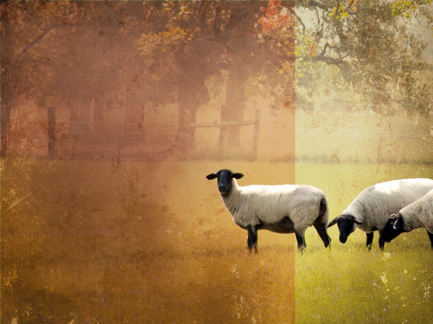
Of all the animals in God’s creation, the Lord refers to us as sheep
Sheep do not defend themselves
Sheep can wander off
Sheep get scared
Sheep need a someone to help them

Slide 8
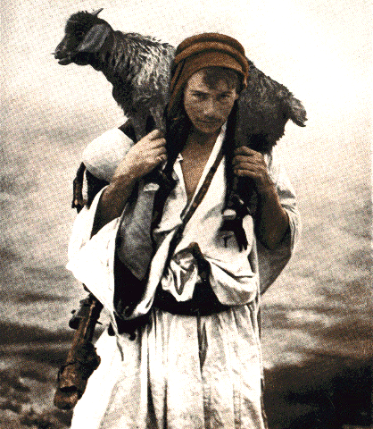
Acts 20:28 Be on guard for yourselves and for all the flock, among which the Holy Spirit has made you overseers, to shepherd the church of God which He purchased with His own blood.
This is a Divine appointment
It involves working with God’s people
God gave His life for these people

Slide 9
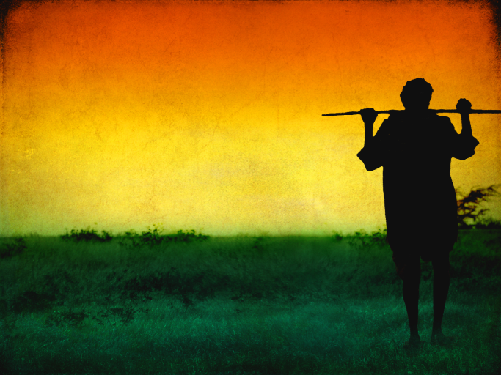
1 Peter 5:2 shepherd the flock of God among you, exercising oversight not under compulsion, but voluntarily, according to the will of God; and not for sordid gain, but with eagerness;

Slide 10
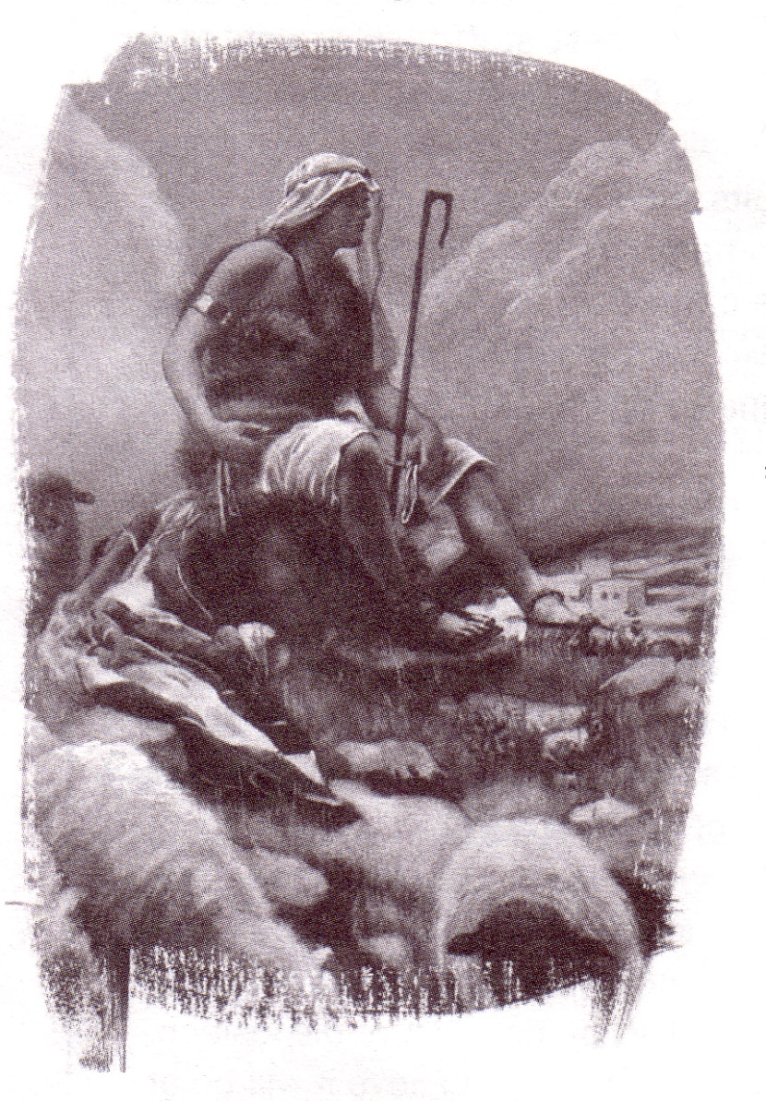
Psalm 78:70-72 He also chose David His servant and took him from the sheepfolds; From the care of the ewes with suckling lambs He brought him to shepherd Jacob His people, and Israel His inheritance. So he shepherded them according to the integrity of his heart, and guided them with his skillful hands.

Slide 11
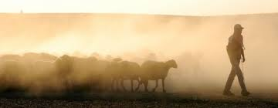
John 10:2-4 But he who enters by the door is a shepherd of the sheep. To him the doorkeeper opens, and the sheep hear his voice, and he calls his own sheep by name and leads them out. When he puts forth all his own, he goes ahead of them, and the sheep follow him because they know his voice.

Slide 12
Four passages:
Ezekiel 34; Psalms 23; Proverbs 27 and Acts 6

Slide 13
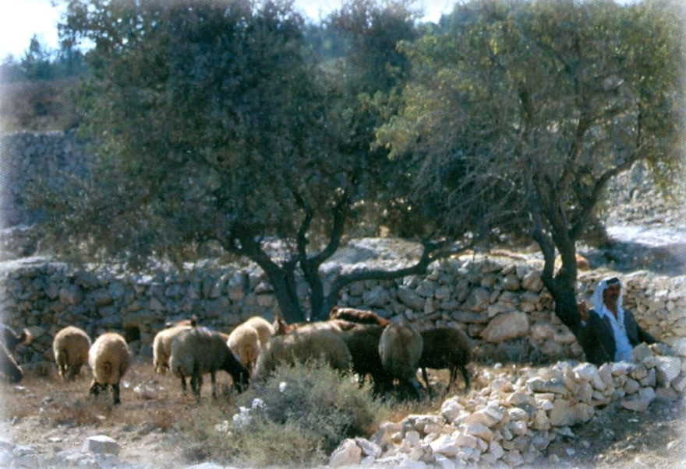
There has been a shift away from the Biblical pattern to a business concept in the past few generations

Slide 14
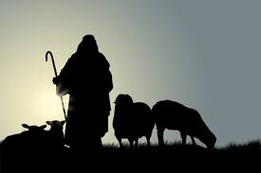
The thrust of many elders has shifted from shepherding to overseeing the complex
Decision Making (mostly physical)
Administration
Money
Focus of overseeing
Deacons
Building
Schedules
Maintenance

Slide 15
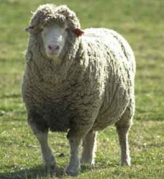
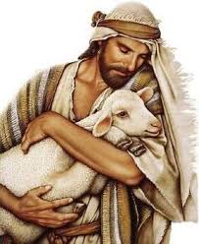
Ezekiel 34:2-10
Feed the flock (2, 3)
Strengthen the sickly (4)
Heal the diseased (4)
Bind up the broken (4)
Bring back the scattered (4)
Seek the lost (4)

Slide 16
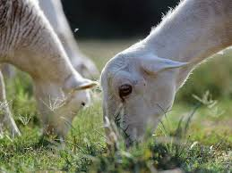
Their attitudes and manner
were wrong
Force, severity and dominance (4)

Slide 17
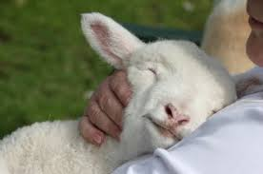
1 Thessalonians 5:14 We urge you, brethren, admonish the unruly, encourage the fainthearted, help the weak, be patient with everyone.

Slide 18
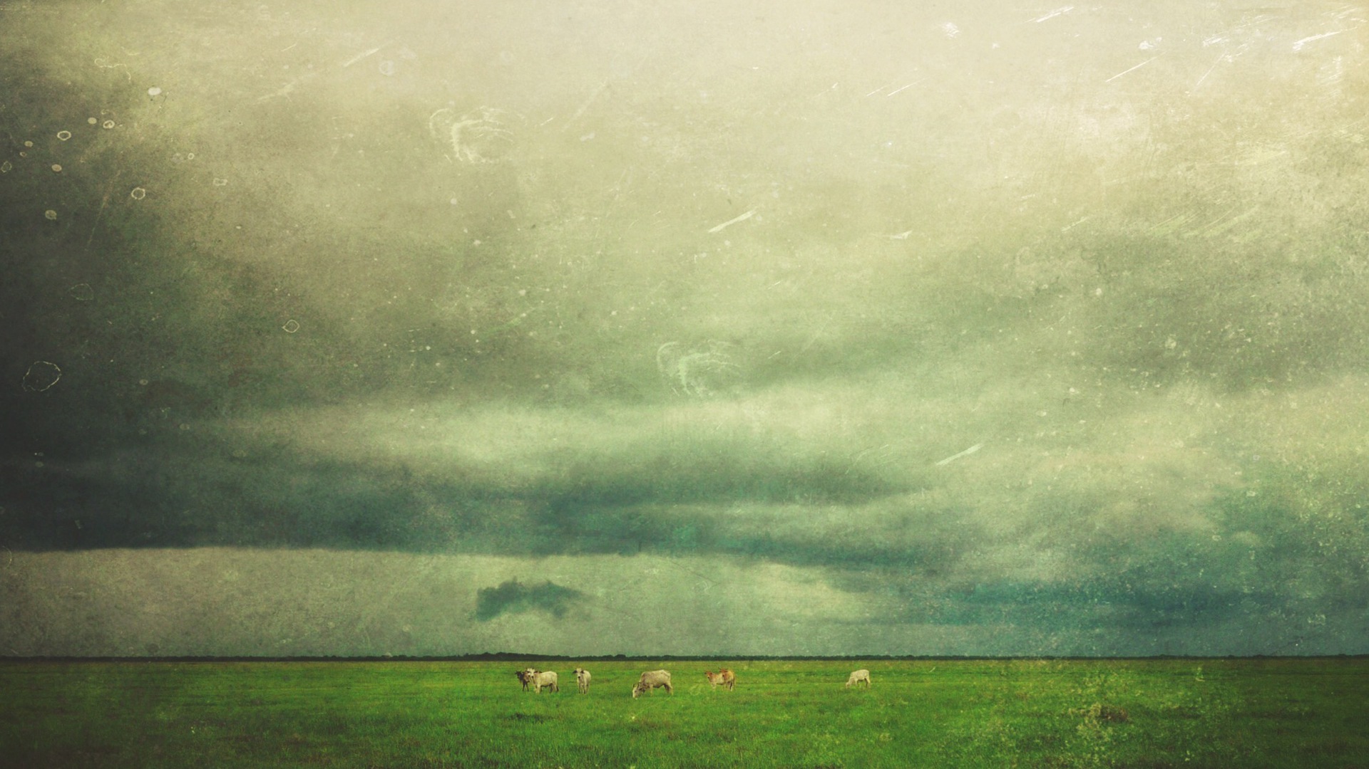
Proverbs 27:23 Know well the condition of your flocks, And pay attention to your herds

Slide 19
The LORD is my shepherd, I shall not want.² He makes me lie down in green pastures; He leads me beside quiet waters.³ He restores my soul; He guides me in the paths of righteousness for His name’s sake.⁴ Even though I walk through the valley of the shadow of death, I fear no evil, for You are with me; Your rod and Your staff, they comfort me.

Slide 20
⁵ You prepare a table before me in the presence of my enemies You have anointed my head with oil; My cup overflows. ⁶ Surely goodness and lovingkindness will follow me all the days of my life, And I will dwell in the house of the LORD forever.

Slide 21
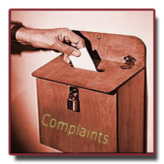
Acts 6:1-4
1. The apostles did not ignore the complaint
2. The apostles did not decide who was going to fix this problem
3. The apostles didn’t tell the chosen ones what to do

Slide 22
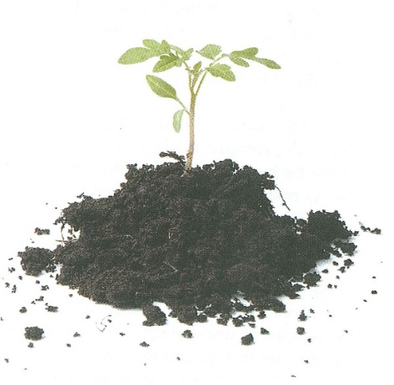
All living things will grow if three things take place
(a) Proper diet
(b) Regular exercise
(c) Fight diseases

Slide 23
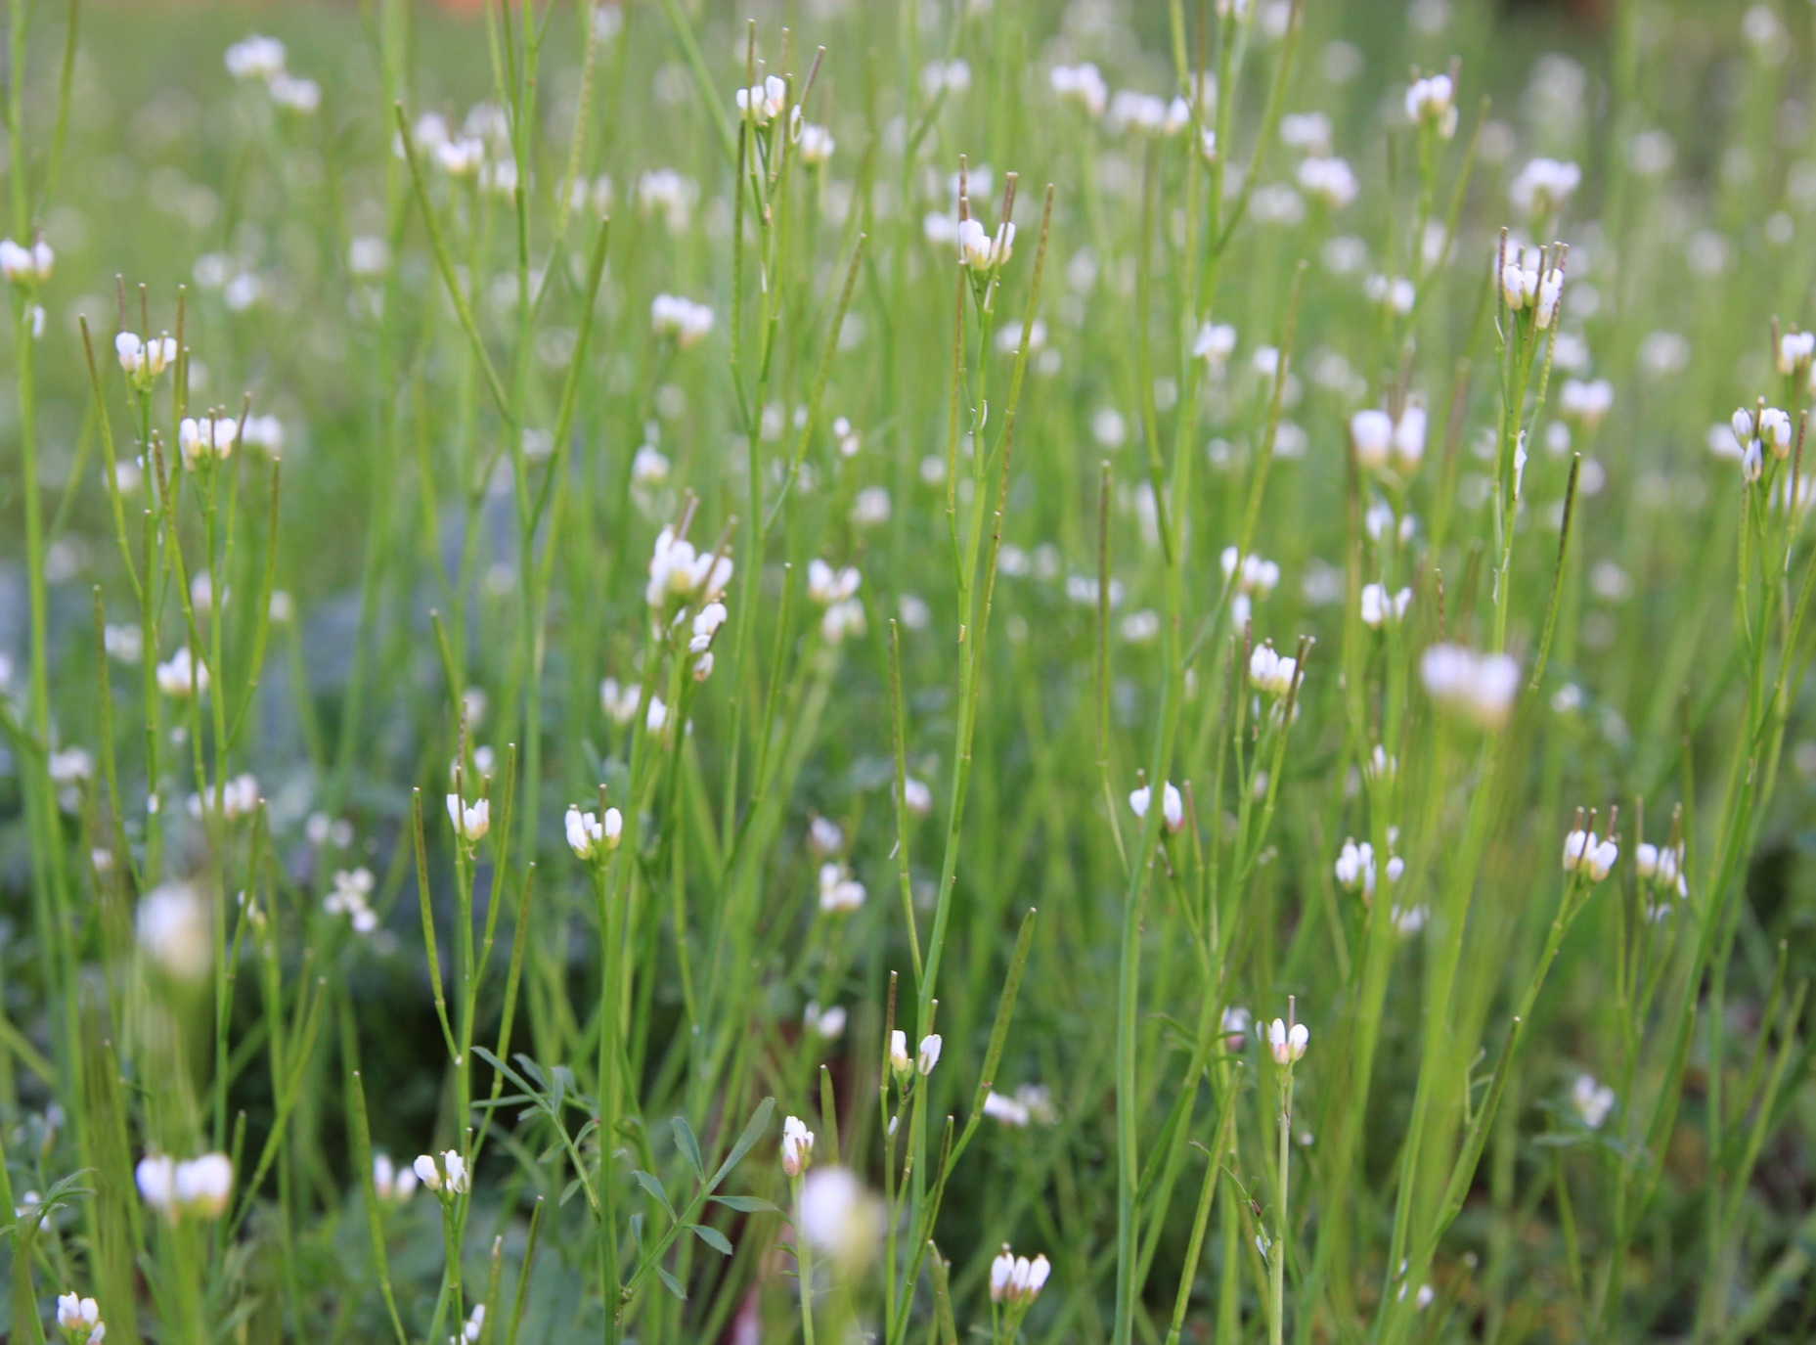
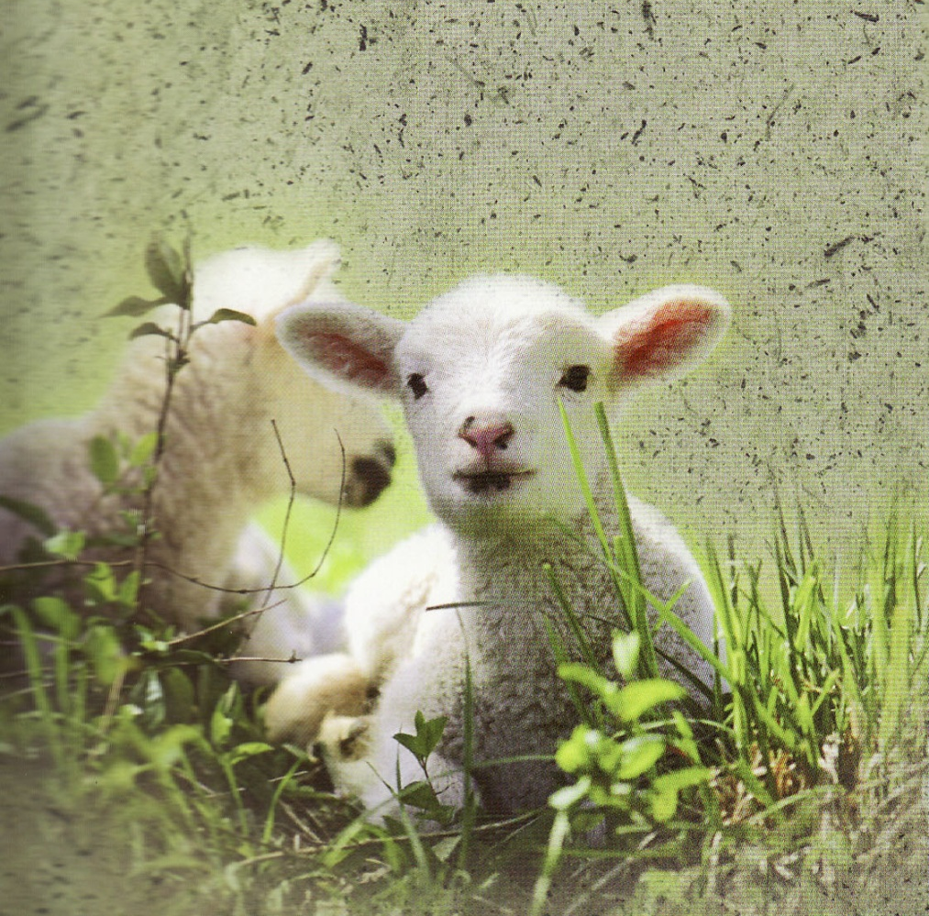
It means keeping both eyes open
It means dealing with complaints
It means getting messy with problems
It means being calm when others are fearful
It means knowing what to do when others are doubting
It means having a plan and knowing how to accomplish that plan

Slide 24
It means praying and staying close to the book
It means having the heart of a servant

Slide 25
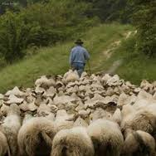
Matthew 9:36 Seeing the people, He felt compassion for them, because they were distressed and dispirited like sheep without a shepherd.

Slide 26
The Concept of Shepherding

