Slide 2
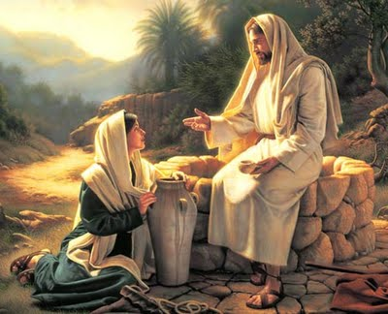
Exhausted, But Not Too Tired:
Lessons for Us
from Jesus
and the Woman at the Well
John 4:1-42

Slide 3
Exhausted, But Not Too Tired
Background Information / Setting
Jesus was totally exhausted, v.6.
He had spent months wrestling with enthusiastic crowds in Judea who were eager for miracles, but mostly ignorant of the eternal truths He attempted to teach them, cf. 2:14-22,23-25.
He did not trust (rightfully so) the Pharisees regarding His own growing popularity, and departed again for Galilee, vv.1-3.

Slide 4
Exhausted, But Not Too Tired
Background Information / Setting
From Jerusalem to Sychar was about a 30 mile walk, and it was noon, vv.4-6.
Plus, the arrest of John the Baptist by Herod surely weighed heavily on His mind, cf. Matt.4:12.
He is trying teach and save the world from eternal damnation, but they’re seemingly more worried about food, signs, and money, vv.8,31,33; cf.2:14-18!
He surely was exhausted…and lonely.*
Notes:
*With John arrested, and His disciples not really understanding what He was trying to accomplish, and the crowds clamoring for signs and miracles, He surely felt alone….all alone!

Slide 5
Exhausted, But Not Too Tired
The Story
Jesus asked a Samaritan woman for water from the well, vv.7-8,11a.
She was shocked that He even spoke to her, given the Jews hatred of Samaritans, v.9; cf. 2Kings 17:24-33,41; Neh.4:1-2.
Now stop and think for a moment- put yourself in Jesus’ place…

Slide 6
Exhausted, But Not Too Tired
Would You, in Similar Circumstance:
Just have wanted a simple drink and to be left alone to rest?
Have thought and said to yourself, “Please don’t let this woman be a ‘talker’- I’m too tired, and she has no idea what I’ve been through, and what I still have to endure!”?
Let your ‘personal problems’ supersede your love for and desire to save lost souls, cf. Phil.2:3-5; Matt.16:26; Mark 6:34?
If you’re like me, probably so- but Jesus was instead planning how to use the circumstances to lead into and teach her about salvation, vv.10-14.

Slide 7
Exhausted, But Not Too Tired
Would You, in Similar Circumstance:
If you had the knowledge that Jesus did regarding her, cf. vv.16-18, still perceived and pursued her as a prospect for salvation? After all, she certainly wasn’t looking for it, v.15!
Have patiently listened to and graciously and truthfully answered her questions, or been dismissive, vv.19-24?
Have “preached Jesus” to her, or just answered what she asked, and drank your water, vv.25-26; cf. Acts 8:31-35?

Slide 8
Exhausted, But Not Too Tired
But because He was not too tired or impatient or self-absorbed or bigoted, look what happened:
She went into the city and told others, vv.28-29;
They came and believed in Him- first because of her testimony, v.39;
And then because of His word, vv.41-42!

Slide 9
Exhausted, But Not Too Tired
Lessons for Us:
Opportunity doesn’t always knock. Sometimes you have to look for it- even in what might seem to be unlikely places, v.10; cf. Matt.9:10-13.
Opportunity also doesn’t usually come when it’s convenient and we’re well-rested, well-fed, and have nothing better to do, vv.35-38; Luke 19:10.
Doing the right thing(s) even when you “don’t feel like it,” or are “just too tired,” has regenerative power for the doer as well as the recipient, vv.32-34!
Opportunities are usually short-lived, v.43;
But often have a chain-reaction effect, v.39.

