Slide 2
From the beginning of their existence as a nation, God commanded Israel:
“You shall have no other gods before (or besides) Me,” Ex.20:3; and,
“You shall not make for yourself an idol (or graven image), or any likeness of what is in heaven above or on earth beneath or the in the water under the earth. You shall not worship them or serve them; for I the Lord your God, am a jealous God” Ex.20:4-5.

Slide 3
But idolatry was in their ancestry...
Abraham, their progenitor, came from a family of idolaters, Josh.24:2-3;
Rachel, one of the wives of Jacob (from these idolatrous relatives), stole her father’s “household idols” to take with her back to Canaan, Gen.31:17-19,30;
Jacob later purged his household of these “foreign gods” before he worshipped at Bethel and his name was changed to “Israel,” Gen.35:1-4.

Slide 4
So,
Even after God had freed this new nation He had formed from Abraham’s family from Egyptian bondage (cf. Gen.15:13 and Ex.12:37-40),
It didn’t take them long for them to return to their idolatrous past- undoubtedly influenced also by the very idolatrous Egyptians, Ex.32.
Idolatry remained a problem throughout Jewish history, and certainly in Gentile history as well, cf. Acts 17:16ff.

Slide 5
But,
Is it really any better today?
Even among God’s people, do we not have our own household idols- inherited, borrowed, or stolen from our “fathers,” or more recently “created” for our own use and worship?
Think about some of OUR “gods”...

Slide 6
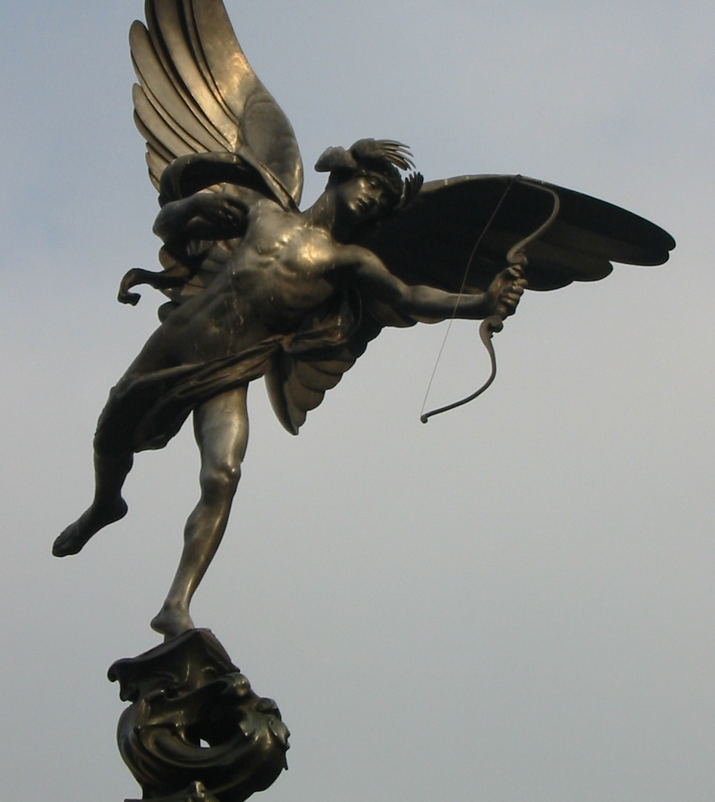
Modern Idolatry
Eros- the god of sexuality
Evidence of our devotion to this god is everywhere:
Everything is sold with sex.
Pornography undermines and corrupts our (young and old) concepts of sex and love.
Immodest clothing and attitudes promote lust, 1Tim.2:9; 1Pet.3:3-4;
Young girls dress and act like prostitutes, and old men take drugs to maintain their virility to the grave.
Sex has its proper place (Heb.13:4; 1Cor.7:1-5), but our obsession has made it a god!
Angel of Christian Charity, “Eros” Piccadilly Circle, London

Slide 7


Modern Idolatry
Pleasuros- the god of fun and entertainment
There is nothing inherently wrong with wholesome recreation and entertainment. God intended for us to enjoy life and its pleasures.
No fair reading of Ecclesiastes, Song of Solomon, or Proverbs suggests otherwise.
But we have turned what should be the dessert into the whole meal! Prov.21:17
Everything from work to school to worship now has to be “fun,” or is rejected. Phil.3:19
We have to be “entertained” full-time. 2Tim.3:4
Angel of Christian Charity, “Eros” Piccadilly Circle, London

Slide 8

Modern Idolatry
Opinionitus- the god of opinions
“Opinions are like noses in that pretty much everyone has one- but it’s where you stick ‘em that counts!”
A.k.a. “Intellectus”- the false god that convinces us that our opinions are intelligent, factual, or relevant, Jer.10:23.
Opinions are not the problem, it is the notion that they must always be shared, Prov.18:2.
We have become like Elihu- who first restrained, but ultimately could not contain his opinions, Job 32:17-20.

Slide 9


Modern Idolatry
Gossipos- the god of gossip
Gossip, in its truest sense, is simply talking/hearing things that shouldn’t be to or heard- let alone repeated.
This false god owes its success to the insatiable appetite of “telling or hearing something new,” Acts 17:21.
Though 1Tim.5:13-15 links the tendency to younger widows, it is certainly not so limited by age OR gender!
Notice its company in Rom.1:28-32.
Those who engage in gossip (hearing or telling) are surely to become its object!

Slide 10
Conclusions:
There are surely many other false gods and idolatrous worship practices that could be listed-but we must avoid them all!
Instead, let’s heed the wise counsel of the inspired apostle Paul in 2Cor.11:3,
“But I am afraid, lest as the serpent deceived Eve by craftiness, your minds should be led astray from the simplicity and purity of devotion to Christ.”
For, “there is salvation in no one else; for there is no other name under heaven that has been given among men, by which we must be saved.” Acts 4:12
Let’s break the pattern and heritage of idolatry!
cf. Acts 7:39 and Heb.10:39

