Slide 2
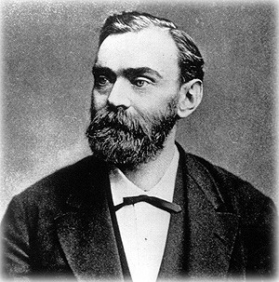
Anyone know this man?
He is the man who, in 1895, instituted the Nobel Prizes in Physics, Chemistry, Physiology or Medicine, Literature, and Peace (first awarded in 1901).
Though he held 355 different patents, he is most famous for one which made it much safer to handle nitroglycerin.
He is the Swedish chemist and engineer Alfred Bernhard Nobel.
He called it “dynamite.”
He discovered that incorporating nitroglycerin in an inert substance like diatomaceous earth made it safer and easier to handle.
Notes:
*Diatomaceous earth is a primarily silica-based (roughly 80%) sedimentary rock formed from a hard-shelled algae. It is has very low density and high porosity, and is used in a variety of products from polishing compounds for metal (and toothpaste) to filtration systems and cat litter.

Slide 3
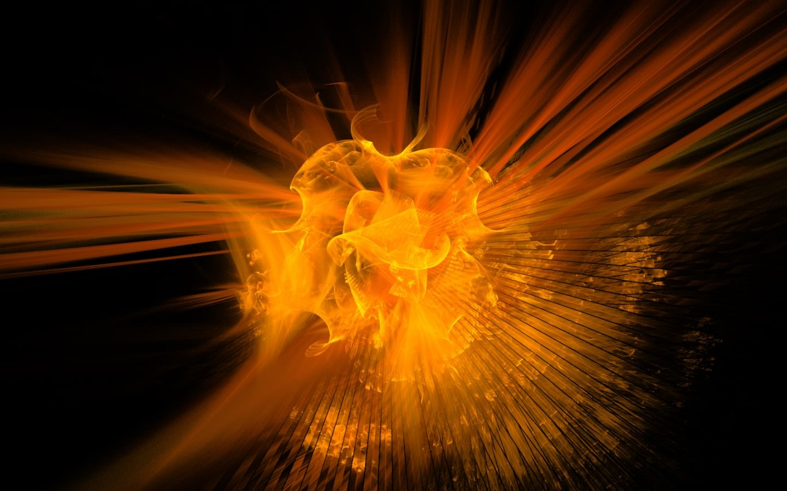
Do you know where Nobel got the name “dynamite”?
It comes from the Latin/Greek dunamis- which means strength, power, ability; inherent power, power residing in a thing by virtue of its nature- Enhanced Strong’s Lexicon
This word is the same one the Holy Spirit chose in Romans 1:16,
“For I am not ashamed of the gospel, for it is the power of God for salvation to everyone who believes, to the Jew first and also to the Greek.”
We need to appreciate the power of the Gospel.

Slide 4
I’d like to ask a favor this morning:
For everyone who can read, get out a Bible and look at the following passages with me:
Matthew 22:29
They didn’t understand the power of God because they didn’t understand the Scriptures.
1Corinthians 1:18
The power of God was/is in the word of the cross.
1Corinthians 1:21-24
The message preached contained the power of God.

Slide 5
(cont.)
1Corinthians 2:4-5
It’s not about the men but the message.
2Corinthians 4:5-7
The men may be dark/dim but the message is light and power.
2Timothy 1:8
Therefore, don’t be ashamed of the testimony of our Lord for the gospel is the power of God.
1Peter 1:5
Our salvation is protected through faith in the power of God.

Slide 6
From this I hope we see,
That the partaking of the Lord’s Supper is vitally important to our memory of and appreciation for the Lord’s sacrifice in our stead, 1Cor.11:23-34,
But isn’t the power of God;
That our singing praises to God and encouragement to one another is vitally important, Heb.13:15; Eph.5:19,
But isn’t the power of God;
That our blending of our hearts and minds together in prayer is vitally important, 1Tim.2:1-3,8,
But isn’t the power of God;
And that the giving of means is vitally important to the work of the Lord, 1Cor.16:1; 2Cor.8-9,
But isn’t the power of God.

Slide 7
Now do you understand why…
Preachers are discouraged and disheartened when about half of those present for the Lord’s Supper on Sunday morning don’t return to hear the message on Sunday evening?
It’s not about his ego, or #s, but the power of God!
Some Elders try to spend roughly 80% of their congregation’s yearly budget on preaching/teaching?
Nice pews, paint, and parking lots may be important, but don’t save people, the power of God does!
The Preacher spends most of his time each week preparing, delivering, and publishing sermons, bible classes, and articles- both in print and on a website?
Visiting sick members and maintaining the facilities are important, but are not the power of God!

Slide 8
Do you also understand why…
The majority of our time in worship is not spent partaking the Lord’s Supper, Singing, or Giving of our means, but in Preaching?
It contains the power of God!
The Elders, the Deacons, the Preacher, and the Teachers always stress the importance of attending Bible Class at every opportunity for both young and old?
These classes are aids in learning and properly applying the power of God!
Why the Elders would spend money to bring in a preacher from 500 or 1000 miles away for a Gospel Meeting for our members and the community?
The answer is to provide additional and special opportunities for the power of God!

Slide 9
Brethren,
It’s all about the power of God!
“For I am not ashamed of the gospel, for it is the power of God for salvation to everyone who believes, to the Jew first and also to the Greek.” Romans 1:16
Our task here at Southport, in addition to being “totally committed” to reading, studying, learning, and applying the power of God both individually and collectively, is to be:
“the pillar and support of the truth.” 1Timothy 3:15.
At these task, we can all do better.
This is why preaching is such a significant part of our worship! Acts 2:41-42; 5:20

