Slide 2
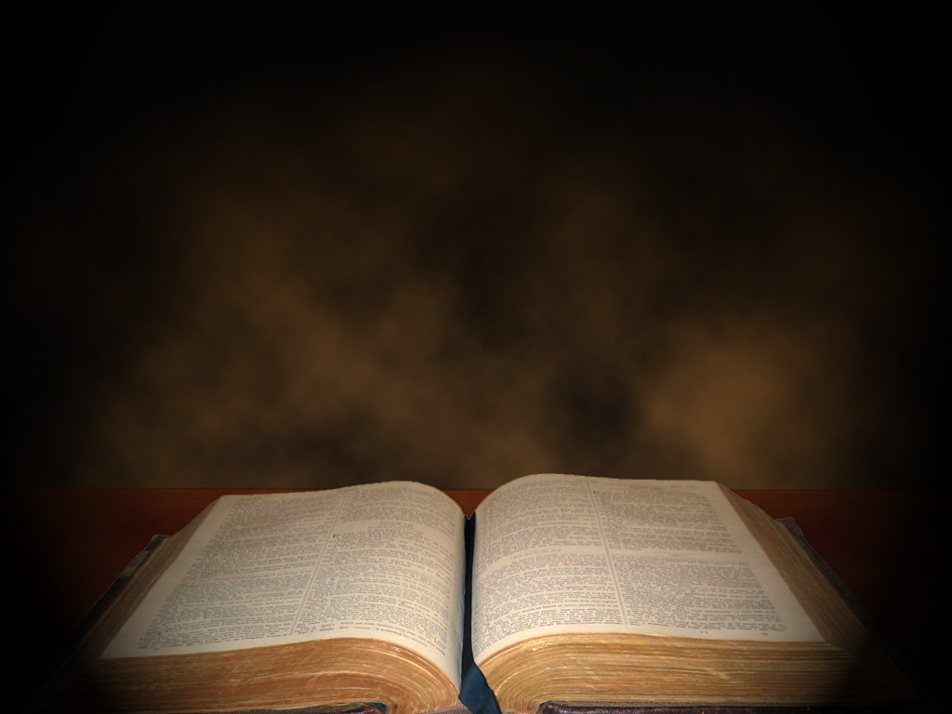
Miracles are not:
Simply happenings unexplainable by man.
Just wondrous events.
Merely exotic occurrences.
The providence of God at work, even if in answer to prayer.

Slide 3
Miracles are:
Extraordinary events that are inexplicable in terms of natural forces, Matt.14:22-33.
Events which cause the observers to postulate a superhuman cause, John 9:30-33.
Events that constitute evidence as a sign with implications much wider than the event itself, John 20:30-31.

Slide 4
The Purposes of Miracles were:
Not to merely effect physical changes, Acts 10:38; but
To confirm His presence or approval, Acts 2:1-21; and
To reveal His word and will, Acts 2:22-36,40.
Isn’t this confirmation what Jesus said would happen in Mark 16:17-18, and for the purpose of revelation as indicated in v.20?

Slide 5
The Purposes of Miracles illustrated in the O.T.
Through the burning bush, Ex.3:1-2
Through the staff/serpent, Ex.4:1-5; 7:1-12
Through the plagues, Ex.7-13
Especially regarding the plagues, consider and understand that…

Slide 6
The Purposes of Miracles illustrated in the O.T.
These plagues were not random- they confirmed and revealed God’s power with implications wider than the event itself. For instance:
Nile turned to blood revealed God’s power over Khnum (guardian of the Nile), Hapi (spirit of the Nile), and Osiris (Nile was bloodstream)
Frogs revealed God’s power over Heqt (god of resurrection in the form of a frog);
Pestilence (Murrain) on Cattle revealed God’s power over Hathor (mother-goddess in cow form), Apis (bull god or Ptah, the symbol of fertility), and Mnevis (the sacred bull of Heliopolis);

Slide 7
The Purposes of Miracles illustrated in the O.T.
These plagues were not random- they confirmed and revealed God’s power with implications wider than the event itself. For instance:
Hail and Locusts revealed God’s power over Nut (sky goddess), Isis (goddess of life), and Seth (protector of crops);
Darkness revealed God’s power over Re, Aten, Atum, and Horus (all sun gods of various sorts);
Death of Firstborn revealed God’s power over Pharaoh (supposed deity incarnate) and Osiris (giver of life).

Slide 8
The Purposes of Miracles illustrated in the O.T.
You see, these were not just random miracles designed to “hit ‘em where it hurts.”
They were extraordinary events that were inexplicable in terms of natural forces, that caused the observers to postulate superhuman causes, and had implications much wider than the event itself.
Through these miraculous signs, God confirmed His presence with and approval of Israel, and revealed His will that Pharaoh should “Let My people go!” in no uncertain terms!

Slide 9
The Purposes of Miracles illustrated in the N.T.
Through the dove and God’s voice at Jesus’ baptism, Matt.3:16-17 (see also John 1:31-34)
Through the transfiguration of Jesus and God’s voice, Matt.17:1-5
Through the signs at the crucifixion, Matt.27:45,51,53,54

Slide 10
So, what should these things mean to us?
Consider:
Jesus opening the eyes of a blind man, John 9:35-41, demonstrates His power over darkness- He is the light of the world, John 1:4-5; 8:12!
Jesus walking on water and calming the sea, Matt.14:24b,30-33, demonstrates His power over the elements and natural world, but also over our storms of life….if we have faith in Him!

Slide 11
So, what should these things mean to us?
Consider:
Jesus casting out demons, Matt.8:28-33, demonstrates His complete power over Satan- He has bound the strong man and is plundering his house, Matt.12:22-29; Heb.2:14-15!
Jesus healing the paralytic, Matt.9:1-6, demonstrates His power over sin and His ability to forgive sins!
These are implications much wider than the events themselves!

Slide 12
So what are the points for us?
We need to understand, define, and use the term “miracle” as God’s word does, rather than as the world understands, defines, and uses it.
We need to understand the spiritual purposes with which God used miracles- and learn from them, rather than seeking a “miracle” in our own lives for some mere physical benefit.

Slide 13
So what are the points for us?
Jesus has the power:
To enlighten you (though blind and living in darkness);
To handle all your storms of life (whatever they may be);
To cast out/aside whatever spiritual obstacles you have or face; and most importantly,
To forgive your sins (no matter how great or many)!

