Slide 2
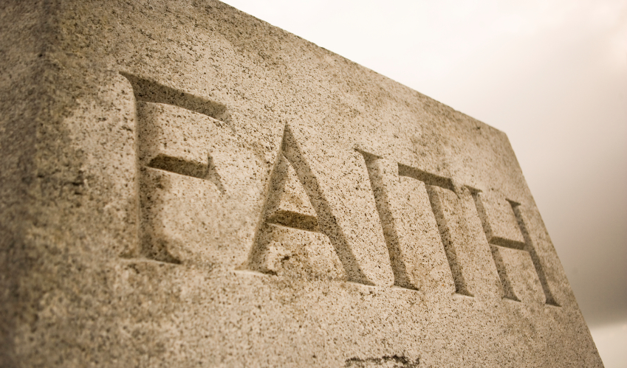
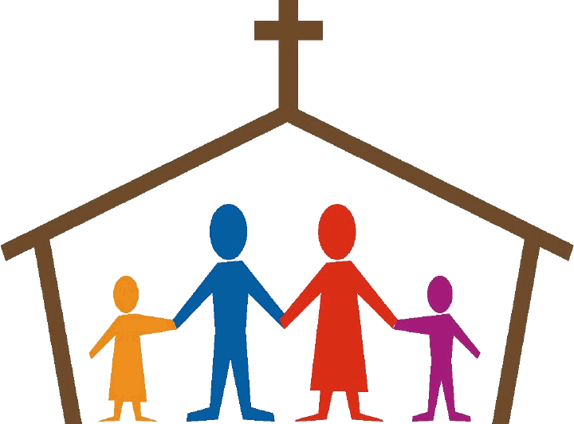
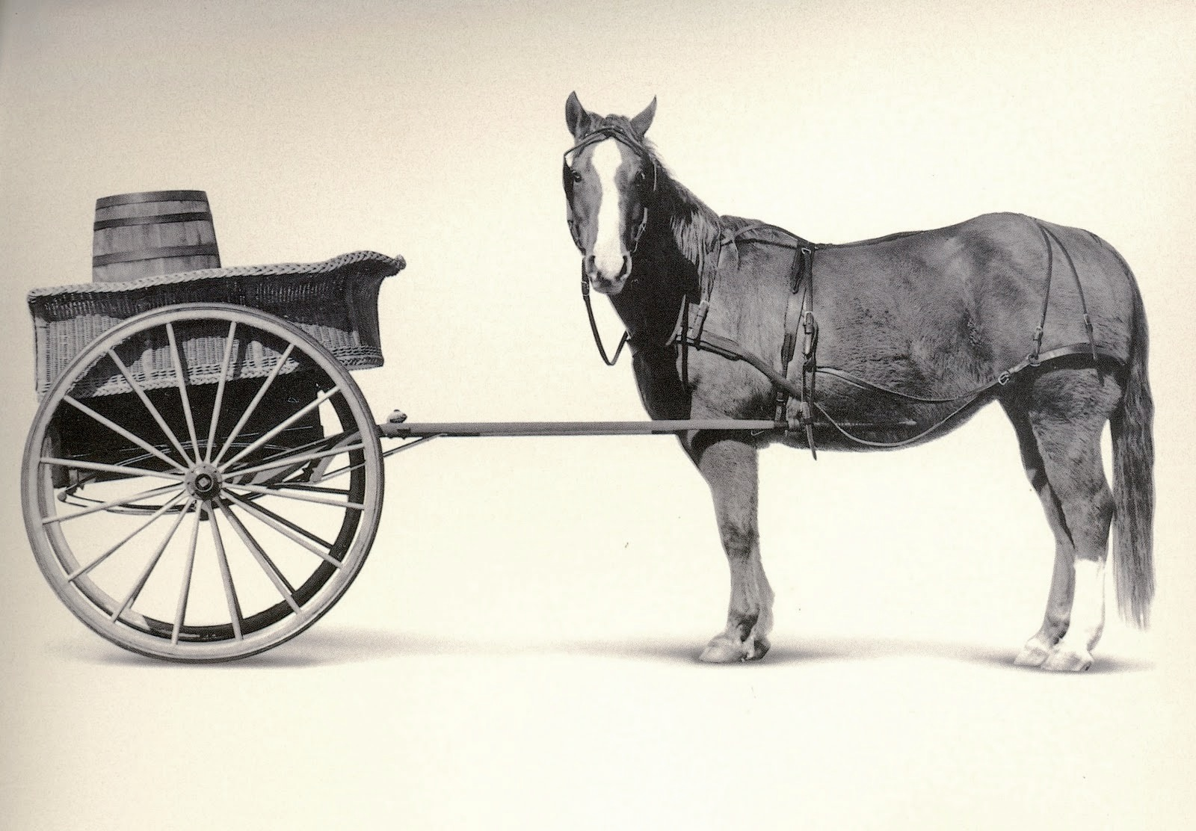
Faith, Fellowship, and Family
For churches,
which is the horse
and
which is the cart?

Slide 3
For churches, which is the horse, and which is the cart?
Faith, Fellowship, and Family
First, let’s be sure we’re all on the same page with regard to the terms being utilized:
By faith, we mean a belief in/of God that comes from both
Natural revelation, Rom.1:20; and,
Specific revelation, Rom.10:17.
But by faith we also refer to that which becomes the modus operandi (mode of operation) for those who believe God, 2Cor.5:7 and Heb.11:6.

Slide 4
For churches, which is the horse, and which is the cart?
Faith, Fellowship, and Family
By fellowship, we mean joint participation and the part which one has by it within a group. But,
Though this is the meaning of koinonia as used in the NT, it is not the common usage today.
The NT uses koinonia 19 times, but always in reference to a shared spiritual relationship, 1John 1:3,6,7; or participation in spiritual works, Rom.15:26-27 and Phil.4:15.
The modern usage of fellowship as “food and fun” is just not what koinonia means in the NT.

Slide 5
For churches, which is the horse, and which is the cart?
Faith, Fellowship, and Family
And by family, we mean husband and wife or husband, wife, and children.
As with faith and fellowship, we don’t get to decide what family means to God or us, 1Pet.4:11.
God set the arrangement for family from the very beginning, Gen.1:26-28; 2:23-24.
But family also means kinship, belonging, and care, Matt.12:46-50; 1Cor.12:22-27.
Therefore, those who walk by faith, and are thus in fellowship with God, do not attempt to define or create family differently than He does.

Slide 6
For churches, which is the horse, and which is the cart?
Faith, Fellowship, and Family
Now, with our terms faith, fellowship, and family defined, let’s clarify the question of our title.
Virtually all churches (congregations) want to grow, and faith, fellowship, and families are all involved and important.
But,
Which one of them is the horse that pulls the cart containing the other two?
As always, let’s look to the NT for the answer...

Slide 7
For churches, which is the horse, and which is the cart?
Faith, Fellowship, and Family
Why is this so?
Churches correctly motivated to grow want to do so in faith and in number, Acts 16:5.
But those incorrectly motivated seek to grow in number by providing more fellowship (of the modern and misunderstood variety), and
More family-focused atmosphere and activities, and
Then hope faith will follow.
This approach has the cart before the horse!

Slide 8
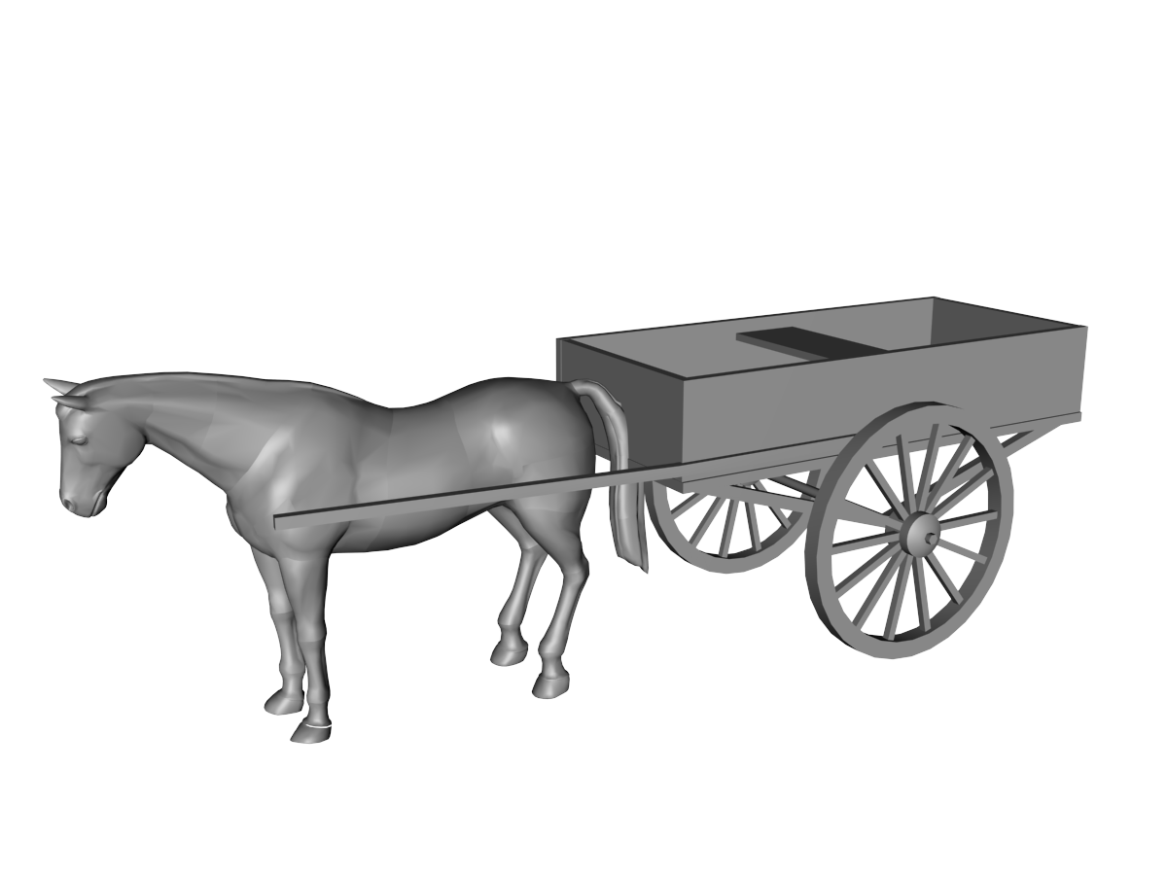
For churches, which is the horse, and which is the cart?
Faith, Fellowship, and Family
Fellowship
Family
Faith
Churches must grow in faith first, Acts 4:4; 5:14; 6:7; 12:24; 16:5; 19:20.
And then true fellowship and family develop from it:
Fellowship came from faith, Acts 2:41-42; 4:32;
and
Family resulted, Acts 2:43-44; 6:1ff; Rom.15:26-27.
So, faith is the horse that pulls the cart of fellowship and family- not the other way around!
Notes:
On the sensing belonging as it relates to “family,” see also 1Cor.3:21-23 and Gal.3:26-29.

Slide 9
For churches, which is the horse, and which is the cart?
Faith, Fellowship, and Family
Fellowship
Family
Faith
So, efforts to grow in the right way, and have true fellowship and a sense of family, must begin with growth in faith by:
Preaching and teaching the Word, 2Tim.4:1-4; 1Tim.4:16; and
Developing and encouraging dedication to it, Acts 20:32; 2Thess.2:13-15.
This will produce genuine faith, and result in true fellowship and a real sense of family.
But if we get the cart of fellowship and family ahead of the horse of faith, we will have members dependent on artificial socializing and physical relationships instead of God’s Word!

Slide 10
For churches, which is the horse, and which is the cart?
Faith, Fellowship, and Family
Fellowship
Family
Faith
Now, there is absolutely nothing wrong with get-togethers and family-oriented activities provided that we understand them in the proper context as:
A private matter instead of a scriptural work of the church, 1Cor.11:22; and,
We allow them to be the result of growth in faith rather than expecting them to be the cause of it.
Our faith in and dedication to the Word of God must be “the tie that binds us together” in fellowship with a sense of family for it is that on which our salvation is based! Rom.10:8-11

