Slide 1
1.

Slide 3
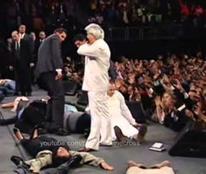
Misunderstanding
is Dangerous
“Full Gospel” Churches

Slide 4
Led to the following PRACTICES:
Misunderstanding
is Dangerous

Slide 5
Led to the following PRACTICES:
Modern-day tongue speaking (Heb 13:8).
Misunderstanding
is Dangerous

Slide 6
Led to the following PRACTICES:
Modern-day tongue speaking (Heb 13:8).
A “Second-blessing” via the baptism of the Holy Spirit upon all believers (Matt 3:11).
Misunderstanding
is Dangerous

Slide 7
Led to the following PRACTICES:
Modern-day tongue speaking (Heb 13:8).
A “Second-blessing” via the baptism of the Holy Spirit upon all believers (Matt 3:11).
Miraculous Divine Healing (Mk 16:18).
Misunderstanding
is Dangerous

Slide 8
Led to the following PRACTICES:
Modern-day tongue speaking (Heb 13:8).
A “Second-blessing” via the baptism of the Holy Spirit upon all believers (Matt 3:11).
Miraculous Divine Healing (Mk 16:18).
High Energy Spontaneous Worship (1 Thess 5:19).
Misunderstanding
is Dangerous

Slide 9
A Neglected
Study

Slide 10
A Neglected
Not a “Motivating” Study
Study

Slide 11
A Neglected
Not a “Motivating” Study
Far Too controversial
“Hot-Button”
Study

Slide 12
A Neglected
Not a “Motivating” Study
Far Too controversial
“Hot-Button”
Study
Instead of 2 Tim 4:2, we hear “testimonies.”

Slide 13
A Neglected
Not a “Motivating” Study
Far Too controversial
“Hot-Button”
Study
Instead of 2 Tim 4:2, we hear “testimonies.”
Rather than Rom 14:11, we get “personal experiences.”

Slide 14
A Neglected
Not a “Motivating” Study
Far Too controversial
“Hot-Button”
Study
Instead of 2 Tim 4:2, we hear “testimonies.”
Rather than Rom 14:11, we get “personal experiences.”
In place of 1 Pet 4:11, preachers are saying “God led me to speak to you about _______”

Slide 16
For in Him dwells all the fullness of the Godhead bodily
Colossians 2:9

Slide 17
Godhead translates theotes: Thayer: “deity i.e., the state of being God” (pg. 288).
Variations of theotes are found in Acts 17:29 (theion, Divine Nature, NKJ) and Rom 1:20 (theiotes, Godhead, NKJ; Divine Nature, NIV).
Each refers to the same majestic One God!
For in Him dwells all the fullness of the Godhead bodily
Colossians 2:9

Slide 18
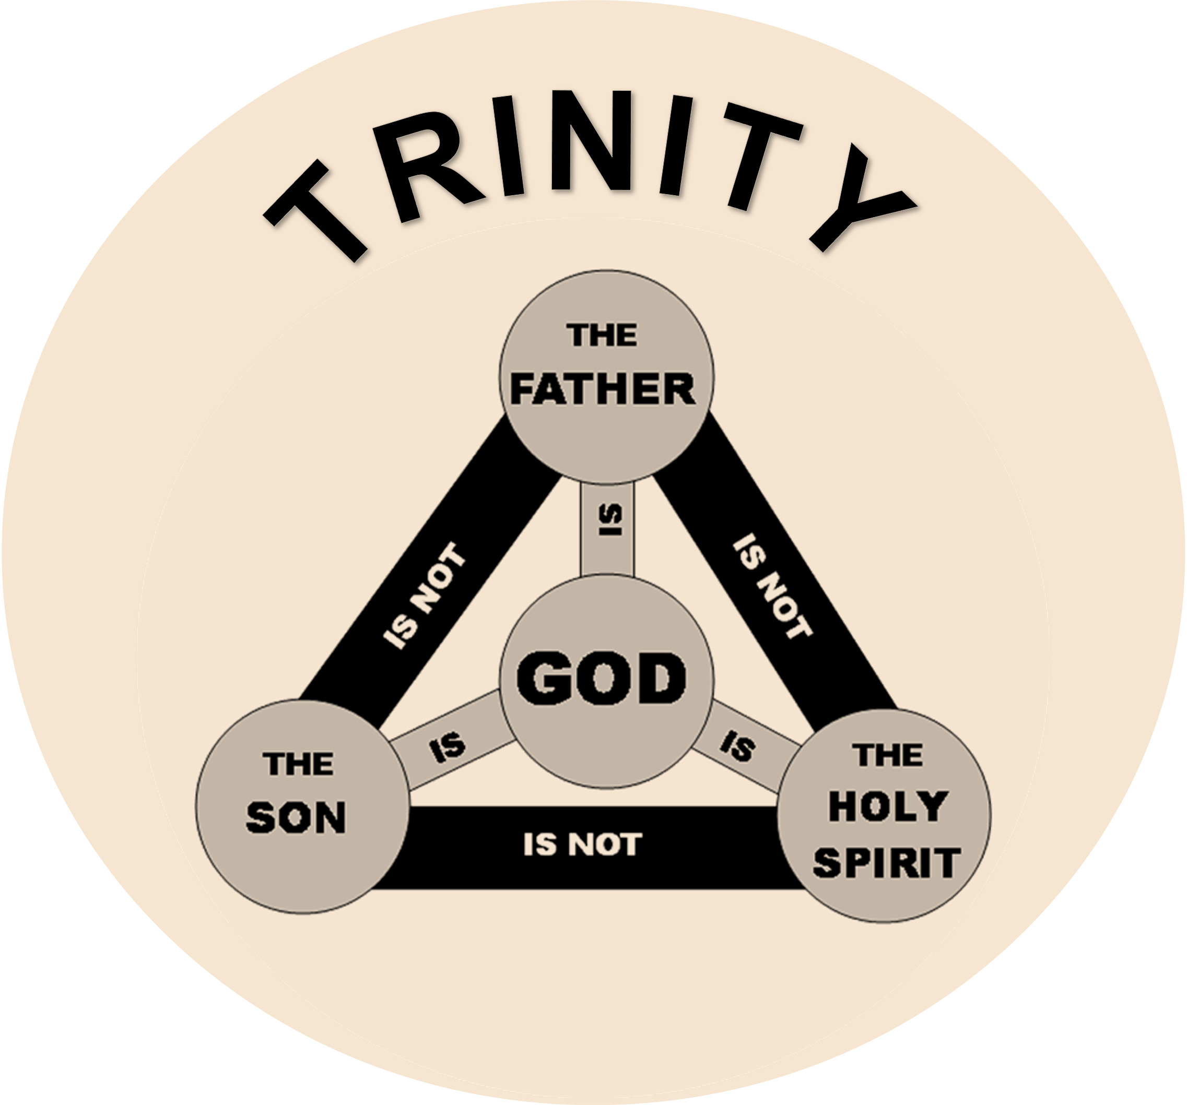
Godhead translates theotes: Thayer: “deity i.e., the state of being God” (pg. 288).
Variations of theotes are found in Acts 17:29 (theion, Divine Nature, NKJ) and Rom 1:20 (theiotes, Godhead, NKJ; Divine Nature, NIV).
Each refers to the same majestic One God!
For in Him dwells all the fullness of the Godhead bodily
Colossians 2:9

Slide 20
But Peter said, Ananias, why has Satan filled your heart to lie to the Holy Spirit and keep back part of the price of the land for yourself? While it remained, was it not your own? And after it was sold, was it not in your own control? Why have you conceived this thing in your heart? You have not lied to men but to God,
(Acts 5:3-4).

Slide 21
Attributes of God

Slide 22
Attributes of God
Holy Spirit is ETERNAL, Heb 9:14.

Slide 23
Attributes of God
Holy Spirit is ETERNAL, Heb 9:14.
Holy Spirit is OMNIPRESENT, Psa 139:7-10.

Slide 24
Attributes of God
Holy Spirit is ETERNAL, Heb 9:14.
Holy Spirit is OMNIPRESENT, Psa 139:7-10.
Holy Spirit is OMNISCIENT, 1 Cor 2:10-

Slide 25
Attributes of God
Holy Spirit is ETERNAL, Heb 9:14.
Holy Spirit is OMNIPRESENT, Psa 139:7-10.
Holy Spirit is OMNISCIENT, 1 Cor 2:10-11.
Holy Spirit is OMNIPOTENT, Gen 1:2.

Slide 26
But the Helper, the Holy Spirit, whom the Father will send in My name, He will teach you all things, and bring to your remembrance all things that I said to you. (John 14:26)

Slide 27
But the Helper, the Holy Spirit, whom the Father will send in My name, He will teach you all things, and bring to your remembrance all things that I said to you. (John 14:26)

Slide 28
But the Helper, the Holy Spirit, whom the Father will send in My name, He will teach you all things, and bring to your remembrance all things that I said to you. (John 14:26)
Has Knowledge, 1 Cor 2:11

Slide 29
But the Helper, the Holy Spirit, whom the Father will send in My name, He will teach you all things, and bring to your remembrance all things that I said to you. (John 14:26)
Has Knowledge, 1 Cor 2:11
Speaks, 1 Tim 4:1

Slide 30
But the Helper, the Holy Spirit, whom the Father will send in My name, He will teach you all things, and bring to your remembrance all things that I said to you. (John 14:26)
Has Knowledge, 1 Cor 2:11
Speaks, 1 Tim 4:1
Wills, 1 Cor 12:11

Slide 31
But the Helper, the Holy Spirit, whom the Father will send in My name, He will teach you all things, and bring to your remembrance all things that I said to you. (John 14:26)
Has Knowledge, 1 Cor 2:11
Speaks, 1 Tim 4:1
Wills, 1 Cor 12:11
Teaches, Jn 14:26

Slide 32
But the Helper, the Holy Spirit, whom the Father will send in My name, He will teach you all things, and bring to your remembrance all things that I said to you. (John 14:26)
Has Knowledge, 1 Cor 2:11
Speaks, 1 Tim 4:1
Wills, 1 Cor 12:11
Teaches, Jn 14:26
Forbids, Acts 16:6

Slide 33
But the Helper, the Holy Spirit, whom the Father will send in My name, He will teach you all things, and bring to your remembrance all things that I said to you. (John 14:26)
Has Knowledge, 1 Cor 2:11
Speaks, 1 Tim 4:1
Wills, 1 Cor 12:11
Teaches, Jn 14:26
Forbids, Acts 16:6
Loves, Rom 15:30

Slide 34
But the Helper, the Holy Spirit, whom the Father will send in My name, He will teach you all things, and bring to your remembrance all things that I said to you. (John 14:26)
Has Knowledge, 1 Cor 2:11
Speaks, 1 Tim 4:1
Wills, 1 Cor 12:11
Teaches, Jn 14:26
Forbids, Acts 16:6
Loves, Rom 15:30
Grieves, Eph 4:30

Slide 35
But the Helper, the Holy Spirit, whom the Father will send in My name, He will teach you all things, and bring to your remembrance all things that I said to you. (John 14:26)
Has Knowledge, 1 Cor 2:11
Speaks, 1 Tim 4:1
Wills, 1 Cor 12:11
Teaches, Jn 14:26
Forbids, Acts 16:6
Loves, Rom 15:30
Grieves, Eph 4:30
Lied to, Acts 5:3

Slide 36
But the Helper, the Holy Spirit, whom the Father will send in My name, He will teach you all things, and bring to your remembrance all things that I said to you. (John 14:26)
Has Knowledge, 1 Cor 2:11
Speaks, 1 Tim 4:1
Wills, 1 Cor 12:11
Teaches, Jn 14:26
Forbids, Acts 16:6
Loves, Rom 15:30
Grieves, Eph 4:30
Lied to, Acts 5:3
Blasphemed, Matt 12:31

Slide 37
But the Helper, the Holy Spirit, whom the Father will send in My name, He will teach you all things, and bring to your remembrance all things that I said to you. (John 14:26)
Has Knowledge, 1 Cor 2:11
Speaks, 1 Tim 4:1
Wills, 1 Cor 12:11
Teaches, Jn 14:26
Forbids, Acts 16:6
Loves, Rom 15:30
Grieves, Eph 4:30
Lied to, Acts 5:3
Blasphemed, Matt 12:31
Resisted, Acts 7:51

