Slide 2
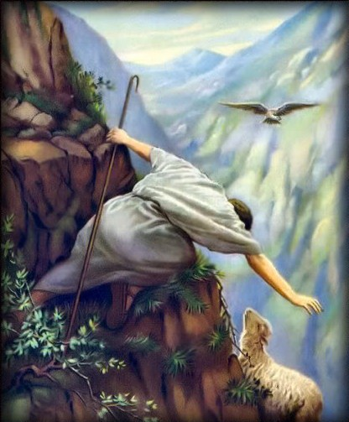
Psalm 23
The Sheep of
Primarily, this is a psalm extolling the provision and protection of the Lord through the metaphor of a Shepherd.
But secondarily, it is also a psalm that demonstrates the need of the sheep for such a Shepherd…
Or shepherds, cf.1Pet.5:1-4

Slide 3
The Sheep of Psalm 23
Thus, without Shepherds, Sheep:
Will want (lack; be in need), v.1
Titus 1:5; 1Tim.3:15
Struggle to find green pastures and quiet waters, v.2
1Tim.1:3-11
May not be restored, v.3a
Luke 15:1-7
Lack guidance in paths of righteousness, v.3b
Acts 14:22-23

Slide 4
The Sheep of Psalm 23
Thus, without Shepherds, Sheep:
Will be fearful, alone, and uncomfortable, v.4
Titus 1:10-16
Lack provision and protection, v.5
John 10:9-15
May become eternally lost and separated, v.6
Acts 20:27-32
Now...

Slide 5
The Sheep of Psalm 23
Conclusions/ Take-Home Points:
Sheep need Shepherds…
we are sheep.
As such, we need (in our case) additional Shepherds that understand and are willing help meet the needs of the sheep.
1Timothy 3:1, aspiring to the office of overseer/shepherd it is a fine work he desires to do… because it needs doing.
Notes:
#3 Additional Note: Aspiring to and desiring the office is not for personal glory or to lord over the sheep; but because he loves the sheep, and wants the best for them. Having the ability but not the love, or the love without the ability does not profit the sheep. Having both but withholding them is selfish and cruel.

