Slide 3
Heaven: what did you expect?

Slide 4
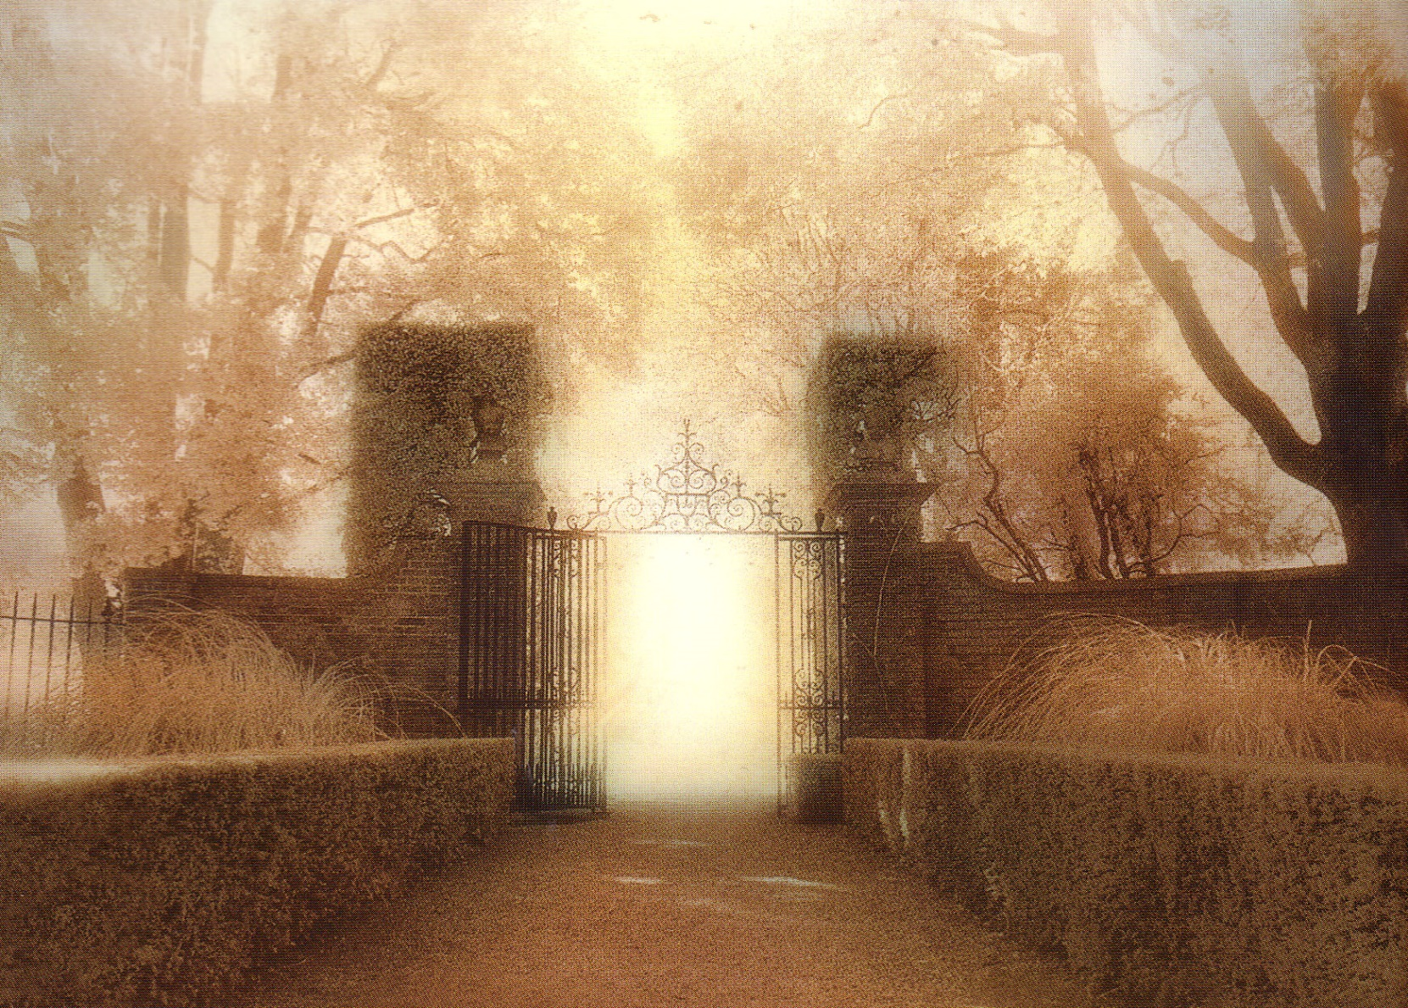
“Come up here and I will show you what must take place after these things.”

Slide 5
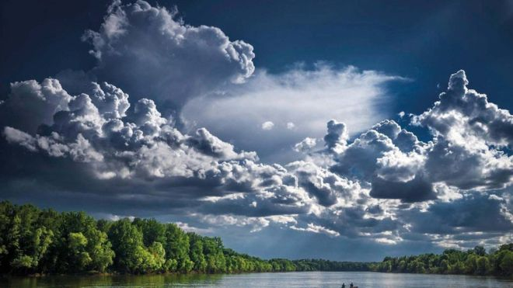
Colossians 3:2 “Set your mind on things above, not on the things that are on earth”

Slide 6
Revelation 4

Slide 7
Ten things you need to know about Heaven
1. Heaven is a real place (Matthew 6:9)
2. Heaven isn’t like earth (Revelation 21:4)
3. Near death experiences are not accurate

Slide 8
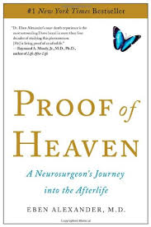
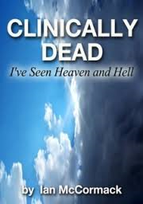

Slide 9
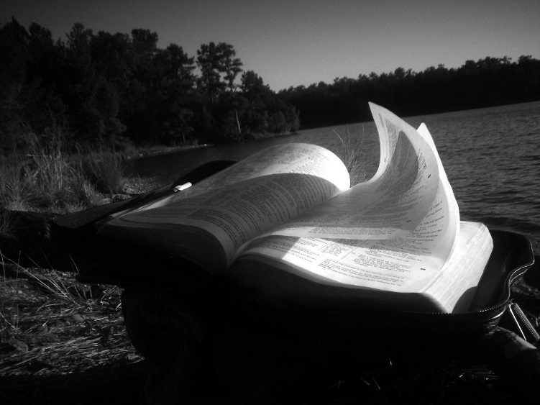
1. What they are saying is inconsistent
2. There is little emphasis upon God
Isaiah 6:1 In the year of King Uzziah’s death I saw the Lord sitting on a throne, lofty and exalted, with the train of His robe filling the temple.

Slide 10
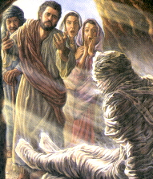
No one resurrected in the Bible ever told their experiences
Paul was not allowed to repeat what he heard
2 Cor 12:4 “was caught up into Paradise and heard inexpressible words, which a man is not permitted to speak”

Slide 11
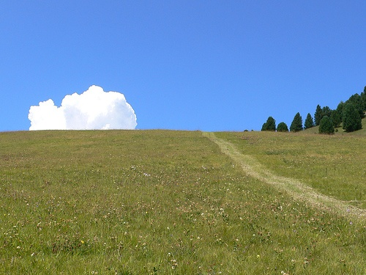
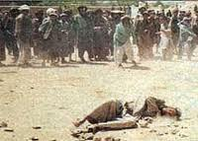
Paul, near death, didn’t reveal anything
Acts 14:19b, 20 “…they stoned Paul and dragged him out of the city, supposing him to be dead. But while the disciples stood around him, he got up and entered the city.”

Slide 12
1. What they are saying is inconsistent
2. There is little emphasis upon God
3. God speaks through Jesus (Heb 1:1-2)

Slide 13
Ten things you need to know about Heaven
1. Heaven is a real place (Matthew 6:9)
2. Heaven isn’t like earth (Revelation 21:4)
3. Near death experiences are not accurate
4. Not everyone goes to Heaven (Mt 7:21-23)
5. We won’t become angels

Slide 14
Ten things you need to know about Heaven
6. We will recognize one another in Heaven (1 Thes 4:17)
7. We will be in a resurrected state (1 Cor 15:51-53)
8. Time stops (2 Pet 3:8)
9. We wont be tempted any more (Rev 20:10)
10. We won’t miss our old lives (Phil 1:21)

Slide 15
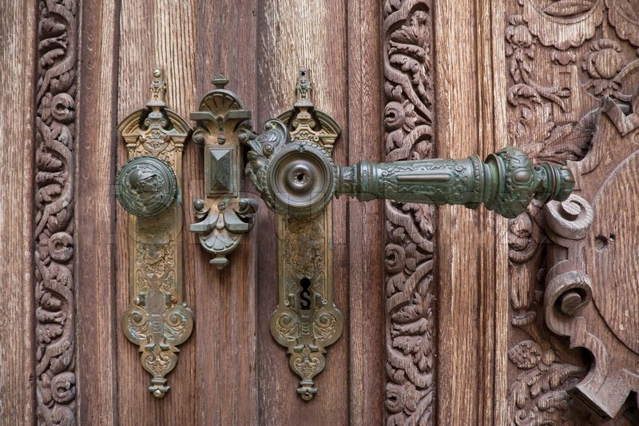
John was shown three things
1. John stood in the presence of God
As the door opens, the emphasis is upon God
Ex 33:18-23

Slide 16
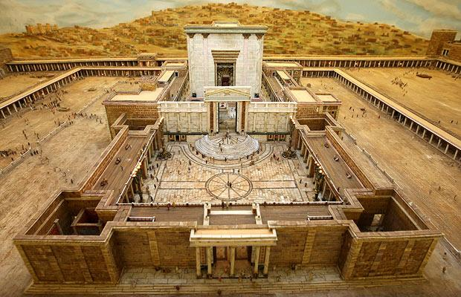
No temple (Rev 21:22)
No separation
No sea (Rev 21:1)

Slide 17
2. John stood in the midst of the best people in the world (Rev 7:9-17)
Their names are in the book of Life
They built their lives upon the rock
They developed a character based upon God
Forgiven by God, they forgive.
Loved by God, they love

Slide 18
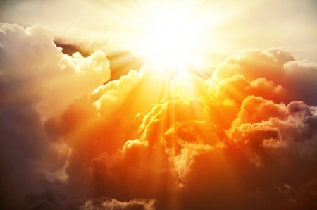
You may be surprised who is there
You may be surprised who is not there

Slide 19
3. John stood in God’s heavenly home
Deut 3:23-27 Moses wanted to go to the promise land

Slide 21
Heaven: what did you expect?

