Slide 2
“Life, the way it was meant to be.”

Slide 3
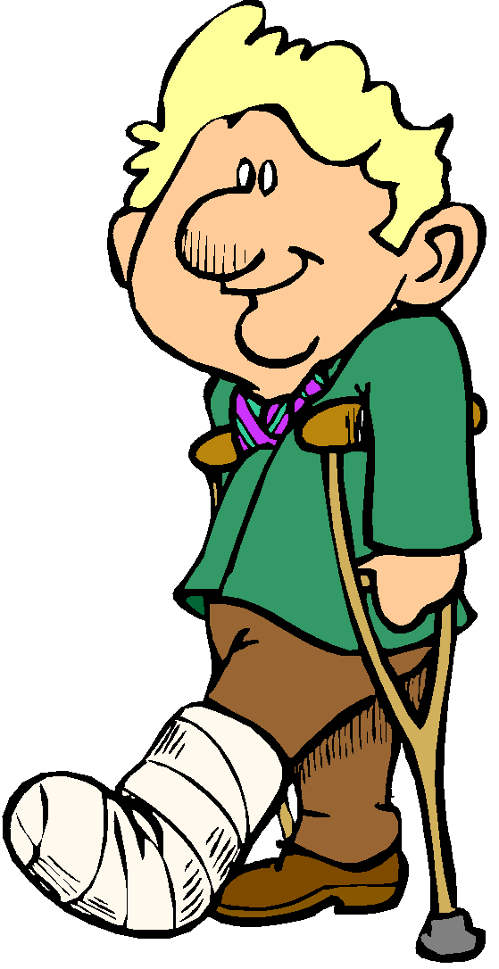
What Christianity looks like when the bottom falls out

Slide 4
Job 14:1 “Man, who is born of woman is short-lived and full of turmoil.”
“…full of trouble” (NIV)

Slide 5
James 1:2-4
1. You will have troubles
2. Troubles come in many forms
3. Good can come from troubles

Slide 6
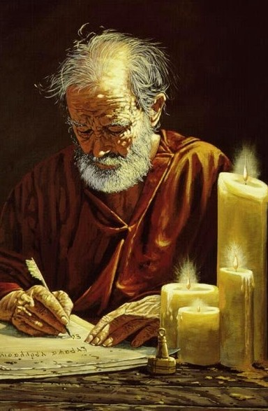
Paul not only knew adversity, he shows us how to handle it
2 Corinthians 4:7-18

Slide 7
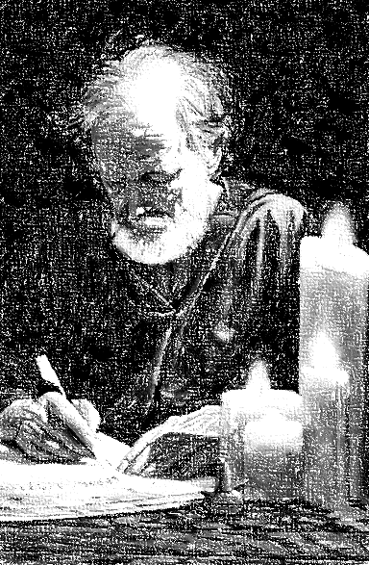
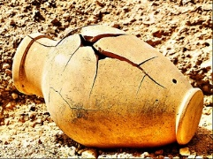
2 Corinthians 4:7-18
We are breakable (7)

Slide 8
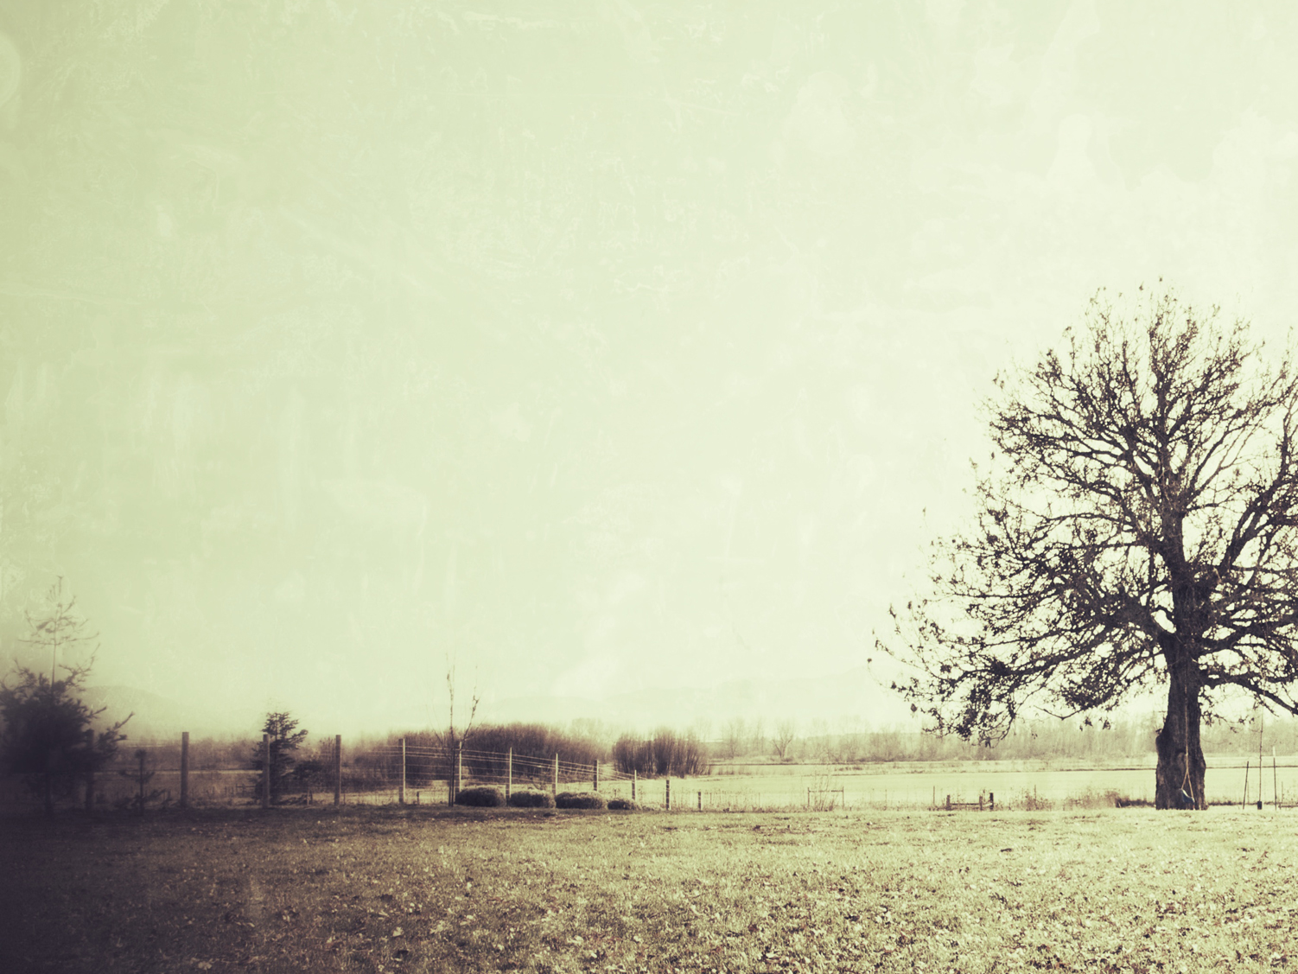
2 Corinthians 4:7-18
We are breakable (7)
We are afflicted in every way (8)
We are perplexed (9)
We are persecuted (9)
We are struck down (9)

Slide 9
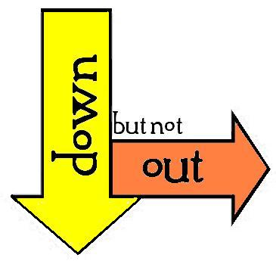
2 Corinthians 4:7-18
Afflicted but not CRUSHED
Perplexed but not DESPAIRING
Persecuted but not FORSAKEN
Struck down but not DESTROYED

Slide 10
What was happening on the outside was not
changing the inside
(A) His heart was founded upon the rock
Matthew 7:25 “And the rain descended, and the floods came, and the winds blew, and burst against that house; and yet it did not fall, for it had been founded upon the rock.”

Slide 11
The Rock is Jesus Christ

Slide 12
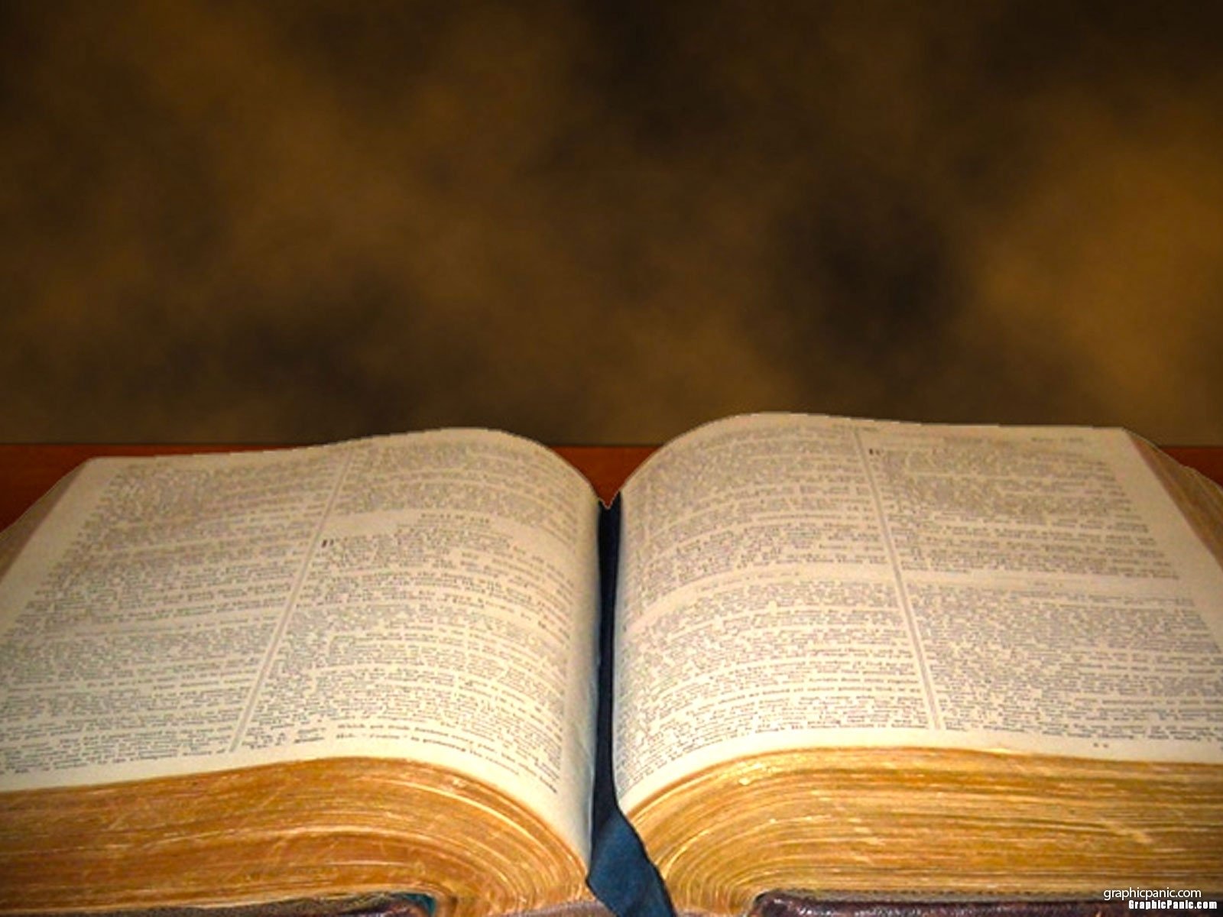
What was happening on the outside was not changing the inside
Psalms 23:4 “Even though I walk through the valley of the shadow of death, I fear no evil; for Thou art with me. Thy rod and Thy staff, they comfort me.”

Slide 13
What was happening on the outside was not changing the inside
Psalms 46:1-2 “God is our refuge and strength, a very present help in trouble. Therefore we will not fear, though the earth should change, and though the mountains slip into the heart of the sea”

Slide 14
What was happening on the outside was not changing the inside
2 Timothy 1:12 “For this reason I also suffer these things, but I am not ashamed; for I know whom I have believed and I am convinced that He is able to guard what I have entrusted to Him until that day.”

Slide 15
What was happening on the outside was not an indication of God’s feelings toward him
(B) His help came from the Lord
“…we are not forsaken” (2 Cor 4:9)
Heb 13:5b “…for He Himself has said, ‘I will never desert you, nor will I ever forsake you,’ so that we confidently say, ‘The Lord is my helper, I will not be afraid. What shall man do to me?’”

Slide 16
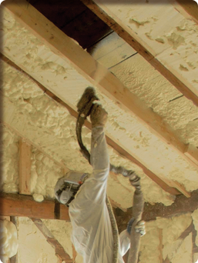
Instead of isolating us from troubles, God insulates us to keep troubles from coming in to our heart

Slide 17
Acts 26:22 “And so, having obtained help from God, I stand to this day testifying both to small and great, stating nothing but what the Prophets and Moses said was going to take place”

Slide 18
2 Tim 4:16-17 “At my first defense no one supported me, but all deserted me; may it not be counted against them. But the Lord stood with me, and strengthened me, in order that through me the proclamation might be fully accomplished, and that all the Gentiles might hear; and I was delivered out of the lion’s mouth.”

Slide 19
What was happening on the outside was not going to stop the incredible work he was doing
(C) His life became better because of these experiences
“For momentary, light affliction is PRODUCING for us an eternal weight of glory” (2 Cor 4:17)

Slide 20
He understood that adversity is God’s classroom
He learned to depend upon the Lord
He learned to be humble
He learned to see the big picture
He understood that God’s kingdom is indestructible

Slide 21
Hebrews 12:28 “Therefore, since we receive a kingdom which cannot be shaken, let us show gratitude, by which we may offer to God an acceptable service with reverence and awe.”
Daniel 2:44 “And in the days of those kings the God of Heaven will set up a kingdom which will never be destroyed, and that kingdom will not be left for another people; it will crush and put an end to all these kingdoms, but it will itself endure forever.”

Slide 22
He understood that adversity is God’s classroom
He understood that God’s kingdom is indestructible
He understood that through adversity, he could help others

Slide 23
What was happening on the outside was not enough to destroy his faith
(D) His future was in the hands of the Lord
“Therefore we do not lose heart…” (2 Cor 4:16)
Adversity is momentary
Heaven is forever

Slide 24
The Lord is counting on you

Slide 25
The journey is worth it

Slide 26
You will be disappointed if you let your troubles win

Slide 27
What Christianity looks like when the bottom falls out

