Slide 2
Hi Ho, Hi Ho, it’s off to work we go!

Slide 3
“Life, the way it was meant to be.”

Slide 4
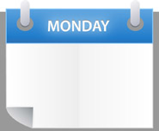
What Christianity looks like on Monday Morning

Slide 5
This topic is important because:
the large volume of time devoted to it
The
Christian
and
Work
If you work 40 hours a week, 50 weeks a year, from the age 22 to 65 = 86,000 hours of your life

Slide 6
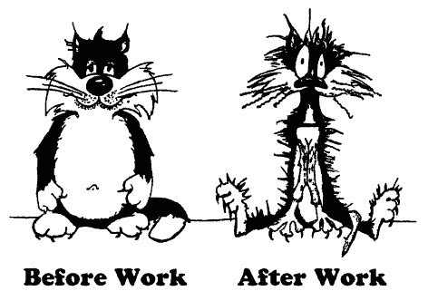
This topic is important because:
Of what it does to us
The
Christian
and
Work

Slide 7
This topic is important because:
Of the redefining nature of work
The
Christian
and
Work

Slide 8
This topic is important because:
We are preparing our children to enter the work force
The
Christian
and
Work

Slide 9
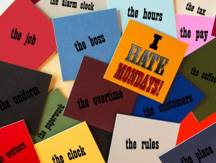
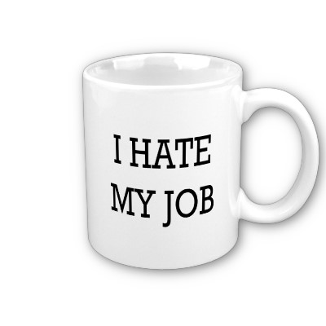
Top Dozen Complaints:
Not respected as a person
Over worked & under paid
Boss is unqualified & never pleased
Not given the right tools
Tired of being lied to
Tired of the drama, politics and favoritism
Don’t feel like you are making a difference
Work is boring
Schedule is not flexible

Slide 10
Top Dozen Complaints:
Company policies are not enforced
Co-workers don’t work
The company doesn’t care about you
“It’s tough to climb the ladder of success, when you are keeping your nose to the grindstone, your shoulder to the wheel, your eye on the ball and your ear to the ground.”

Slide 11
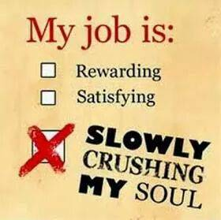
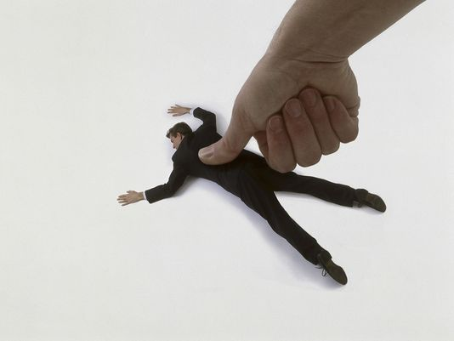
Work has an effect upon the church

Slide 12
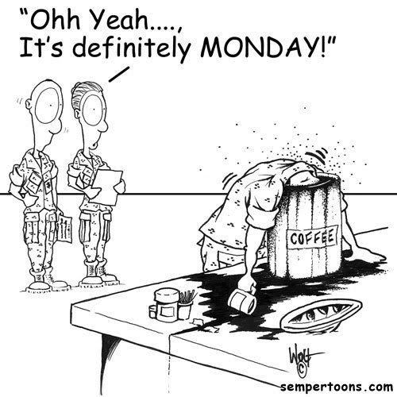
1. God expects us to do our jobs
Work is not punishment

Slide 13
Ephesians 6:5-9
Ephesians 6:5 Slaves, be obedient to those who are your masters according to the flesh, with fear and trembling, in the sincerity of your heart, as to Christ;

Slide 14
Ephesians 6:5-9
Ephesians 4:28 He who steals must steal no longer; but rather he must labor, performing with his own hands what is good, so that he will have something to share with one who has need.

Slide 15
Ephesians 6:5-9
Colossians 3:22 Slaves, in all things obey those who are your masters on earth, not with external service, as those who merely please men, but with sincerity of heart, fearing the Lord.

Slide 16
Work connects us with others
Work brings personal satisfaction
Work is God’s way for us to take care of ourselves

Slide 17
2 Timothy 2:15 Be diligent to present yourself approved to God as a workman who does not need to be ashamed, accurately handling the word of truth.
Matthew 25:21 His master said to him, ‘Well done, good and faithful slave. You were faithful with a few things, I will put you in charge of many things; enter into the joy of your master’

Slide 18
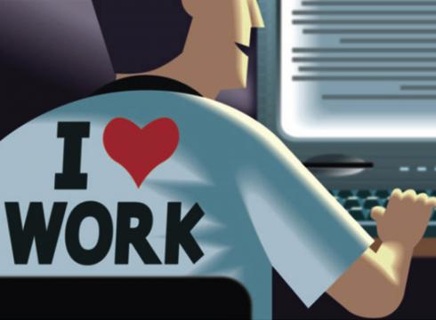
Eph 6:5 sincerity of heart
Eph 6:6 not with eye service
Eph 6:6 as to Christ
Eph 6:6 doing the will of God from the heart

Slide 19
Titus 2:9-10 “Urge bondslaves to be subject to their own masters in everything, to be well-pleasing, not argumentative, not pilfering, but showing all good faith that they may adorn the doctrine of God our Savior in every respect.”

Slide 20
2. God expects our jobs not to do us in
This can happen in a number of ways
By being a workaholic
By being changed by the work environment

Slide 21
Romans 12:1-2 “I urge you therefore, brethren, by the mercies of God, to present your bodies a living and holy sacrifice of worship. And do not be conformed to this world, but be transformed by the renewing of your mind, that you may prove what the will of God is, that which is good and acceptable and perfect.”

Slide 22
Seven Truths about your Attitude
1. The temperature on the outside does not have to be the same on the inside
2. My attitude is the lens of my life
3. Some attitudes are not acceptable
4. I am responsible for my attitude
5. My attitude is influenced by what is around me
6. My attitude shows others what is important
7. My attitude is reflected by my behavior

Slide 23
3. God expects our lives to build bridges to Christ
Our world may be no farther away than the place we work

Slide 24
1 Peter 3:15 but sanctify Christ as Lord in your hearts, always being ready to make a defense to everyone who asks you to give an account for the hope that is in you, yet with gentleness and reverence
Some things to consider:
1. It is tough out there, so pray
2. Make home & worship a restful oasis
3. There may come a time for the sake of your salvation that you must find another job

Slide 25
1 Peter 3:15 but sanctify Christ as Lord in your hearts, always being ready to make a defense to everyone who asks you to give an account for the hope that is in you, yet with gentleness and reverence
Some things to consider:
Don’t let your job ruin your soul
Don’t let your job change your character

Slide 26
1 Peter 3:15 but sanctify Christ as Lord in your hearts, always being ready to make a defense to everyone who asks you to give an account for the hope that is in you, yet with gentleness and reverence
Some things to consider:
4. The good that you do often stays with people longer than you realize.

Slide 27
1 Peter 3:15 but sanctify Christ as Lord in your hearts, always being ready to make a defense to everyone who asks you to give an account for the hope that is in you, yet with gentleness and reverence
Some things to consider:
5. The most important thing is getting to Heaven

Slide 28
“Life, the way it was meant to be.”

