Slide 2
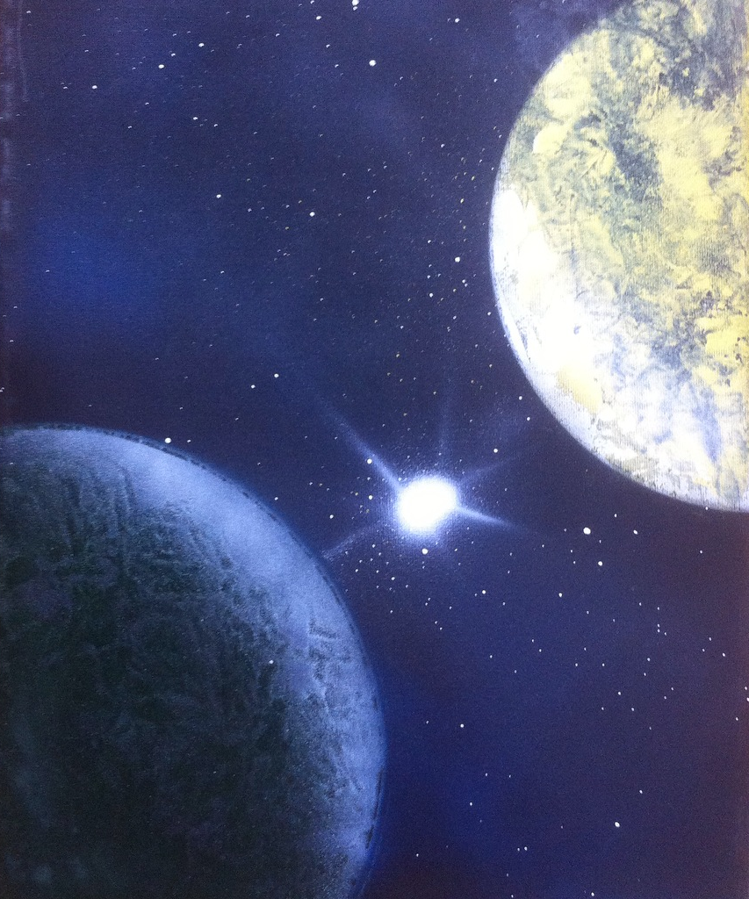
“Everything is supposed to be different than what it is here.”

Slide 3
“Life, the way it was meant to be.”
It’s a joyful life
It’s a life of purpose and meaning

Slide 4
John 10:10 “The thief comes only to steal, and kill, and destroy; I came that they might have life, and might have it abundantly.”

Slide 5
1 Thes 4:1 “Finally then, brethren, we request and exhort you in the Lord Jesus, that, as you received from us instruction as to how you ought to walk and please God (just as you actually do walk), that you may excel still more.”

Slide 6
1 Thes 4:10 “for indeed you do practice it toward all the brethren who are in all Macedonia. But we urge you, brethren, to excel still more.”

Slide 7
Hebrews 6:9 “But, beloved, we are convinced of better things concerning you, and things that accompany salvation, though we are speaking in this way.”

Slide 8
Philemon 21 “Having confidence in your obedience, I write to you, since I know that you will do even more than what I say. “

Slide 9
Genesis 1:27-28
Adam & Eve were the perfect couple living in a perfect world
Adam and Eve were not satisfied

Slide 10
He discredits what God said
He deceives Eve
Genesis 3:1-7
He creates doubt in Eve’s mind
Eve disobeys God

Slide 11
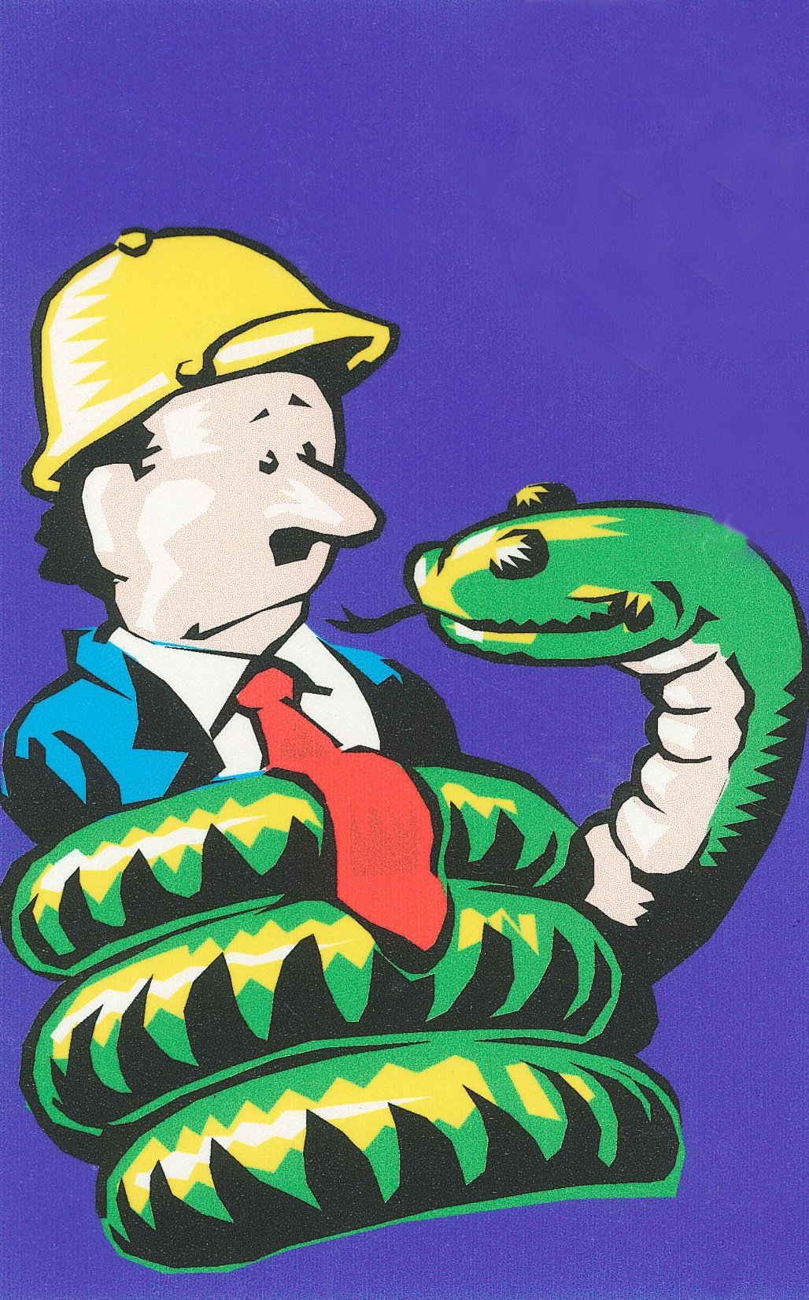
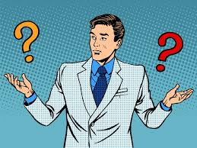
Three questions come out of this
Whose voice will I hear?
Whose will rules my heart?
Who do I trust?

Slide 12
There are many who have never witnessed life as it was meant to be
Never seen forgiveness & grace
Never seen a trusting & thriving marriage
Never seen worship that is meaningful and helpful
Never seen a heart of a servant

Slide 13
Wouldn’t you like to have a marriage the way it was supposed to be?
Wouldn’t you like to raise a family the way it was meant to be?
Wouldn’t you like to have peace of mind the way it was meant to be?

Slide 14
Sin has changed and ruined the life that God intended
missed the mark
Rom 3:23”for all have sinned and fall short of the glory of God”
The “mark” is a life that life that God wants us to hit

Slide 15
Some hide their sin
Some justify their sin
Some run from their sin
What we do with sin reveals whether or not we find that life God intended
Some deny their sin
Some blame others for their sin

Slide 16
God expects you to be
Strong (Eph 6:10)
Faithful (Rev 2:10)
Obedient (Acts 10:35)
A worshipper (John 4:23)
Like Jesus (Rom 8:29)

Slide 17
Life, the way it was meant to be
Life of hope
Beautiful life
Life that pleases God and ends in Heaven
Life of wise choices and spiritually based

Slide 18
“Life, the way it was meant to be.”

