Slide 2
Do we really understand
?
1Corinthians 11:17-34
Notes:
We partake of communion- the Lord’s Supper every Sunday. Some say partaking so often diminishes the significance, or “specialness” of it. Others contend that we need that weekly reminder to keep us focused and motivated. The real answer is not what we say or think, but what Christ said and thinks. While we’ll get to the frequency issue in a moment, think now about the “bigger picture” of the Supper. What is it that Jesus really intended for it to accomplish? Is it about Him, or about us, or both?

Slide 3
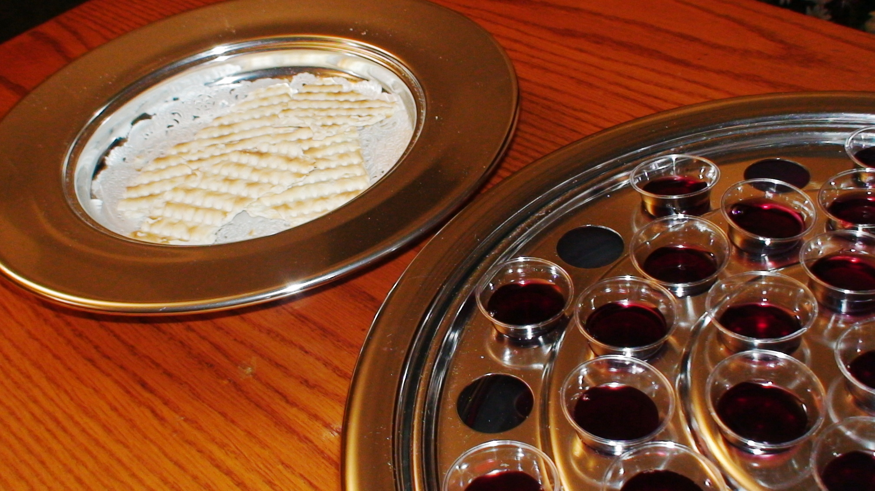
1Corinthians 11:17-34 “Yes,” for the most part, we get the details of it, like…
The what:
Unleavened Bread, vv.23-24
Fruit of the Vine v.25
The when:
On the first day of the week, v.18 → 16:1-2
And on every first day of the week, Acts 20:7 → Ex.20:8
The how:
Worthily and with self-examination, vv.27-28
Notes:
Unleavened Bread because it was instituted during the Jewish Feast of Unleavened Bread, Ex.12:15; and leaven often symbolizes sin, 1Cor.5:6-8;
Fruit of the Vine because that’s what Jesus used and said, Matt.26:29;
Worthily (KJV) and self-examination have to do with the manner of partaking, and in accord with its purpose instead of the condition of one’s soul, otherwise evidently none of the Corinthians could have partaken, cf. 1:10; 3:1ff; 5:1ff; 6:1ff; 11:21-22.

Slide 4
1Corinthians 11:17-34 And, we even get the details of…
The why:
In remembrance of Jesus’ sacrifice, vv.24-25
To proclaim His death until He comes, v.26
But do we truly get the Real Point of the Lord’s Supper?
Notes:
Remembrance: May we never forget the price He paid for us! Cf. 2Pet.1:9.
Proclamation: May we ever proclaim the death of Jesus for the salvation of everyone!

Slide 5
1Corinthians 11:17-34 The Real Point
Is Not:
Some physical concept of fellowship, vv.20-22
Some morbid memorial to the physical pain and suffering of Jesus, v.26
Was and Is:
Spiritual fellowship with God achieved through Jesus’ death, vv.28-32;
Spiritual fellowship with one another through Jesus’s death, vv.33-34.
Notes:
This was the primary problem Paul was addressing to the Corinthians in this text. The Supper had become a physical feast in which they satiated their physical appetites, cf. 3:1ff. While we don’t do the same, we do sometimes desire to use physical “props” to manipulate the hearts and minds of the partakers; e.g. dimming the lights, humming during the partaking, etc. These physical efforts, or the physical desires which prompt them, do not accomplish the spiritual purpose of the Supper.
Though there are benefits to understanding the physical pain and suffering of Jesus on the cross, consider a couple of questions: 1) What shape was the cross? 2) Did it include a peg/seat as was common at the time? 3) Where, exactly were the nails placed (wrists vs. hands; ankles or heels vs. feet)? 4) What size nails were used? You see, the biblical accounts in the Gospels provide none of these details. Why? None of these physical elements was the real point of Jesus’ death, nor should they be the point of spiritual remembrance of it. We can appreciate the physical aspects of His suffering, but such is not really the spiritual point Jesus wants us to remember.

Slide 6
1Corinthians 11:17-34 Take-Home Applications
There is certainly nothing wrong with:
Partaking of the Lord’s Supper on the right day, with the right frequency, with the right emblems, in the right way; or,
Being mindful of the physical pain and suffering Jesus endured on the cross while we partake of the Supper;
But be sure these things don’t prevent:
Our understanding, appreciation, and proclamation of the spiritual fellowship with God and one another that Jesus death allows- which is the real point of the Supper!
Notes:
The Lord’s Supper was instituted without great fanfare by our Lord as a simple, sweet memorial to His sacrifice that allowed the accomplishment of God’s purpose (from before the foundation of the world, Eph.1:3-8a). God desires nothing more than to have fellowship with you eternally. He allows us to have fellowship with one another and be bound together to Him through the death of His Son. Our faithful, mindful, and understanding partaking of this Supper not only strengthens those bounds, it proclaims the benefits of them to all who see (and hopefully motivates them to share in it through their obedience).

