Slide 2
How to Understand the Bible Part 5
From the start of this series, we have tried make the point that the Bible can (and must) be understood!
We’ve tried to provide some keys to help us learn, and to assist others in learning

Slide 3
Keys to Understanding the Bible
Let’s quickly review the keys previously covered:
Get the “Big Picture” (last page first)
The Bible was written “4 us not 2 us”
Remember that “Context is Critical”
It does contain “Figures & Symbols” but it is not all figurative and/or symbolic
It has “Many Writers, One Author” and
We have to “Cut Straight” to get it
All of which brings us to our next key....
Notes:
Salvation through Jesus Christ for all mankind.
There is no letter to the Southport Church of Christ; we must interpret the books of the Bible in light of their original recipients.
“Context” may be one verse above and below; or the paragraph; or the chapter; or everything in the book previous ( Rom.); or everything in the Bible previous (Heb. or Rev)
Assume passage is literal unless context or content dictate otherwise.
40 writers of different cultures, languages, occupations, and times over a span of nearly 1600 years telling a single story without contradiction demand inspiration from God.
Literal of “rightly divide” or “handle accurately”- must follow the lines of division between Old and New, and who is writing to whom and for what purpose.

Slide 4
Keys to Understanding the Bible
#7- Plot the Plot
By this we mean “Plot” (as a verb meaning to mark something on a chart) “the Plot” (as a noun meaning the storyline).
The idea is that if we get the significant events of the storyline in sequential order, we can understand the Bible!
So, let’s see if we can do just that....

Slide 5
Understanding the Bible Key #7- Plotting the Plot The Patriarchal Period
2. Fall of Man & Seed Promise, Gen.3
6. Twelve Sons of Jacob, Gen.22-36
4. Three Promises to Abram: Land, Nation, Seed, Gen.12:1-3
1. Rueben
2. Simeon
3. Levi
4. Judah
9. Issachar
10. Zebulun
5. Dan
6. Naphtali
7. Gad
8. Asher
11. Joseph
12. Benjamin
8. Jacob’s (Israel’s) Family to Egypt, Gen.46-50
by
Leah
1. The Beginning- Creation, Gen.1-2
5. Three Patriarchs: Abraham, Isaac, Jacob, Gen.21-28
by
Bilhah
9. Israel’s Enslavement in Egypt, Ex.1-2
by
Zilpah
3. Destruction of the Flood, Gen.6-9
7. Joseph to & in Egypt, Gen.37-45
by
Rachel
Notes:
The “Beginning” of earth, time, sun & moon, plants & animals, man.
Also the “beginning” of sin- hence the “beginning” of salvation in Gen.3:15, which sets the stage for the rest of the story.
Shows God’s willingness to “destroy” man for disobedience, and His unwillingness to destroy the righteous with the wicked! The concept of salvation “by water” introduced.
God chose Abram to be the patriarch (father) of His nation; promised his descendants the land of Canaan; and promised that through his seed all nations of the earth would be blessed. This passage contains the outline of the rest of the Bible story: Land and Nation promises are the story of the O.T., and the Seed promise is the story of the N.T.
Abraham & Sarah eventually had Isaac; Isaac and Rebekah had Esau & Jacob, but Jacob is the one through whom the story (and its fulfillment) will track.
Jacob wanted to marry Rachel, but was given her older sister Leah first. These two sisters, and their handmaids whom they also gave to Jacob as wives, would become the mothers of 12 sons; from these 12 sons would come the 12 tribes of the nation of Israel. But Judah is the one through whom the story (and its fulfillment in the Seed, Jesus) continues.
The special affection shown to Joseph by his father aroused jealousy amongst his brothers; they sold him into slavery and he wound up in Egypt, but eventually rose to second in command of the land, by God’s blessing of course.
Famine in Canaan (Palestine) forced Jacob, his remaining sons, and their families to move to Egypt. There they lived and were greatly prospered by God, in both wealth and number, for many years.
After Joseph’s death, a Pharaoh arose who “knew not Joseph” (more specifically, a dynastic change occurred, and the new regime chose not to know or honor the promises made to Joseph and his family); the Israelites became slaves in Egypt.

Slide 6
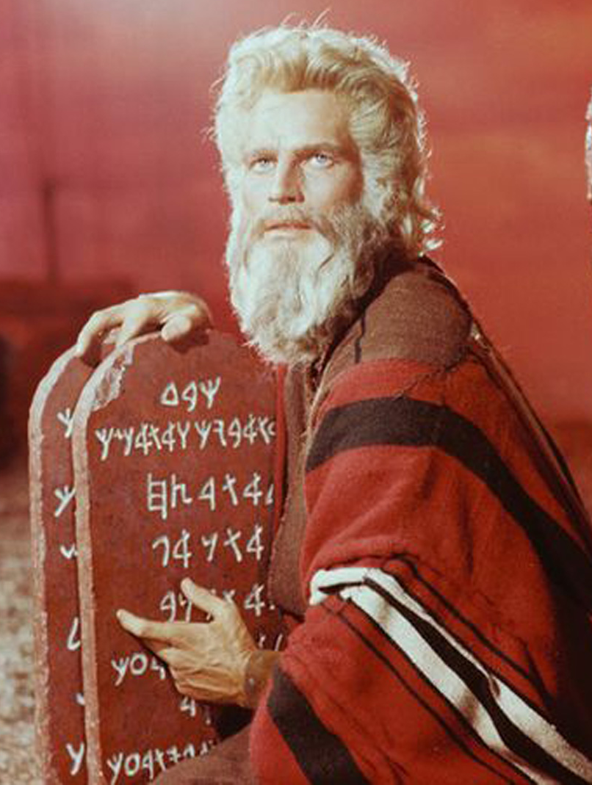
Understanding the Bible Key #7- Plotting the Plot The End of the Patriarchal and Beginning of the Mosaical Period
10. Deliverance: Moses & The Plagues, Ex.3-12
14. Conquest of Canaan, Josh.
12. Wandering in the Wilderness, Num.
16. United Kingdom, 1Sam.- 2Chron.*
Nile turned to blood
Frogs
Gnats (or lice or mosquitoes)
Flies
Pestilence on livestock (murrain)
Boils
Hail
Locusts
Darkness
Death of firstborn
9. Israel’s Enslavement (cont.), Ex.1-2
13. Second Giving of the Law, Deut.
17. Divided Kingdom, 1Sam.- 2Chron.*
11. Giving the Law at Mt. Sinai, Ex.19-40; Lev.
15. Living in the Land, Judges; Ruth
Notes:
God prepared, selected, and sent Moses to deliver Israel from Egyptian bondage. He also prepared and sent Ten Plagues through Moses upon the Egyptians. It is likely that each of these plagues represented power over a specific Egyptian “god”- thus, they are not as randomly strange as we might otherwise suspect.
After Pharaoh first lets Moses and the Israelites go, he then changes his mind and pursues them to the Red Sea where he and his army are drowned by God. Israel then comes to Mt. Sinai where the fledgling nation is given a Law. It takes three elements to constitute a Nation: 1) People (approximately 2.4 million Israelites came out of Egypt); 2: Law (which they received at Sinai); and 3) Place/Land/Country (and they are headed for Canaan!).
Because of a lack of faith and constant murmuring, God caused Israel to wander in the wilderness for 40 years to allow for the death of everyone 20 years old and above to die, Num.14:27-32.
Due to the death of the previous generation to whom the Law was given at Sinai, the Second Law (Deuteros second + nomy law) was given before they entered the land of Canaan.
Moses dies on Mt. Nebo looking over into, but not being allowed to enter, Canaan. Joshua leads Israel into and conquers the land of Canaan, but does not complete destroy the seven nations living there as God commanded. This omission ultimately contributes to Israel’s later idolatry and punishment by God.
The Land of Canaan is divided and settled by the Tribes (derived from Jacob’s 12 sons {Joseph’s two sons replaced he and Levi in the allotment]). They were ruled by Judges whom God selected and appointed, but became dissatisfied with that system and pleaded for “a king like the nations around us.” God through the prophet Samuel warned of the consequences, but granted their petition.
Saul, David, and Solomon ruled the nation of Israel. During Solomon’s reign, heavy taxes were levied and the Temple was built. . *Notes on numbers 16 and 17: The Scripture references are not specific; the range of books given generally covers both the “United” and “Divided Kingdom” periods.
Rehoboam reigned after Solomon’s death, and the kingdom soon split because of his heavy-handed measures and methods. The result was that the two southern tribes constituted “Judah” and were ruled by Rehoboam, while ten northern tribes retained the name “Israel” and were ruled by Jereboam. It is also significant that Jereboam set up alternate places of worship at Dan and Bethel so his northern constituents would not travel to the southern kingdom of Judah to worship as prescribed by the Law (because he feared they would reunite with Rehoboam). This apostasy caused the faithful priests of God to migrate back to the southern kingdom of Judah- which created, in essence, a “spiritual vacuum” in northern kingdom that would eventually usher in their complete apostasy and doom.

Slide 7
Understanding the Bible Key #7- Plotting the Plot The Mosaical Period (continued)
18. Israel’s Apostasy & End, 1 & 2Kings; *
The Inter-Testament Period (overlaps Mosaical and Christian Periods)
20. Judah’s Partial Restoration, +
17. Divided Kingdom (cont.)
21. 400 Years of Silence
19. Judah’s Apostasy & Captivity, **
Notes:
Through a succession of mostly bad and worse (spiritually speaking) kings, the northern kingdom’s apostasy became so complete that God sent the Assyrians to conquer them in 722 B.C. Most of the people were either killed or taken captive to Assyria, and never returned. The few people left behind intermarried with the peoples brought in to settle and occupy the land by the Assyrians and ultimately became known as “Samaritans.” *Specifically, 1Kings 11-22 and 2Kings 1-17; also includes the prophetic works of Joel; Isaiah; Amos; and Micah
While the two southern tribes of “Judah” were certainly more righteous and less idolatrous than their northern neighbors had been, they, too, became so wicked that God likewise punished them with captivity and deportation. The Babylonians destroyed Jerusalem and the Temple in 586 B.C. In ultimately three different deportations, Judah was taken captive to Babylon. ** 1Kings 11-22; 2Kings 1-25; 2Chron.10-36; Jeremiah; Zephaniah; Habakkuk; Daniel; Ezekiel; Esther
Since the Seed promise (of Gen.3:15 and 12:3) still had to be fulfilled through a descendant of Abraham, a “remnant” of Judah was spared. After the prophesied 70 years of Babylonian captivity was fulfilled, this “remnant” of Abraham’s family returned to Jerusalem, rebuilt the Walls and Temple, and began again to worship and serve God. + Ezra; Nehemiah; Haggai; Zechariah; Malachi
From the last prophetic word through Malachi until the arrival of God’s next great prophet, John the Baptist, Judah heard nothing from God.

Slide 8
Understanding the Bible Key #7- Plotting the Plot The End of the Mosaical and Beginning of the Christian Period
22. John the Baptist Prepares the Way, *
26. Church Problems & Solutions, Rom. - Rev.3
24. Jesus’ Death, Burial, & Resurrection, Gospels
21. 400 years of Silence
25. Church Begins & Grows, Acts
23. Jesus the Seed, Gospels
27. The Eternal Kingdom, Rev.4-22
Notes:
John the Baptist, following 400 years of silence from God, had two primary responsibilities: 1) to prepare the way for the coming Messiah, Matt.3:1-12; and 2) to identify the Messiah, John 1:29-36. * Gospels (first part)
With the advent of Jesus the Christ, we see the beginning of the third promise made to Abraham- that through his Seed would come the blessing of all nations with salvation.
Jesus’ teaching and miracles confirmed Him to be the promised Seed, the very Son of God who would save mankind from their sins. As Jesus’ miracles and teaching proved His divinity, His death proved His humanity (for God cannot die); and His ascension proved His victory and Kingship.
The book of Acts chronicles the historic spread of the gospel, and with it the growth and expansion of the Church.
The Epistles (Rom.- Rev.3) provide vital information on the problems the early church faced, and give the inspired solutions of the Holy Spirit.
The final book, Revelation, gives us a glimpse of the future- the ultimate victory over sin, death, and Satan by saints through Christ Jesus, and views of heaven and hell.

Slide 9
Keys to Understanding the Bible
#7- Plot the Plot
When we Plot the Plot of the Bible, a discernable storyline emerges from the individual stories to form a cohesive and comprehensive account, and...
The “Big Picture” becomes clear; and,
The “last page” of salvation for all mankind through Jesus Christ makes sense!
Now, three questions:
Do you know (understand) the story of the Bible?
Will the Bible story save you by your obedience to Jesus Christ? And,
Can/will you tell the story of the Bible?

