Slide 2
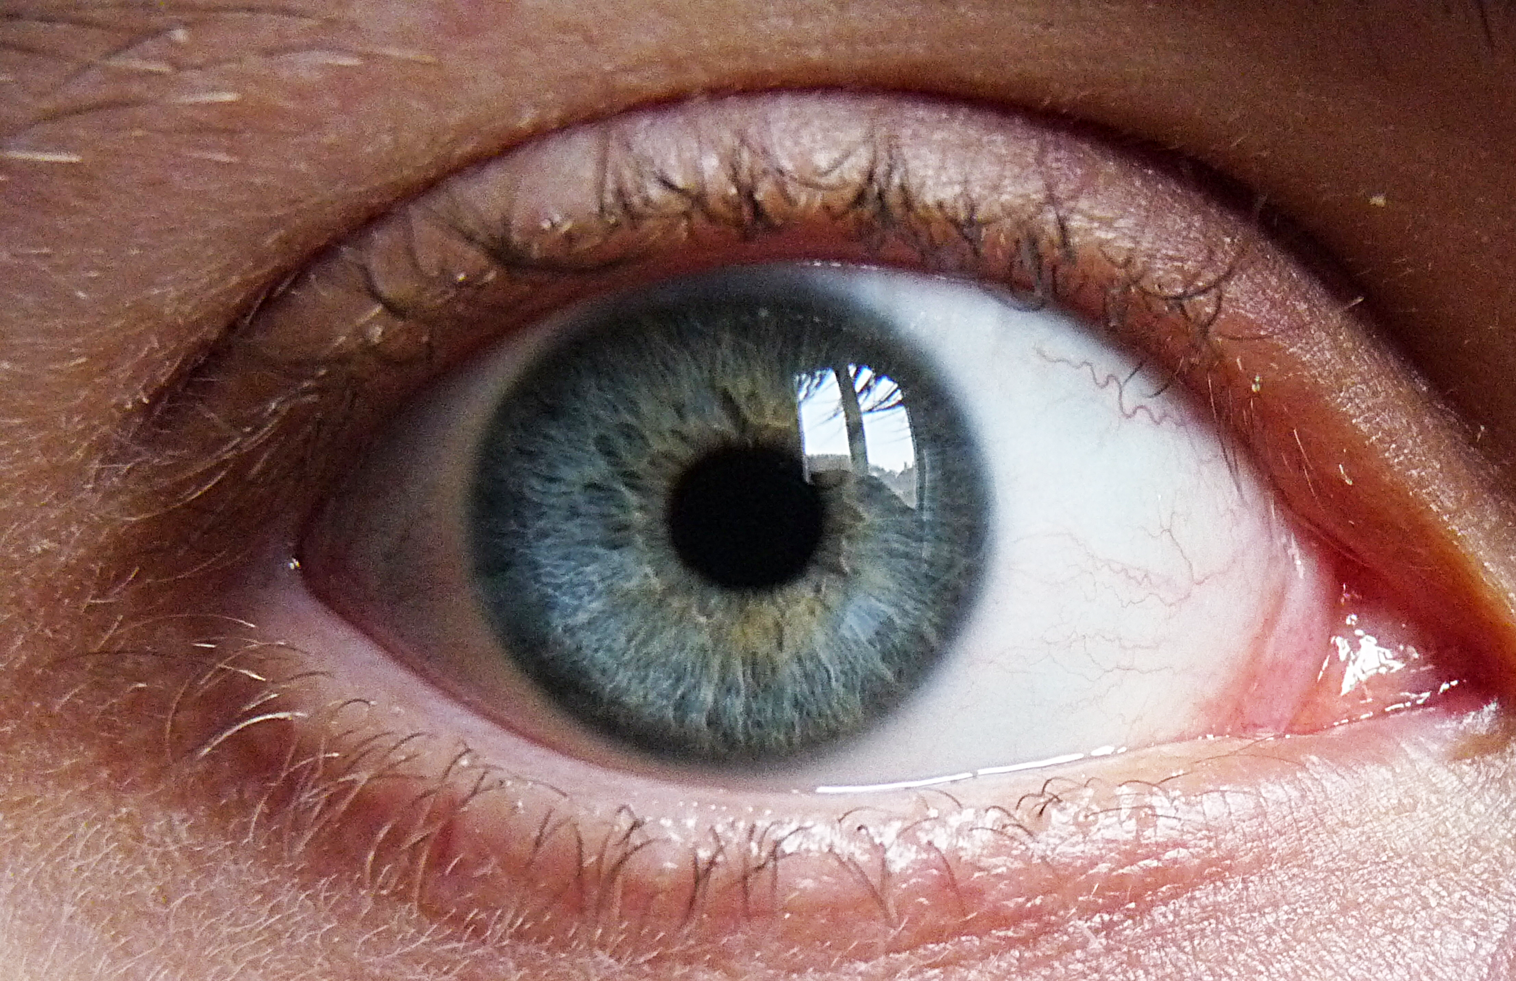
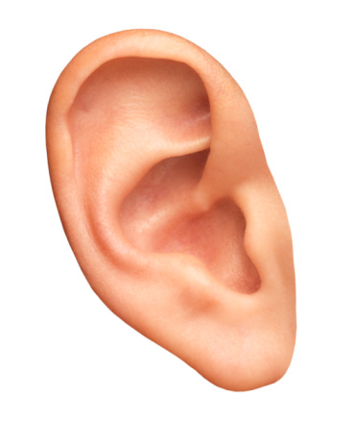
Many Parts-
1Corinthians
12:12-31
But One Body!

Slide 3
Being Part of the One Body
We must understand…
There is one body, v.12a
To be a member, one must be part of the one body, v.12b
Membership is attained by:
One Spirit, v.13a
One Baptism, v.13b
One Sustenance/Guide, v.13c
The body is not one member, v.14
Each member’s importance is not determined by individual function, but by connection to the whole, vv.15-16
Diversity of function in unity is vital, v.17
Multiplicity, diversity of function, dependence (Head), and interdependence (one another) is of divine origin, vv.18-21
There are no less honorable/unseemly members, vv.22-24

Slide 4
Being Part of the One Body
Therefore (because of these things)…
There should be no division in the body, vv.25-30
No division, v.25a
Each part should have the same care for another, v.25b
Connectivity based on commonality, vv.26-27
Diversity of function and unity in purpose ←→ proper submission to the Head ←→ the betterment of the whole!
Now, Are You:
Connected to the Head (Christ) by heeding the Spirit’s instructions and baptism into Him?
Connected to His Body (the church) by heeding the Spirit’s instructions and by being the foot, hand, ear, eye, or nose He intended you to be?

Slide 5
Are you a
Or,
Disconnected?

